Slide 1
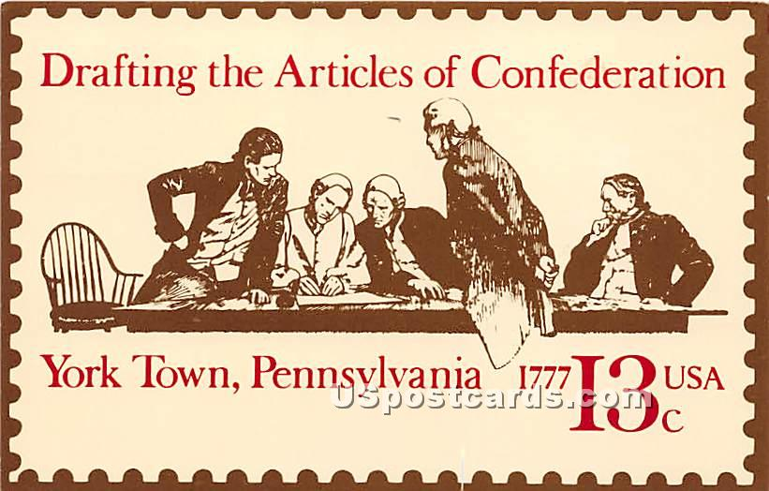
Discussion Questions
What does the Articles of Confederation suggest about the political values of its authors?
What concerns likely motivated the authors to create this form of government?
Under the Articles of Confederation, what are the main duties of the government?

Slide 2
The Articles of Confederation
Structure | One branch of government: Congress, responsible for making national laws Each state had one vote in Congress, regardless of its population or size. No executive branch (No Governor or President – To enforce the law) No judicial branch (No Supreme Court to interpret the law and settle disputes)
Decision-making | 9 of 13 states had to approve a proposal before it could become a law All the states (13 of 13) had to agree to change an existing law
Money and Finances | The national government could not collect taxes from the citizens The national government had to ask the individual states for money The national government could print and borrow money Each state could regulate trade with other states Each state could tax its residents
Protection | The Articles of Confederation managed agreements with other countries and Native Americans The Articles of Confederation could appoint military officers Only the states could establish militias, no national army
Other | The Articles of Confederation established a postal system weights and measures courts consequences for piracy

Slide 3
Evaluating the Articles of Confederation
In groups:
Each group will be assigned one case study to read and complete the worksheet.
Each group will present by giving a summary of their case study and sharing their conclusions.
Focus on the connection between the problems discussed in the case study and the weaknesses of the Articles of Confederation
How did the problem contribute to the growing dissatisfaction with the confederate system?
In what respect were the Articles of Confederation effective?

Slide 4
Articles of Confederation
Issue | Success | Failure
Settling National Debt
Pirating
Soldiers in Times of Peace
Treaty of Paris
Debt & Paper Money
Western Lands

Slide 5
Achievements of the Articles of Confederation | Weaknesses of the Articles of Confederation
Treaty of Paris (1783): Successfully negotiated the end of the American Revolution and set United States western border at the Mississippi River. Western Lands (1787): provided for the surrender of state-claimed lands to the national government for orderly division and sale, as well as, starting the concept of public education. Northwest Ordinance (1787): protection of religious freedom, protection of the rights of the accused (habeas corpus, trial by jury, bail release, and basic due process), and establish a system for the application of statehood. | The national government could do little without the consent of the states. No single national currency – each state had their own money. The national government could not tax the people directly. The national government lack the money to have an army.

Slide 6
Drawing Conclusions
Imagine that the Articles of Confederation were still the government of the United States:
Would the country have survived intact?
What amendments would have been adapted over time?
Compare the Articles of Confederation to the European Union (EU) and the United Nations (UN) – Are the problems faced by these organizations comparable to the problems confronting America under the Articles of Confederation?

