Slide 1
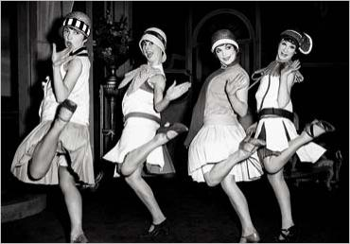
Do Now
What were some cultural changes that took place during the 1920s?
Are people always open to change? Why or Why not?
What are some cultural changes today, that older generations may not agree with? Explain

Slide 2
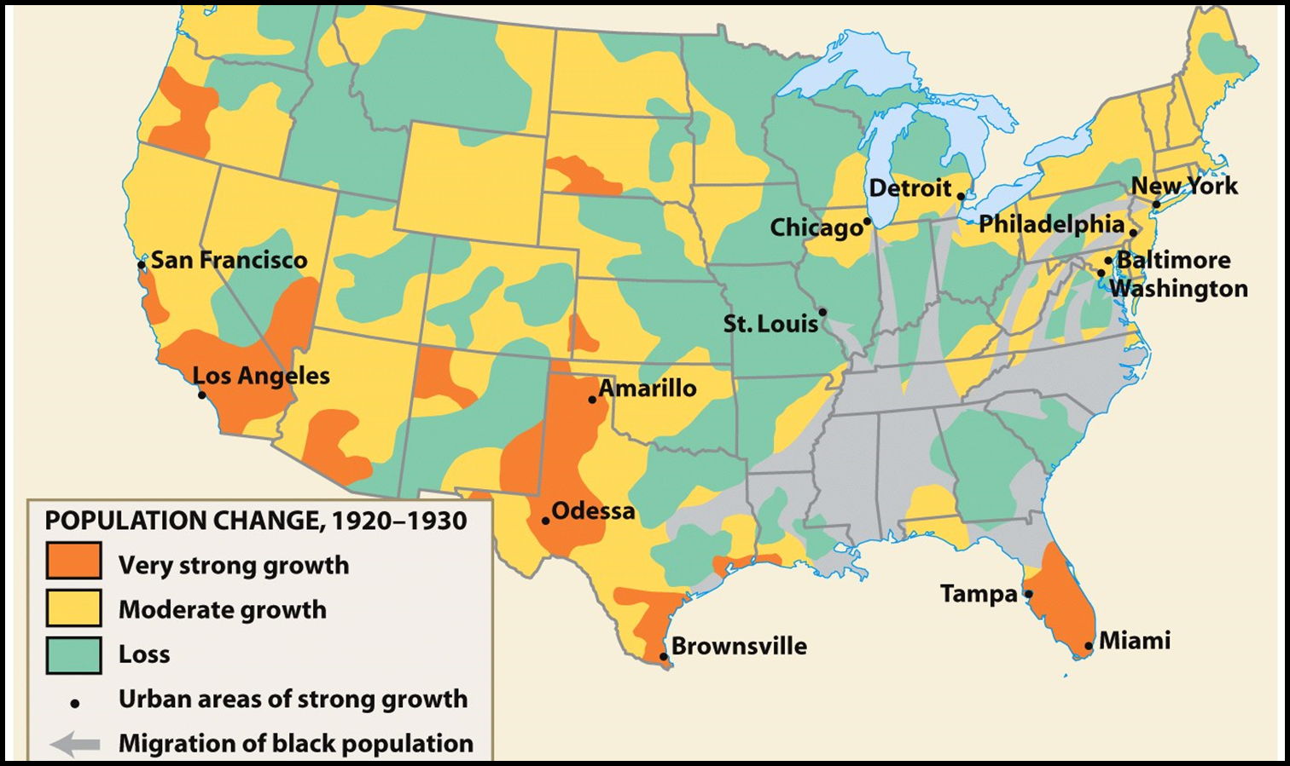
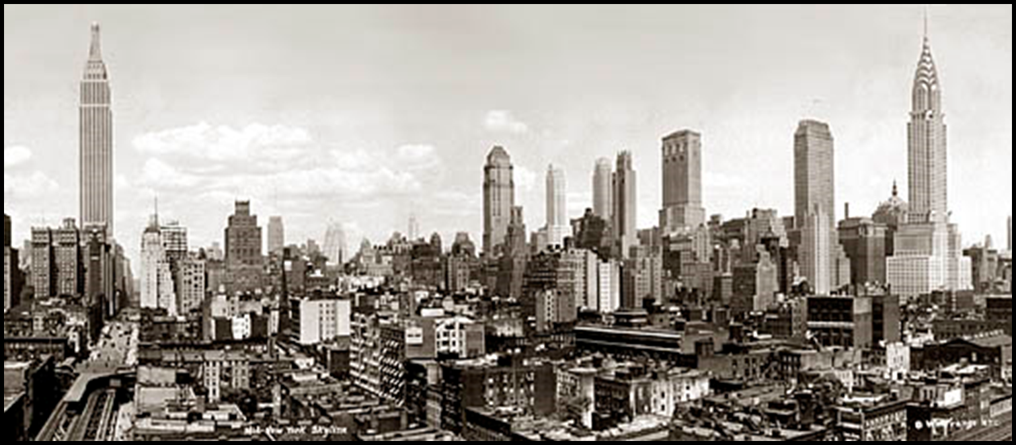
The Rural Counterattack
The shift in focus from the countryside revealed that urban life was different; traditional ties of home, church, schools were absent
First time that more Americans lived in cities than the countryside

Slide 3
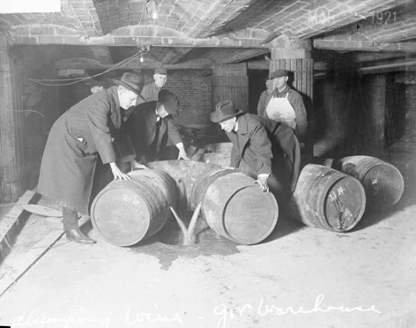
The Rural Counterattack
Rural Americans identified cities with saloons, brothels, communist cells, and immorality
The 1920s saw an attempt to restore a “Protestant” culture in America and an attack on any “un-American” behavior like drinking, illiteracy, and immigration

Slide 4
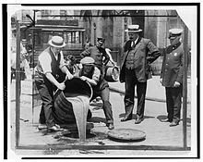
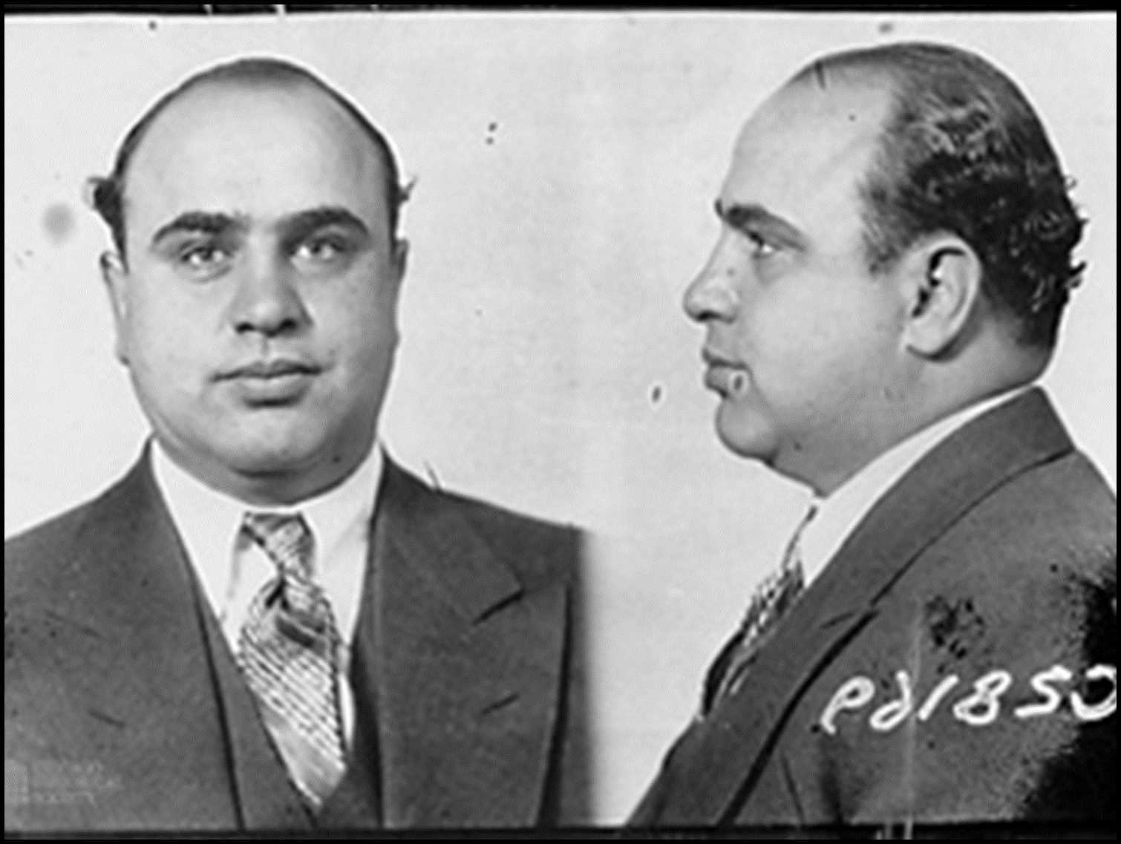
Prohibition
In January 1920, Congress passed the Volstead Act to enforce the 18th Amendment (1919)
26 states had already banned alcohol but the real conflict came when prohibition was applied to urban ethnic groups
A rural, Protestant attack on the “social disease of drunkenness”
Rural America became dry and urban consumption dropped but was severely resisted

Slide 5
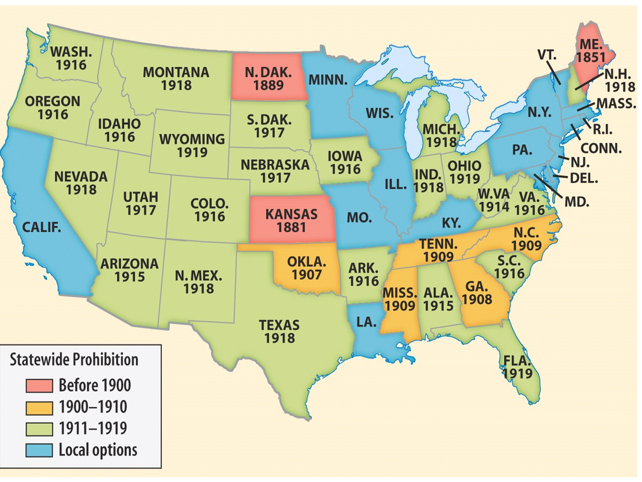

Slide 6
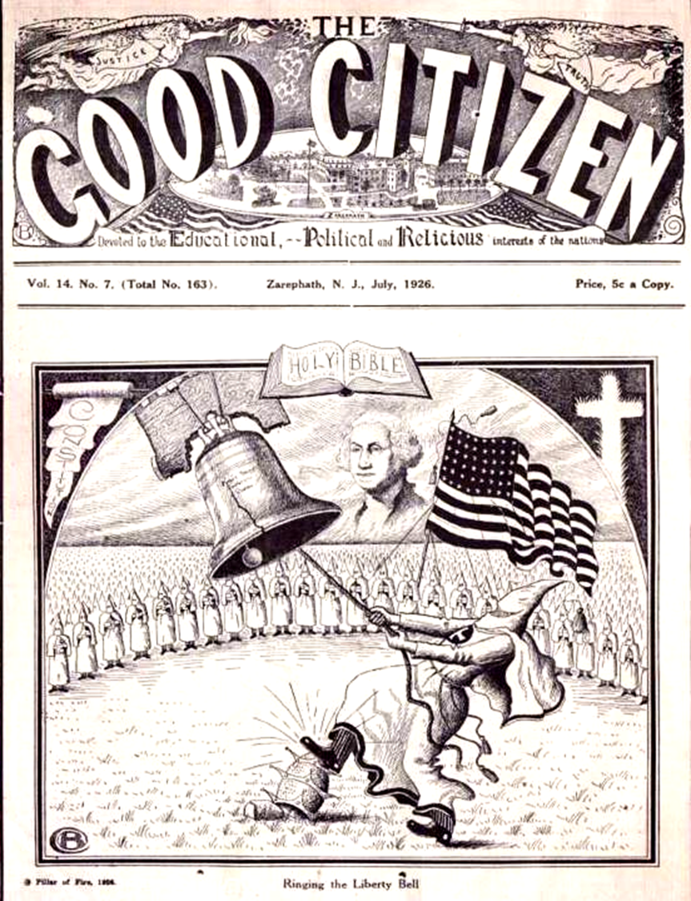
KKK
The First KKK disbanded when Reconstruction ended in the 1870s, but the Second KKK formed in 1915 to protect rural, Christian values
The rebirth of the Ku Klux Klan in 1915 (Stone Mountain, GA) was aimed at blacks, immigrants, Jews, Catholics, and prostitutes
The “Invisible Empire” sought to ease rural anxieties in the face of changing cultural attitudes
Used violence, kidnapping, murder, and politics to affect change

Slide 7
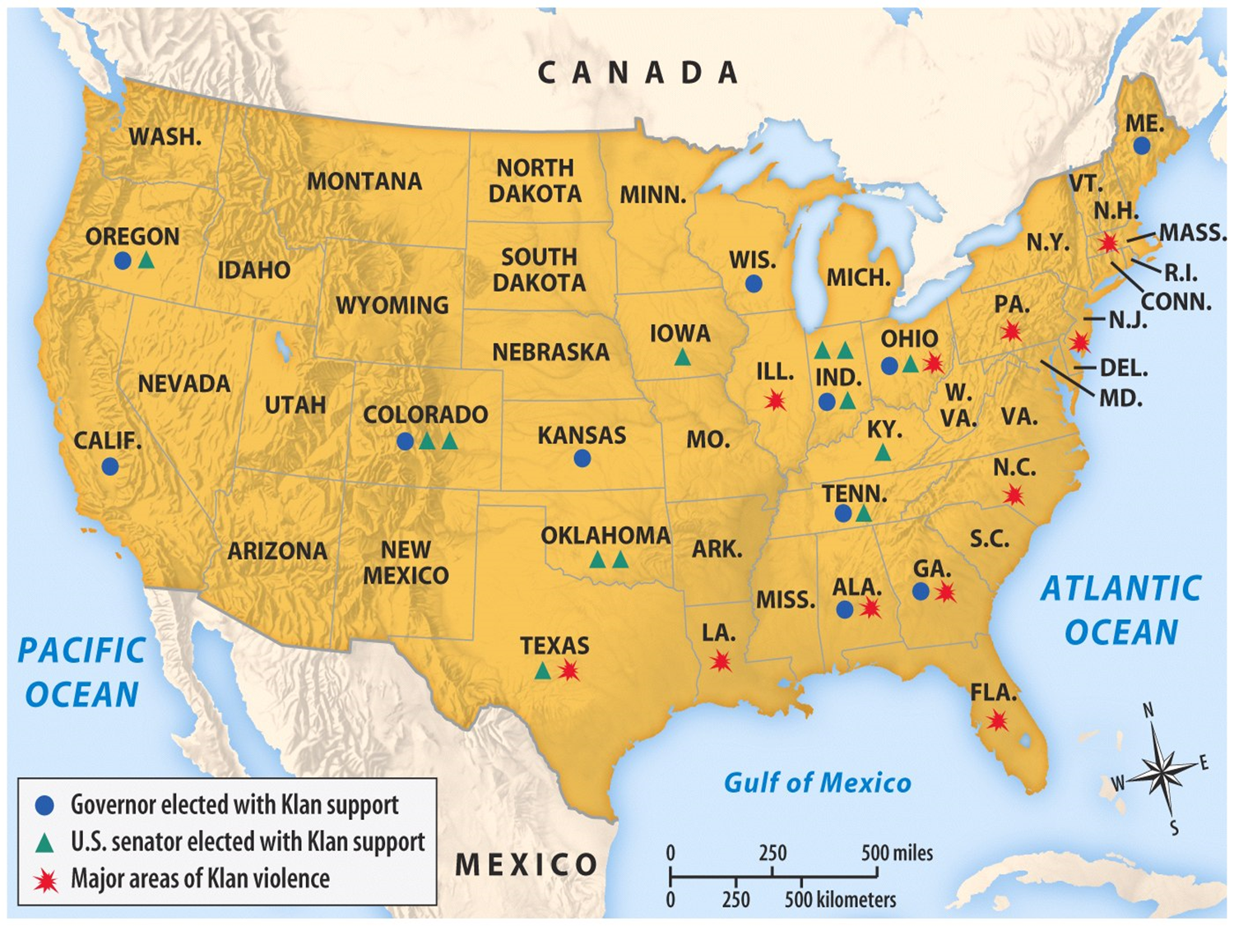

Slide 8
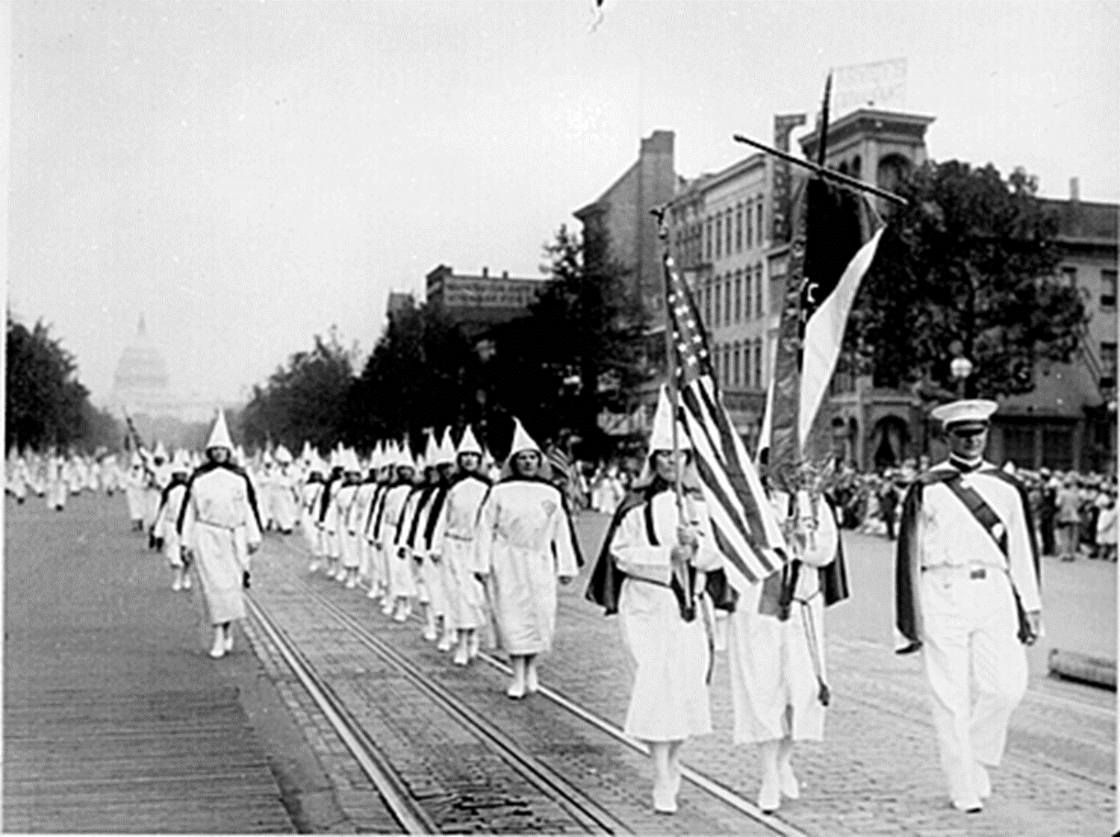
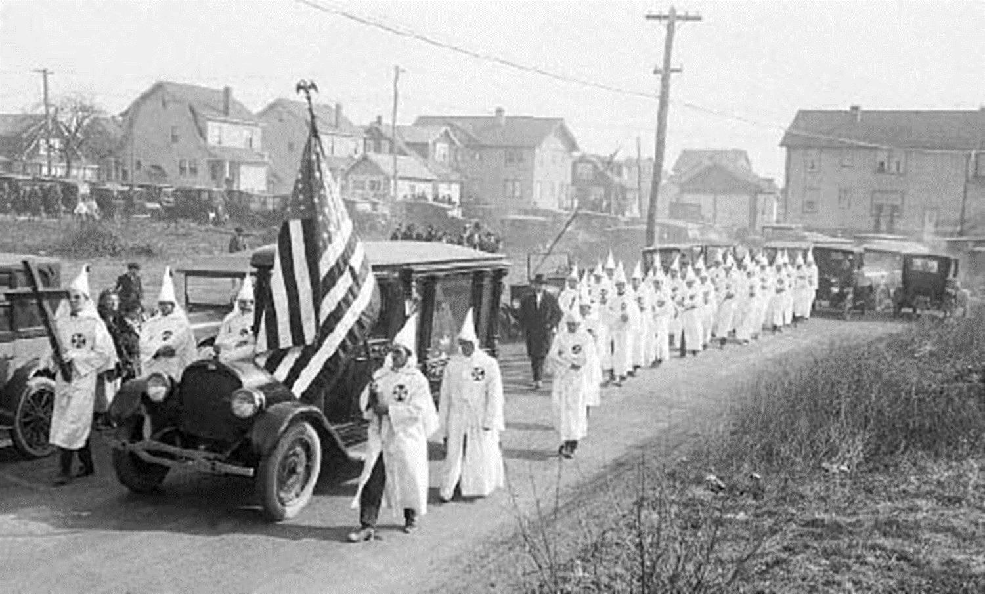
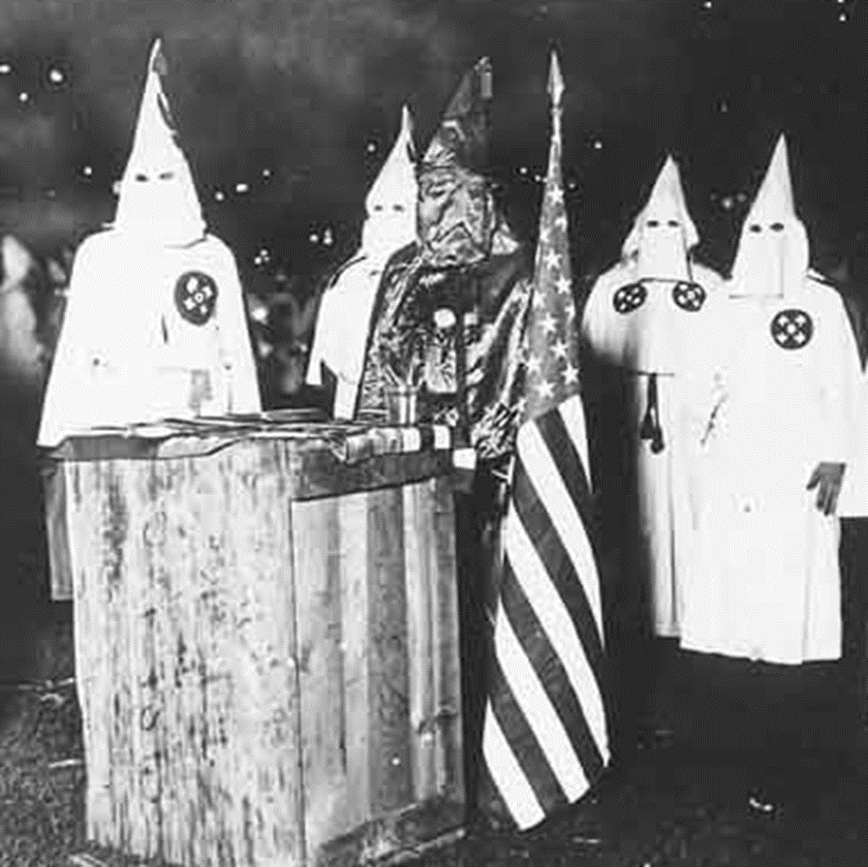
KKK
The KKK provided a sense of identity to its members: Women’s Order, Junior Order for boys, Tri-K Klub for girls, Krusaders for assimilated immigrants
Klan violence met resistance and membership declined by 1925

Slide 9
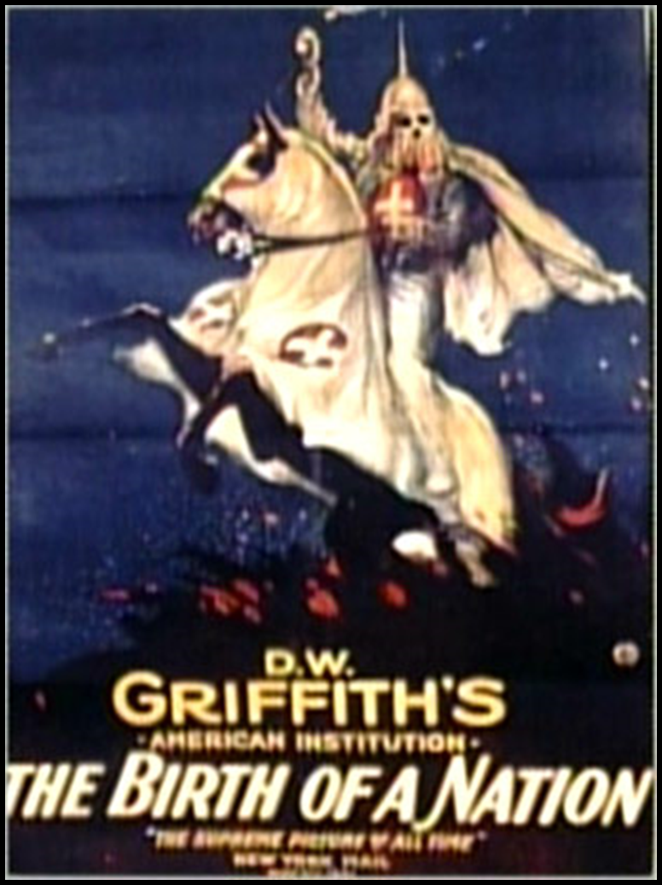
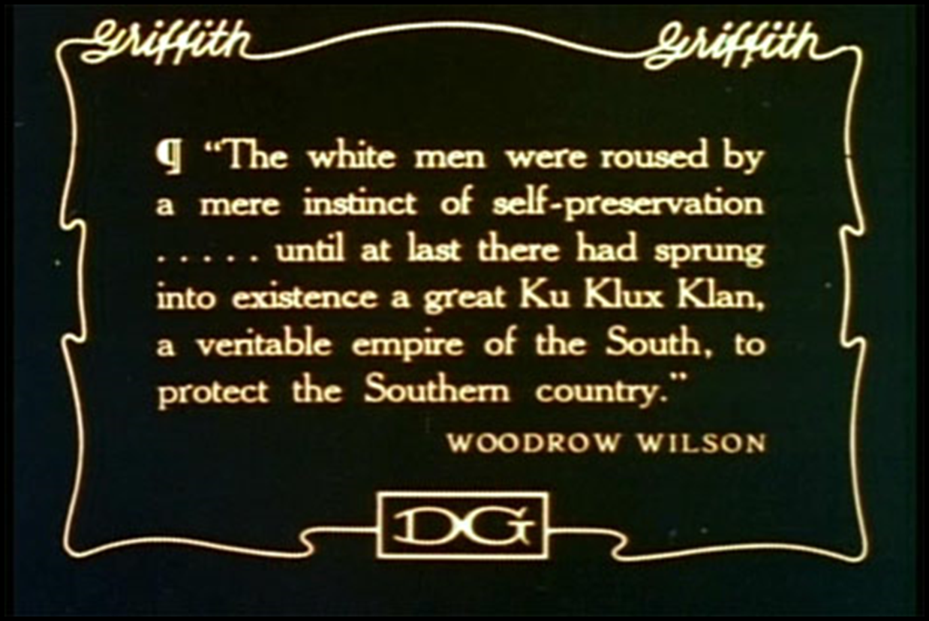
KKK
D.W. Griffith’s The Birth of a Nation (1915) was one of the most controversial films in movie history. Set during and after the Civil War, the film glorifies white supremacy and the KKK

Slide 10
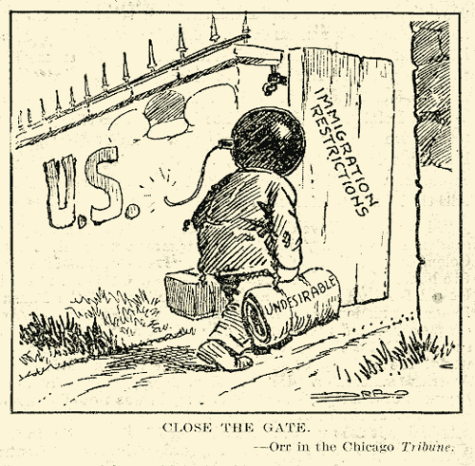
The Fear of Radicalism
The most dramatic rural reaction was the Red Scare (1919-1920):
A general worker strike in Seattle, police strike in Boston, and series of mail bombs led to fears of anarchy and socialism
Including the bombing of Attorney General Palmer’s house in 1919
Deportation without due process, searches without warrants, and imprisonment of innocent people was initially backed by the American people

Slide 11
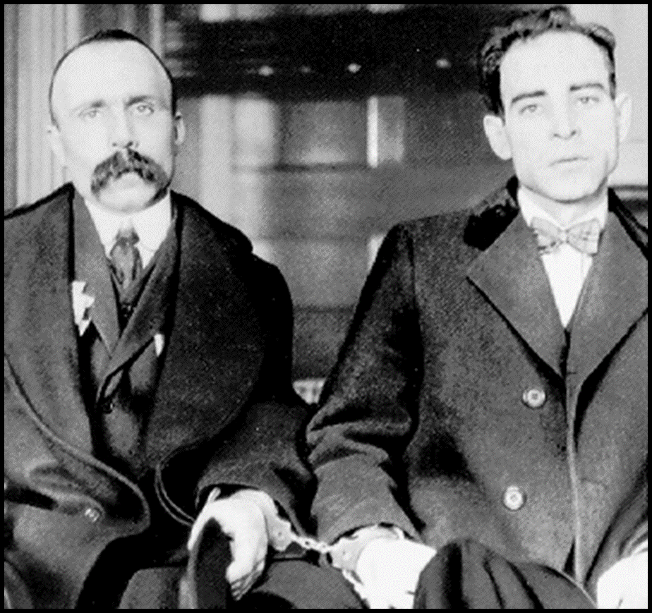
The Fear of Radicalism
Italian immigrants Nicola Sacco and Bartolomeo Vanzetti were executed for armed robbery and murder without evidence
The judge in the case even referred to Sacco and Vanzetti as “those anarchist bastards”

Slide 12
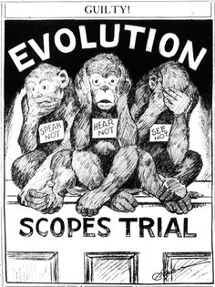
The Fundamentalist Challenge
The most long-lasting reaction of rural America was a retreat to Christian beliefs
Aggressive fundamentalist churches provided a haven for rural American values
The Scopes “Monkey Trial” revealed the rural attack on evolution in schools

Slide 13
Conclusions
Urban America came to define all of the United States in the 1920s:
Radio, movies, advertising reflected urban culture
Consumer goods were made in American cities
Small-town whites, blacks, and immigrants moved to cities
But, conservative rural Americans (religious fundamentalists and KKK) attacked these new, urban ideas

Slide 14
SUM IT UP
How did cultural values come into conflict during the 1920s?

