Slide 1
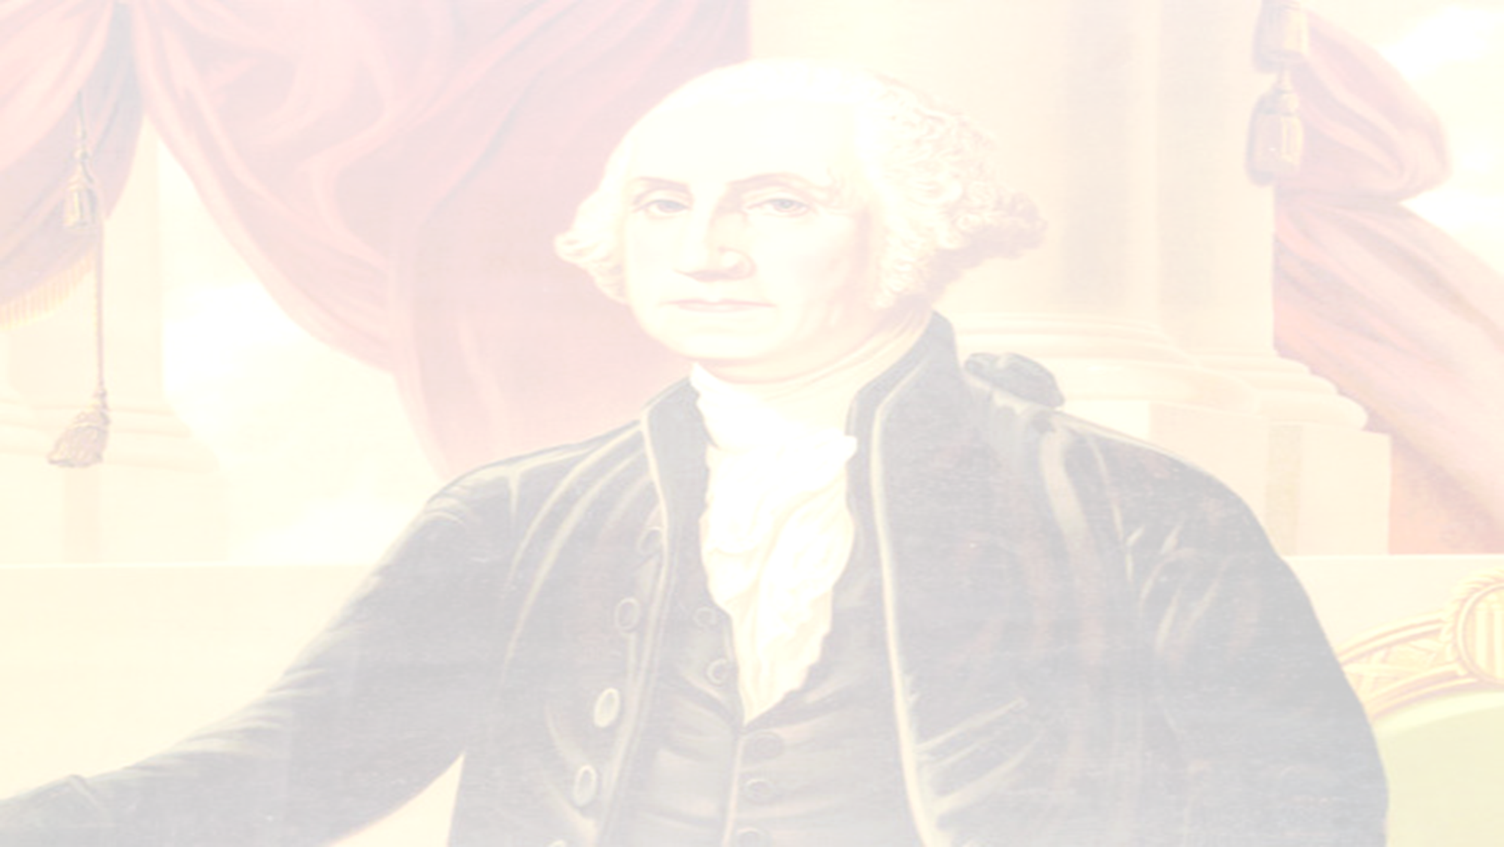
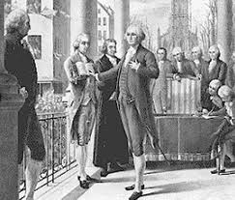
George Washington – 1st President – 1789-1797
Precedent – an event or action regarded as an example or a guide for future people to follow.
Washington's Precedents Video

Slide 2
Precedents George Washington Set:
Oath of Office (Federal Hall, New York City – April 30, 1789)
Creating a Cabinet (Group of Advisors - Secretary of State Thomas Jefferson, Secretary of Treasury Alexander Hamilton, Secretary of War Henry Knox, and Attorney General Edmund Randolph. )
Title of President – “Mr. President”
Two-Term Limit (Stepped down after 8 years – Peaceful Transition of Power – 22nd Amendment Passed in 1951 after FDR served 4 terms as President)
Use of force to enforce national laws (Whiskey Rebellion)
Inauguration Speech
Farewell Address
Neutrality in foreign affairs
Establishing Economic Relationship with England (Jay’s Treaty)
Setting Economic Policy - supported innovative fiscal concepts such as the Bank of America and a national debt, which would be later adopted

Slide 3
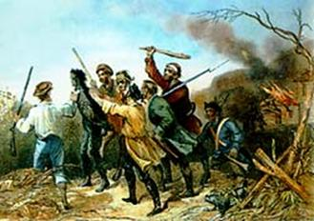
What Would Washington Do? (WWWD?)
Whiskey Rebellion
Congress passed a protective tariff (tax on imports) in 1789. The tax was supposed to encourage people to buy American products and brought in a great deal of money, but, Secretary of Treasury Alexander Hamilton didn’t feel the tariff would be effective. He implemented an excise tax (tax on product manufactured /sale/ distribution) of whiskey, a popular product amongst small frontier farmers. In 1794, farmers in Pennsylvania refused to pay the tax and threatened to secede (withdraw) from the union.

Slide 4
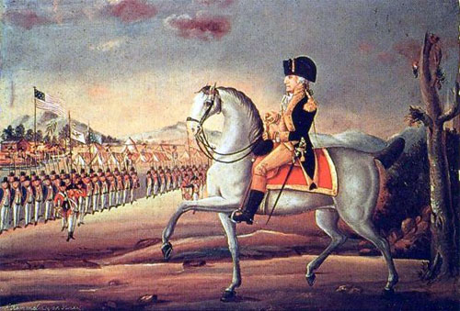
Washington’s Response to Whiskey Rebellion
Washington sends the military to Pennsylvania to crush the rebellion of farmers.
Shows the new national government under the United States Constitution will and can ENFORCE national laws
Establishes the supremacy of the federal government over the state governments and the people.

Slide 5
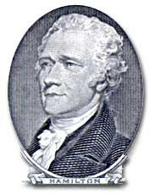
Alexander Hamilton’s Economic Plan
In order to correct the national debt and establish credit, Alexander Hamilton created a plan to form a national bank. The young nation had accumulated a large debt from the revolution. The national government was responsible for 2/3 of the debt, while states were responsible for the other 1/3. The new nation owed debt not only to foreign governments, but also private citizens (especially soldiers who fought in the war).

Slide 6
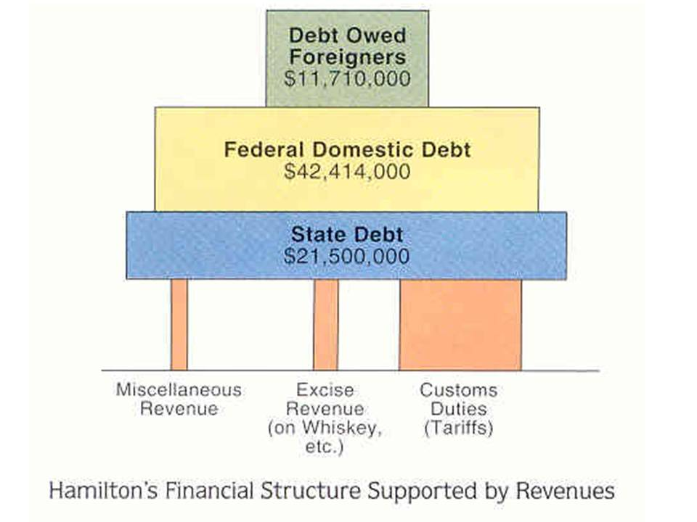
Washington’s Response to Hamilton’s Economic Plan
Washington agreed with Alexander Hamilton's Plan
National government assumes the debt of all the states
Angers the Southern states because they have already paid back their debt.
Compromise: Moving US Capital to newly created Washington D.C.
Helps create a stronger national government.

Slide 7
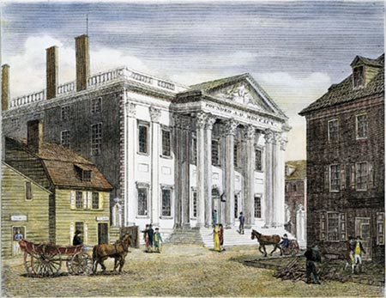
Bank of the United States
Alexander Hamilton’s plan included the concept that wealthy Americans would invest in a bank controlled by the national government. This bank would be responsible for printing paper money, holding debt, and handling taxes. Conflict emerged between Hamilton and leaders such as James Madison and Thomas Jefferson who argued that there was no written support in the Constitution to create a national bank.

Slide 8
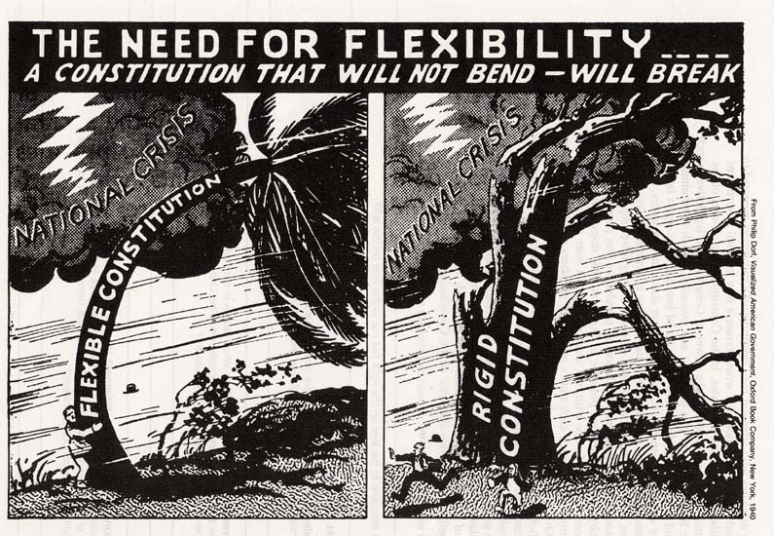
Washington’s Response to the Bank of The United States
Washington agreed with Alexander Hamilton's Plan.
He held a “Loose Interpretation” of Constitution
Used elastic clause to create National Bank
Strengthening the power of the national government over the states.

Slide 9
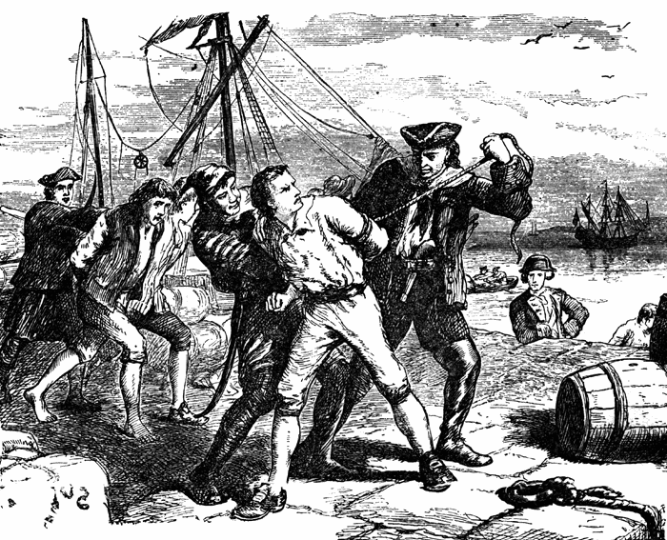
Problems with Great Britain
Although the Treaty of Paris (1783) ended the American War for Independence, the years following saw relations between America and England deteriorate quickly. England refused to leave the frontier forts in the Northwest Territory; in addition, England impressed (seized) American ships, forcing American sailors to serve in England's war against France. The United States, for its part, passed navigation laws that were potentially damaging to Great Britain. It was apparent that a commercial war between the two countries would undermine the health of the American economy.

Slide 10
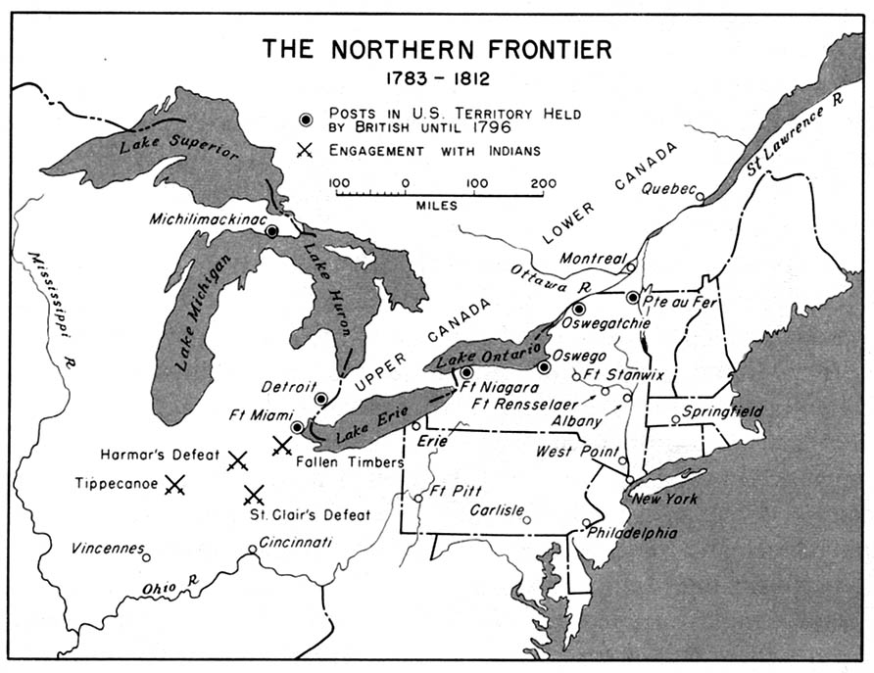

Slide 11
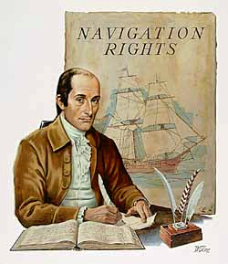
Washington’s Response to Problems With Britain
Jay’s Treaty
Chief Justice of the United States Supreme Court John Jay is sent to Britain to negotiate.
Britain agreed to leave forts in the Ohio River Valley
Britain pays for damages of U.S. ships
The United States gave most favored nation trading status to Britain
Treaty very unpopular, but it allowed the U.S. to avoid war with Britain

Slide 12
Problems with Spain
The western and southern borders of the United States had been a source of tension between Spain and the United States. The U.S. border extended to the Mississippi River, but its southern stretch remained in Spanish territory, and Spanish officials, reluctant to encourage U.S. trade and settlement in a strategic frontier area, kept the Mississippi River closed to American shipping. Moreover, both Spain and the United States claimed portions of the present-day states of Alabama and Mississippi, and earlier negotiations to resolve the territorial disputes had broken off inconclusively. The Spanish government maintained several forts in the disputed territories, and could also count on Native American resistance to U.S. attempts to settle upon Native American lands. U.S. citizens from the southern states and frontier areas found Spanish policies restrictive, and wanted the U.S. Government to renegotiate its positions.

Slide 13
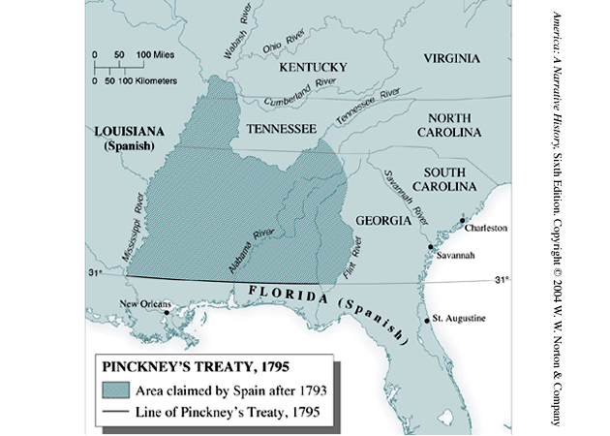

Slide 14
Washington’s Response to Problems with Spain
Pinckney’s Treaty
Thomas Pinckney sent to make an agreement with Spain
Fixing the southern boundary of the United States at 31° N latitude and establishing commercial arrangements favorable to the United States.
U.S. citizens were accorded free navigation of the Mississippi River through Spanish territory.
The treaty granted Americans the privilege of tax-free deposit (temporary storage of goods) at New Orleans.
Spain was a rival of Britain and noted the warming relationship between Britain and the U.S. as evidenced in Jay's Treaty. Therefore, Spain hoped to keep Britain off balance by establishing a positive relationship with America.

Slide 15
Exit Slip –
How did George Washington prove that the new government under the Constitution was stronger than the government under the Articles of Confederation?
(Use a specific example from today’s lesson)

Slide 16
Washington’s Farewell Address
“The unity of government…is a main pillar in the building of your real independence…of your tranquility at home, your peace abroad; of your safety; of your prosperity; of that very liberty which you so happily prize.”
Everyone in America needs to work together.
Working together will provide for safety and prosperity of the United States.

Slide 17
Washington’s Farewell Address
“It [political parties] serves to aggravate the community with ill-founded jealousies and false alarms; kindles the animosity of one against another. It opens the door to foreign influence and corruption…thus the policy and will of one country are subjected to the policy and will of another.”
Do NOT create political parties!!!
Political Parties will create jealousy and problems within the United States government and leave them open to foreign influences and corruption.

Slide 18
Washington’s Farewell Address
“…cherish public credit. One method of preserving it is to use it as sparingly as possible…avoiding the accumulation of debt. Towards the payment of debts…there must be taxes; that no taxes can be devised which are not…inconvenient and unpleasant.”
Avoid going into debt.
Debt = more taxes and taxes should only be used if and when they are truly needed.

Slide 19
Washington’s Farewell Address
“It is our true policy to steer clear of permanent alliances with any portion of the foreign world…”
Make NO alliances!!!
Stay NEUTRAL and ISOLATED

Slide 20
Washington’s Farewell Address
“…avoid the necessity of those overgrown military establishments, which, under any form or government, are inauspicious to liberty.”
Keep a small military because we have no alliances
Keep a small military because a smaller military = lower taxes

Slide 21
The "Unwritten Constitution" refers to the ideas and processes that are accepted as a needed part of American government, regardless of the fact that they are not actually in the Constitution.
Examples:
President’s Cabinet
Political Parties
Judicial Review
Congressional Committees
Outside Influences – Lobbyists

Slide 22
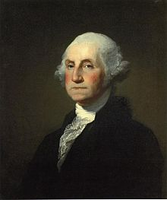
Exit Slip –
Have we as a nation follow the advise that George Washington gave the country while he was President?

