Slide 1
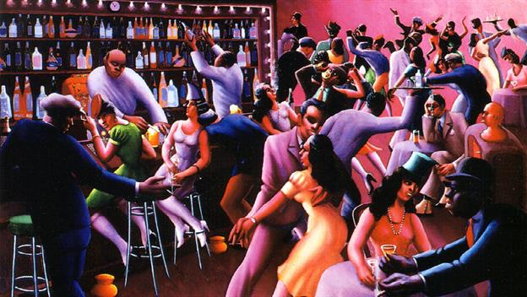
Aim: How did literature of the Harlem Renaissance reflect the African American experience in the 1920s?
Do Now:
View the Video: The Harlem Renaissance and answer the five discussion questions.
Homework:
Continue to review your notes
Current Events Due—April 18

Slide 2
The Harlem Renaissance
Describe what the Harlem Renaissance of the 1920s was.
What caused the mass migration of African-Americans from the South during and after World War I?
What common themes existed in the artistic works of the Harlem Renaissance?
How did the poetry of Claude McKay and Langston Hughes differ?
How were they similar?
Did the Harlem Renaissance just exist in Harlem, NY? Explain!!

Slide 3
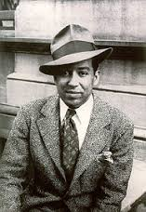
Langston Hughes
Background: Langston Hughes was one of the most important writers and thinkers of the Harlem Renaissance, which was the African American artistic movement in the 1920s that celebrated black life and culture. Hughes's creative genius was influenced by his life in New York City's Harlem, a primarily African American neighborhood. His literary works helped shape American literature and politics. Hughes, like others active in the Harlem Renaissance, had a strong sense of racial pride. Through his poetry, novels, plays, essays, and children's books, he promoted equality, condemned racism and injustice, and celebrated African American culture, humor, and spirituality.

Slide 4
Task:
Select one of the four Langston Hughes’ poems on your worksheet to read and analyze. After you have read your selected poem, complete the document analysis worksheet using the text based evidence and context clues found in your selected reading. Once you have answered the questions, create a visual representation of the main idea of your poem.
Mother to Son (1922)
The Negro Speaks of Rivers (1921)
I, Too, Sing America (1925)
One Way Ticket (1929)

Slide 5
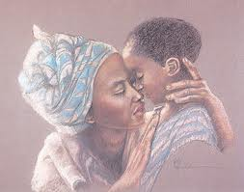
Mother to Son:
Well, son, I’ll tell you:
Life for me ain’t been no crystal stair.
It’s had tacks in it,
And splinters,
And boards turned up,
And places with no carpet on the floor –
Bare.
But all the time
I’se been a’climbin’ on,
And reachin’ landin’s,
And turnin’ corners.
And Sometimes goin’ in the dark
Where there ain’t been no light.
So boy, don’t you turn back.
Don’t you set down on the steps
‘Cause you finds it kinder hard
Don’t you fall now –
For I’se still goin’, honey
I’se still climbin’
And life for me ain’t been no crystal stair

Slide 6
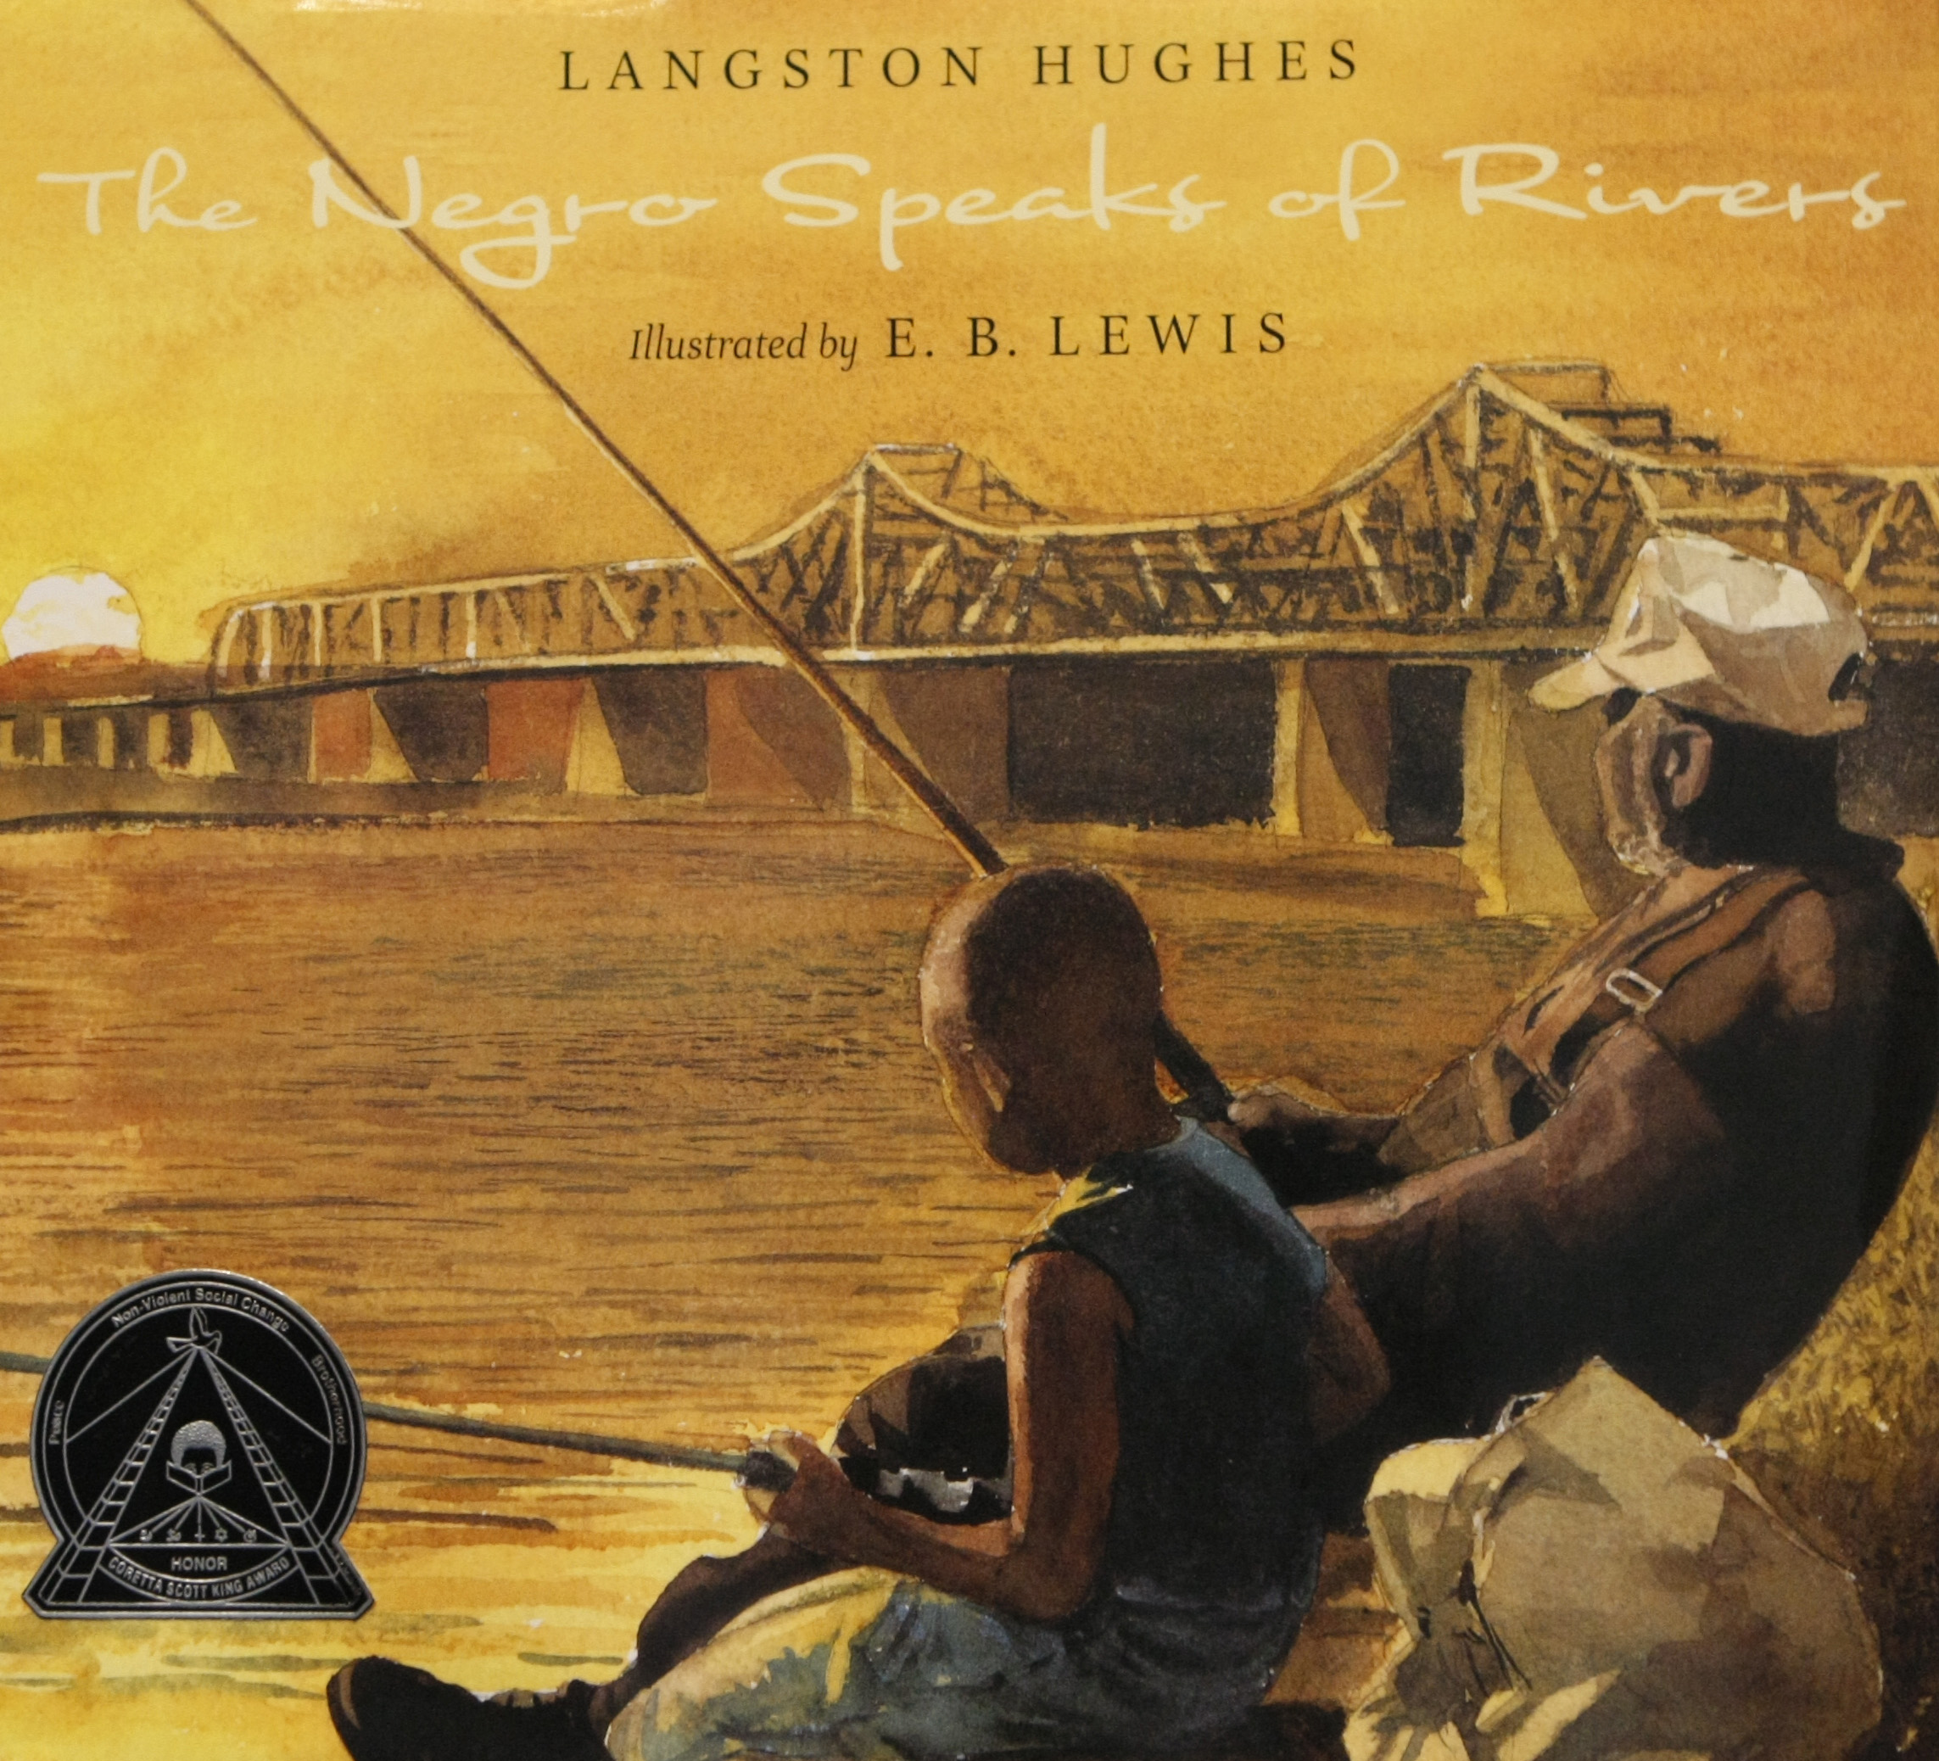
The Negro Speaks of Rivers:
I’ve known rivers:
I’ve known rivers ancient as the world and older than the flow of human blood in human veins.
My soul has grown deep like the rivers.
I bathed in the Euphrates when dawns were young.
I built my hut near the Congo and it lulled me to sleep.
I looked upon the Nile and raised the pyramids about it.
I heard the singing of the Mississippi when Abe Lincoln went down to new Orleans, and I’ve seen its muddy bosom turn all golden in the sunset.
I’ve known rivers:
Ancient, dusky rivers.
My soul has grown deep like the rivers.

Slide 7
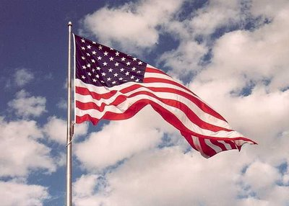
I, Too, Sing America:
I, too, sing America.
I am the darker brother
They send me to eat in the kitchen
When company comes,
But I laugh
And eat well
And grow strong
Tomorrow.
I’ll be at the table
When company comes
Nobody’ll dare
Say to me,
“Eat in the Kitchen,”
Then.
Besides.
They’ll see how beautiful I am
And be ashamed, -
I, too, am America.

Slide 8
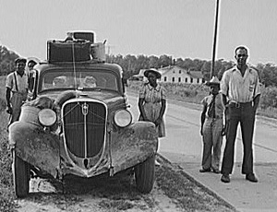
One Way Ticket:
I pick up my life,
And take it with me,
And I put it down in
Chicago, Detroit,
Buffalo, Scranton,
Any place that is
North and East,
And not Dixie.
I pick up my life
And take it on the train,
To Los Angeles, Bakersfield,
Seattle, Oakland, Salt Lake
Any place that is
North and West,
And not South.
I am fed up
With Jim Crow laws,
People who are cruel
And afraid,
Who lynch and run,
Who are scared of me
And me of them
I pick up my life
And take it away
On a one-way ticket-
Gone up North
Gone out West
Gone

Slide 9
New York City was home to another notable African American names Marcus Garvey. He came to NY from Jamaica in 1916 to establish a new headquarters for his Universal Negro Improvement Association (UNIA). This organization sought to build up African Americans’ self-respect. Its message of racial pride attracted masses of followers. He urged his followers to “Motherland Africa” by appealing to the black masses on the basis of racial pride He also invested his money in the Black Star steamship line which eventually collapsed. And he was brought up on fraud charges. Despite this failure, Garvey’s ideas remained an inspiration to “black pride” movements.; sometimes referred to as the “Back to Africa” Movement. It would be there in Africa that they would be able to create their own civilization in their own homeland.
Closure:
Define the Harlem Renaissance
How might the conditions of this era contribute to the future problems facing African Americans?

Slide 10
Apply your knowledge:
Why do you believe the ideas of the Harlem Renaissance were not achieved until the beginning of the Civil Rights Movement in 1947?

