Slide 1
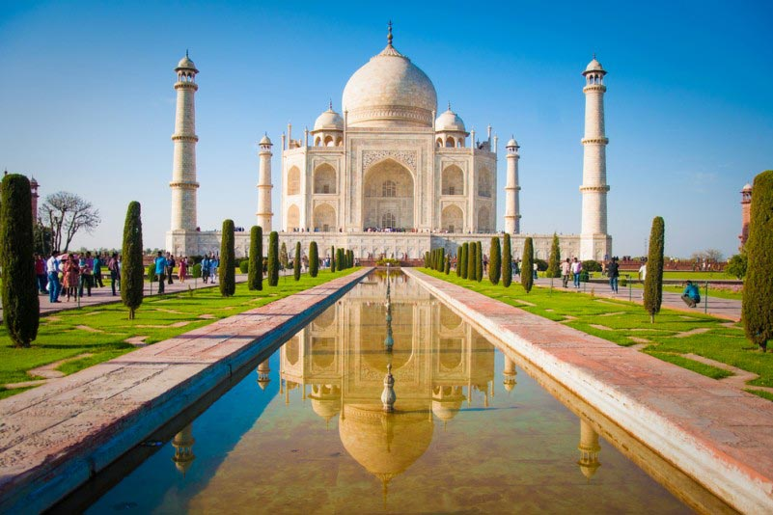
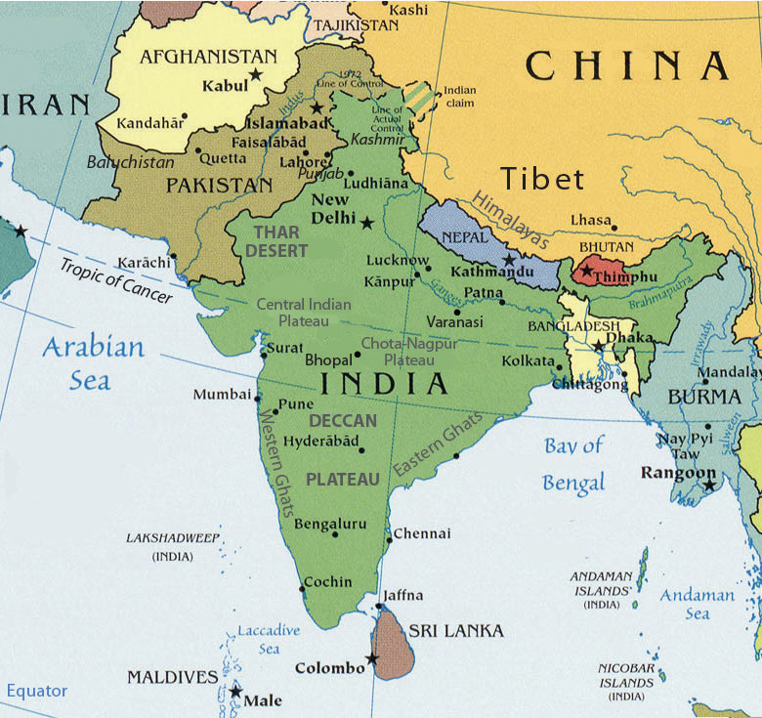
Pre-AP World Throwback!

Slide 2
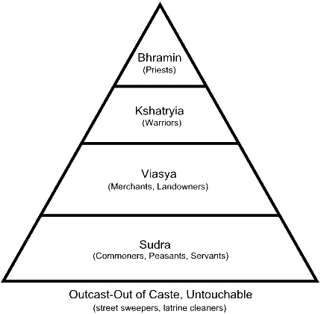
The Caste System
Linked to Hindu beliefs
Caste determined by birth
One could strive to be in a higher caste in their next life
Rules governed every aspect of life
Even though it has inequalities, it helped keep social order.
Gave people a sense of identity

Slide 3
Religious group | Population % 1951 | Population % 1961 | Population % 1971 | Population % 1981 | Population % 1991 | Population % 2001 | Population % 2011
Hinduism | 84.1% | 83.45% | 82.73% | 82.30% | 81.53% | 80.46% | 79.80%
Islam | 9.8% | 10.69% | 11.21% | 11.75% | 12.61% | 13.43% | 14.23%
Christianity | 2.3% | 2.44% | 2.60% | 2.44% | 2.32% | 2.34% | 2.30%
Sikhism | 1.79% | 1.79% | 1.89% | 1.92% | 1.94% | 1.87% | 1.72%
Buddhism | 0.74% | 0.74% | 0.70% | 0.70% | 0.77% | 0.77% | 0.70%
Jainism | 0.46% | 0.46% | 0.48% | 0.47% | 0.40% | 0.41% | 0.37%
Other religions / No religion | 0.43% | 0.43% | 0.41% | 0.42% | 0.44% | 0.72% | 0.9%

Slide 4
Review of India
5. Why did England want to imperialize India in the 1800s?
Natural resources/raw materials (ex: tea, opium)
Large market for goods and large labor supply “CROWN JEWEL OF THE BRITISH EMPIRE”
6. What were some positive and negative effects of imperialism on India?

Slide 5
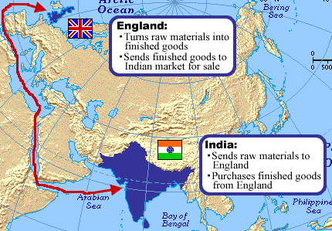
“The Jewel of the Crown.”
British Mercantilism in India

Slide 6
Government | The Economy | Employment | Social Changes
The British united India under one government and system of law, similar to Great Britain's. | The British built railroads, roads schools, colleges, and installed telegraph wires. | Many Indians worked for the British government. However, those that made goods in their own homes lost their jobs to English goods produced in factories. Other worked long hours for low wages under terrible conditions, to serve their British rulers. | Schools & hospital were built. However, the subjects taught in the schools were those which British thought were important. In general, Indians & Indian culture was treated as inferior to Britain.

Slide 7
Review of India
7. What was the purpose of the Sepoy Mutiny? Was it successful? Why or why not?
A rebellion of Hindu and Muslim soldiers against the British in India. The rebellion was unsuccessful- but forced Britain to take direct control of India, transferring control away from the British East India Company, and establishing the British Raj.

Slide 8
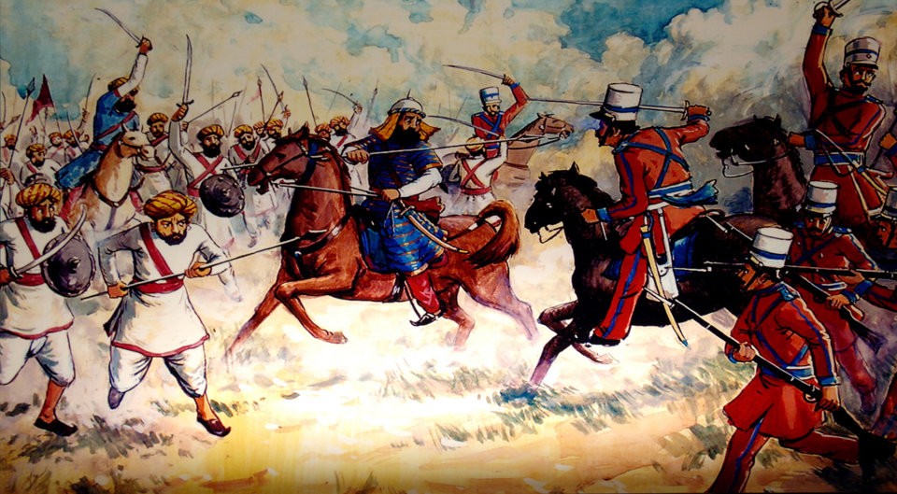

Slide 9
Review of India
8. Why was the Indian National Congress created?
A group of Indian people were unhappy with British rule established the INC in 1885. The Congress demanded a greater voice in government and better job opportunities for the Indian people. These demands were not met.
The British continued to hold high positions in the government, and the major businesses remained under their control. Frustrated and angry, some of the leaders of the Indian National Congress came to the conclusion that India had no choice but to seek self-government and independence.

Slide 10
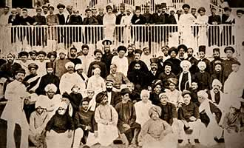
The Indian National Congress

Slide 11
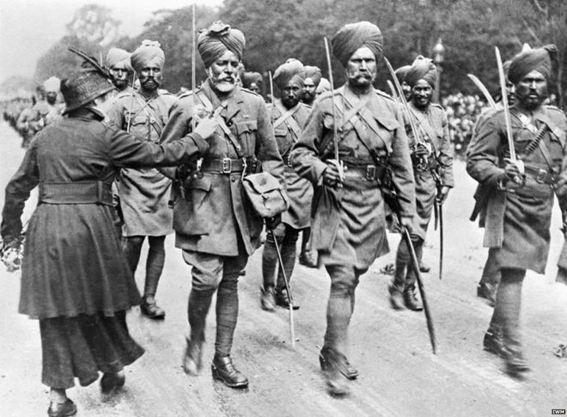
Indians marching off to war, to help defend the British, WWI
“If we would improve our status…it was our duty to win their help by standing by them in their hour of need.”
– Mohandas Gandhi, Indian political leader.

Slide 12
The Amritsar Massacre
THE SPARK – HRS: Causation
In 1919, the British responded to cries for Indian independence by passing the Rowlatt Acts. These laws allowed the government to jail protesters without trial for as long as two years. To Western-educated Indians, denial of a trial by jury violated their individual rights- the same rights that the British supposedly had fought in World War I to protect.

Slide 13
The Amritsar Massacre
THE EVENT
To protest the Rowlatt Acts, Hindus, Muslims, and Sihks flocked to Amritsar, an Indian city. They intended to fast and pray and to listen to political speeches. The demonstration was viewed as a nationalist outburst by the British, and British troops fired on the crowd without warning. The shooting in the enclosed courtyard continued for ten minutes. Official reports showed nearly 400 Indians died and about 1,200 were wounded.

Slide 14
The Amritsar Massacre
HRS: CCOT
News of the slaughter sparked an explosion of anger across India. Almost overnight, millions of Indians changed from loyal British subjects into nationalists who demanded independence.

Slide 15
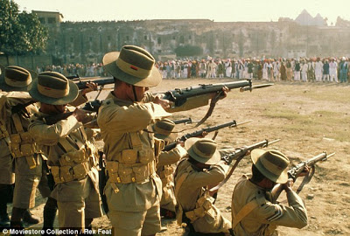
Summary Question
How do you think the independence of India effect global history in the 20th and 21st centuries? Try to address at least three of the five AP World Themes in your response.

Slide 16
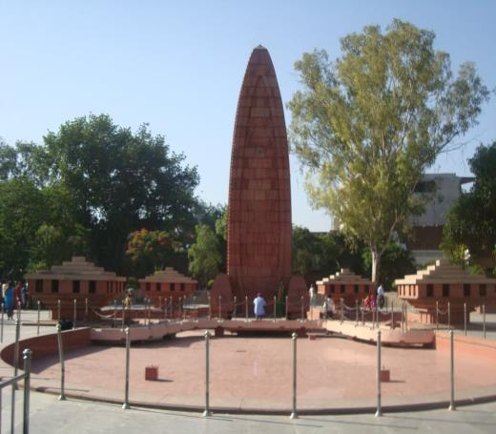
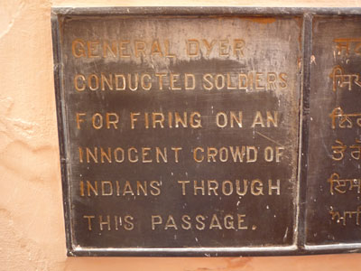
The Amritsar Massacre ignited cries for Indian independence.

Slide 17
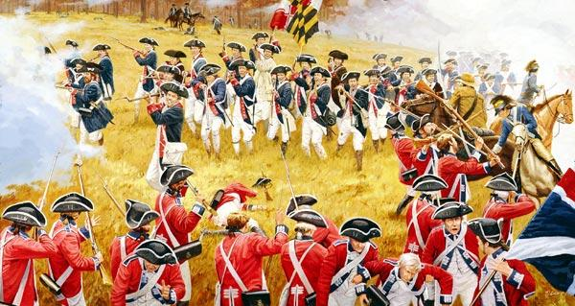
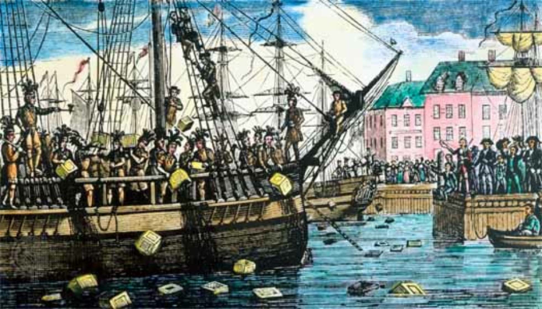
Let’s hop in our time machine and head back to the 1770’s, and to the American 13 Colonies…
But ultimately the Colonists felt that their approach needed to change…
The Colonists sought political change, and complete independence from Great Britain.

Slide 18
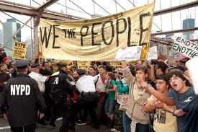
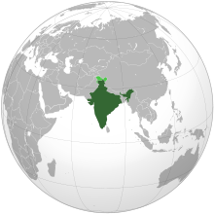
Essential Question: What is the most effective method for bringing political and social change? Aim: How successful was Gandhi in leading India’s movement for independence? Brainstorm revolutions that we have studied that have focused on bringing political change.

Slide 19
What made Amritsar a turning point in the Indian nationalist movement?
What is civil disobedience?
What types of non-violent actions did Gandhi use during India’s struggle for independence?
Was the civil disobedience campaign successful?
What were the similarities between Mohandas Gandhi and Muhammad Ali Jinnah?
Why was India partitioned?

Slide 20
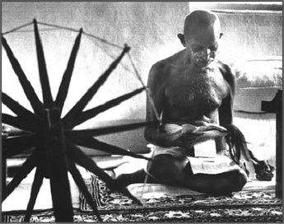

Slide 21
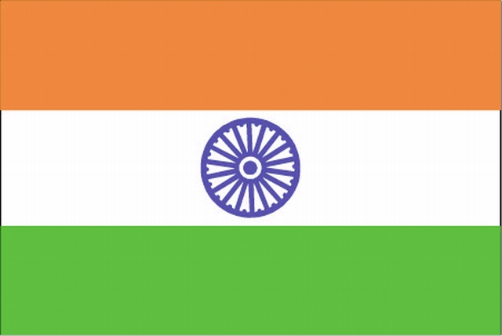

Slide 22
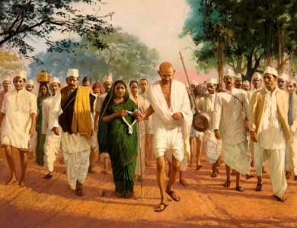
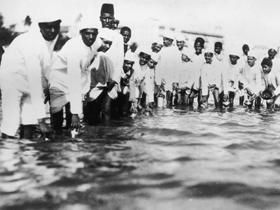
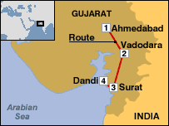
Civil Disobedience: Deliberately and publically refusing to obey unjust laws, using non violent means. For example, wearing homespun clothing, rather than British produced textiles.
Gandhi leads the Salt March to boycott the British monopoly on salt production.

Slide 23
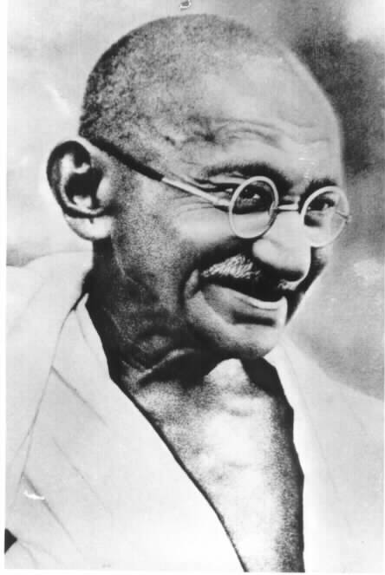
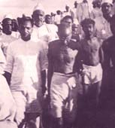

Slide 25
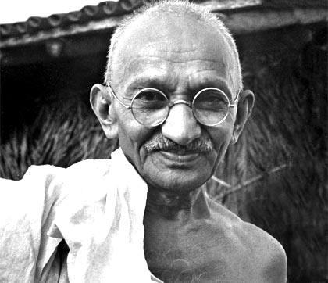
Who was Mohandas Gandhi?
An Indian Hindu
Studied law in London
Practiced law in and advocated civil disobedience in South Africa.
Nationalist Leader
Drew inspiration from all major religions and their teachings.
Policy of Noncooperation with the British government:
Boycott British goods, services, influence.

Slide 26
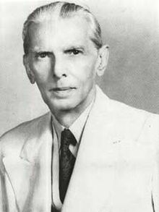
Who was Muhammad Ali Jinnah?
An Indian Muslim
Studied law in London
Nationalist Leader, who originally advocated Muslim and Hindu unity in achieving Indian independence.
However, later rejected the Indian National Congress’s support of Gandhi’s satyagraha, non-violent resistance.
Therefore, advocated for the creation of a Muslim state- Pakistan, and as the new nation’s first Governor-General, helped to establish the new government.

Slide 27
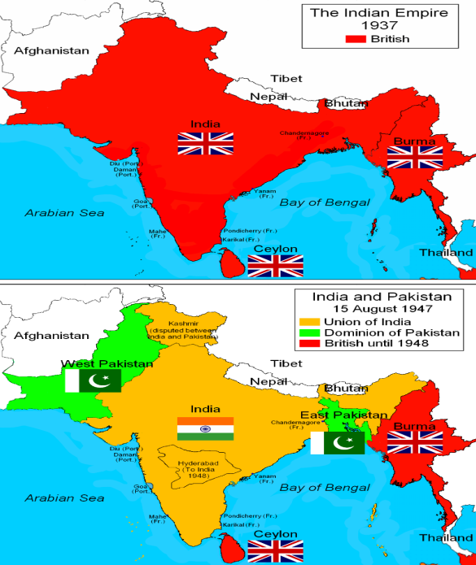
As India and Pakistan gained total independence in 1947.
Tensions between Muslims and Hindus existed over representation in government..
**INDIA WAS PARTITIONED **
Pakistan was created as a separate state for Muslims.
Gandhi worked to stop the carnage between Hindus and Muslims, but was assassinated by a Hindu extremist.

Slide 28
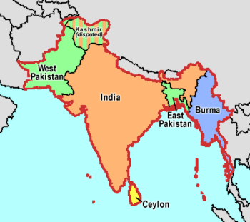

Slide 29
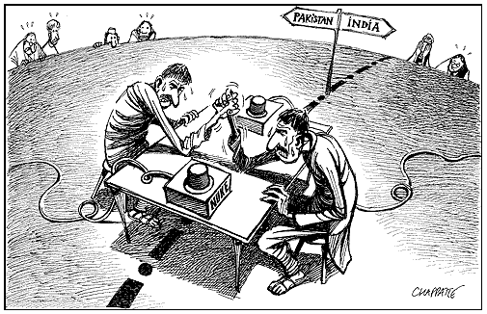
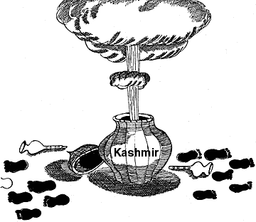

Slide 30
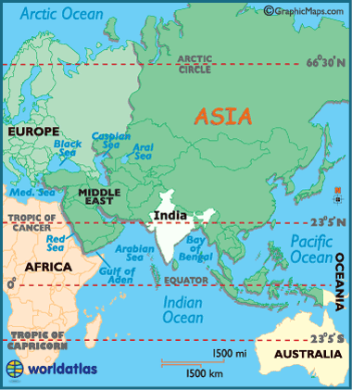
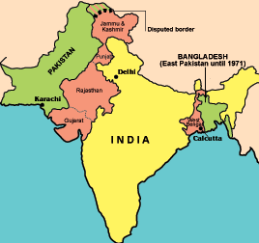
In a region with over 1.3 billion people, which problem do you think is the most pressing issue to the world? Explain why.

Slide 31
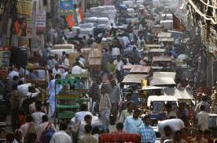
Overpopulation in India

Slide 32
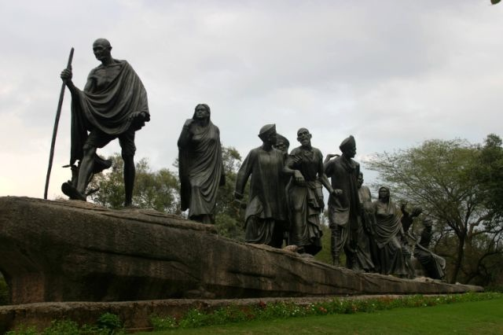
Choose ONE of the following questions to answer:
1)Why do you think Gandhi’s approach of non-violence was successful in achieving independence for India, when nonviolence was not successful in other revolutionary movements?
2)Think about other areas of the world that we have studied that have oppressive governments (i.e. China, North Korea). In your opinion, can nonviolence achieve political change in today’s world? Explain your answer.
3) Who was a more in achieving his goals: Mohandas Gandhi or Muhammad Ali Jinnah?

