Slide 1
Monday, 11/26/18 AIM: Why did labor unions emerge during the Industrial Revolution?
DO NOW: We’re going to get into groups for an activity about labor unions! For now, just sit in your regular seat and prepare to relocate!
Extra Help TOMORROW in room 251 from
6:45-7:15AM and 2:30-3PM
5Q MC QUIZ ON FRIDAY: Everything on Industrial Revolution through Command Economy
Unit Exam next Tues-Weds

Slide 2
Groups--Period 1
1 | Darian, John Y, Brady, Regina
2 | Sierra, Jessica R, Oscar, Josh, Evan
3 | Michael, Robby, Emily, Jess H
4 | Elliot, Danielle, Johnny, Yasmine
5 | Richie, Emma, Louis, Amanda, Alex
6 | Joe, Madison, Carly, Gio, Nick

Slide 3
Groups--Period 3
1 | Emily, Tristan, Ryan L, Josh, Craig
2 | Jamie, Cassie, Bella, Claire, Jaspreet
3 | Thomas, Samantha, Stef Stalzer, Jake
4 | Lily, Valerie, Steph, Erika, Ben Y
5 | Ava, Ryan E, Julia A, Dylan
6 | Annalise, Julia C, Ben S, JJ, Shannon

Slide 4
Groups--Period 4
1 | Ava, Michael, Charlie, Grace
2 | Nawar, Hailey, James, Collin
3 | Dennis, Kayla, Chris, Katie
4 | Nick, Natalie, Taylor, Darian, Sarah
5 | Jesee, Justin, Austin, Sarika

Slide 5
Groups--Period 6
1 | Albulena, James, Ryan, Shaina, Alyssa
2 | Sarah, Nick, Riley, Claire, Kevin
3 | Thomas, Ariana, Isabella, Matt D, Ally C
4 | Matt R, Madison, Allie M, Holly

Slide 6
Groups--Period 8
1 | Dev, Tyler, Ellie, Lorraine
2 | Chris B, Renee, Jason, Nicole
3 | Chris M, Sam, Caitlyn, Jacob
4 | JJ, Nick, Antonio, Connor P
5 | Vinny, Jessica, Ryan, Brendyn
6 | Paul, Connor D, Erik, Paige

Slide 7
DO NOW Scenario Question
Scenario: Imagine that you work at a restaurant and your boss has just decided to decrease your salary from $12 to $9 per hour and shorten your lunch break from 1 hour to 30 minutes. What would you do?

Slide 8
Labor Unions
Groups of workers at the same job who join together to get better working conditions
How do labor unions achieve more rights?
Collective Bargaining: Negotiations between the labor union (workers) and the employer (boss)

Slide 9
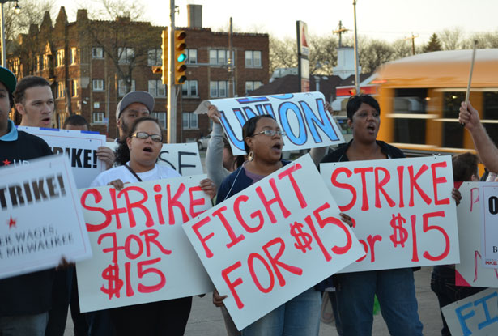
What if Collective Bargaining doesn’t work?
Strike: Workers go on strike by refusing to work until their terms are met by their employer

Slide 10
Who are the workers in this cartoon? Who is the employer?
Why are the reindeer protesting?
What tactics might the reindeer use to get their demands met?
What do we call the negotiations between the reindeer and the Santa?

Slide 11
It’s time for some collective bargaining!
You will be working in groups of 4-5
2-4 Workers: You are labor union representatives are speaking on behalf of your coworkers. You are trying to get better working conditions.
1-2 Employers: You are trying to meet some demands of your workers while also continuing to make profit $.

Slide 12
Closing Task
Why did labor unions emerge during the period of industrialization? Explain.
Describe two effects that labor unions have had on the world today.

