Slide 1
Motivation
On the index card, write down a time when someone in your life really motivated you to do something that you wouldn’t ordinarily do.
What did that person do to motivate you and why do you believed it worked?

Slide 2
Motivation and Emotion

Slide 3
Definitions
Motivation and Emotion
Motivation – internal state that activate and gives direction to thoughts
Biological: internal physiological state
Internal factors and external cues
Emotion – positive or negative feelings
Biological changes (physiological arousal) and characteristic behavior

Slide 4
Primary Motives
Biological needs
Food, water, warmth, safety, and sex
Homeostasis – biological thermostats regulated by homeostasis mechanisms
Hunger – regulation of food intake
Hypothalamus (lateral, ventromedial, and paraventricular)

Slide 5
Psychological Motives
Affiliation motivation
All humans have need to be social
Theories on need for affiliation
Need gained through learning experiences
Affiliative behaviors positively reinforced
Need for emotional comfort in trying times
Arousal and performance
Yerkes-Dodson Law - If arousal is too low, performance will be inadequate; if it’s too high, performance may become disrupted and disorganized.

Slide 6
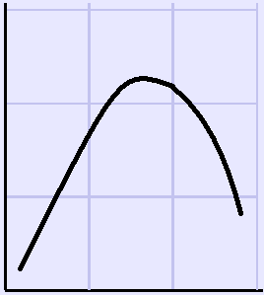
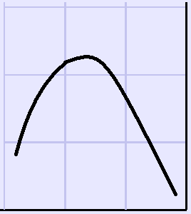
Cognition, Language, and Intelligence
Yerkes-Dodson Law
Simple task
Complex task
High
High
Efficiency of performance
Efficiency of performance
Low
Low
Low
High
Low
High
Level of arousal
Level of arousal
If arousal is too low, performance will be inadequate; if it’s too high, performance may become disrupted and disorganized.

Slide 7
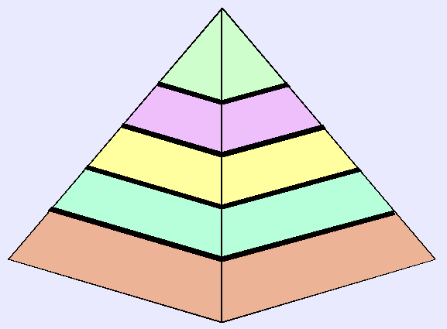
Maslow’s hierarchy of motives
Self-actualization (ethics, philosophical and artistic expression)
Self-esteem (accepting of self as you are)
Safety (low risk of physical harm)
Love and belonging (loving, being loved, social relationships)
Biological (food, water, sleep, sex)

Slide 8
Maslow’s Hierarchy of Motives
Human needs organized; arranged from most basic to personal and advanced needs
Lower needs must be met first or higher needs cannot operate
Exceptions to hierarchy
Cannot explain suicide bombers and martyrs

Slide 9
Achievement Motivation
Psychological need to succeed in school, work, and other areas of life
Controversy on how individuals define success
Elliot and Church’s study
Mastery goals (intrinsically motivated)
Performance-approach goals (work harder to gain respect of others)
Performance-avoidance goals (worker harder to avoid being looked down on by others)

Slide 10
Intrinsic and Extrinsic Motivation
Motivation and Emotion
Intrinsic – motivated by inherent nature of an activity (ie: make oneself feel good)
Affected by how praise is given
Extrinsic – motivation is external to the activity, not inherent (get a raise in pay)
Must be desired by the person to be a motivator

Slide 11
Emotions
Experiences giving color, meaning, and intensity to life

Slide 12
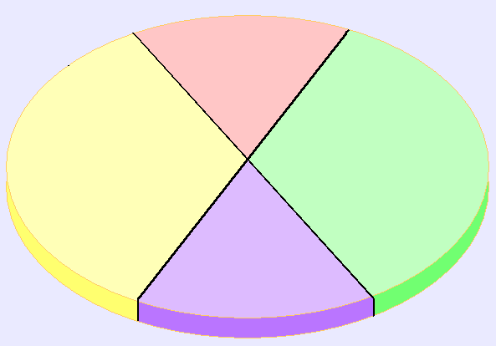
Watson and Tellegen’s emotional map
High Positive Emotion
High Negative Emotion
Fearful
Elated
Surprised
Angry
Sad
Happy
Relaxed
Sluggish
Low Negative Emotion
Low Positive Emotion

Slide 13
Role of Learning and Culture in Emotions
Most believe basic emotions are inborn
Children born blind and deaf show normal emotional reactions
Two ways culture affects emotions
Learning influences emotional expressions
Culture influences interpretation of different situations; reactions correspond accordingly
Cultural differences are important

Slide 14
Maslow’s hierarchy of motives
Self-actualization (ethics, philosophical and artistic expression)
Self-esteem (accepting of self as you are)
Safety (low risk of physical harm)
Love and belonging (loving, being loved, social relationships)
Biological (food, water, sleep, sex)

Slide 15
As you listen to the speech, think about what Kurt Russell’s character is trying to do in his speech?
http://www.youtube.com/watch?v=vwpTj_Z9v-c

Slide 16
Identify which level of needs these speeches are drawing on to motivate their intended audience
http://www.youtube.com/watch?v=WO4tIrjBDkk
http://www.youtube.com/watch?v=FWW4KogocfQ
https://www.youtube.com/watch?v=lEOOZDbMrgE

Slide 17
Key Terms and Ideas
Motivation
Primary Motive or Drive
Secondary(Acquired) Motive or Drive
Affiliation Motive (Need for Affiliation)
Need for Approval
Need for Achievement
Need for Power
Yerkes-Dodson Law
Intrinsic Motivation
Extrinsic Motivation

