Slide 1
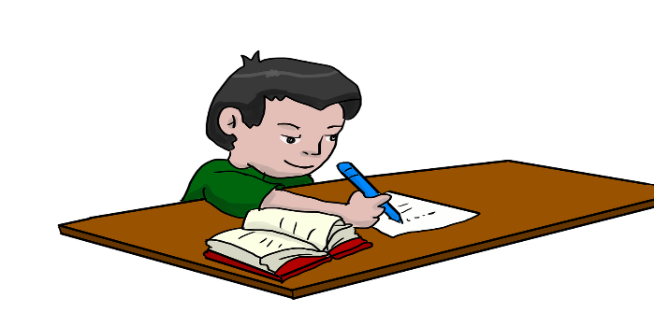
Welcome to Resource Room 9/10 Ms. Pagliuca
As a Support Service
There are many Goals for Resource Room
As your child enters High School, a goal is for them to increase their self-advocacy skills
We can do that by reviewing the Goals on their Individual Education Plan and by reviewing classroom accommodations
The more a student is aware of their needs the more likely they will advocate for themselves when needed

Slide 2
Routine in Resource Room I am your student’s contact teacher and I will advocate for him or her throughout the school year For some I will be your child’s Case Manager as well and your contact person for any reason or concern

Slide 3
Goal Monitoring
Each student has certain Goals that need to be addressed throughout the year.
They can be Reading, Writing and Math Goals along with any other Related Service Goals or Academic Goals
Each student has a folder in Resource Room in which they will work out of periodically to address these goals. We will also incorporate these goal with their content area assignments t

Slide 4
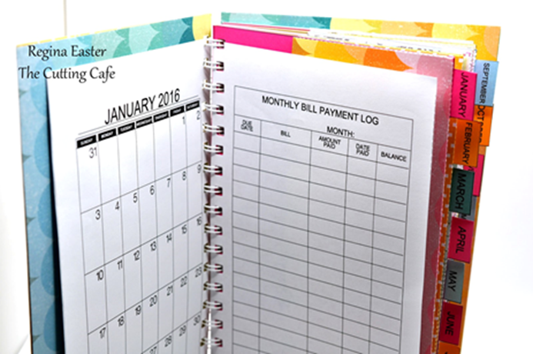
Routine
At the beginning of each class, students review their Google Classroom Agendas and check for missing work under the Google “To Do” List Each student will then plan out their assignments on a sheet provided or by using their own agenda book
Organize Notebooks *Check for tests or quizzes Skills we work on in Resource Room Building on testing strategies/ annotating / Inferencing /Highlighting Increasing vocabulary including Math /Creating flash cards

Slide 5
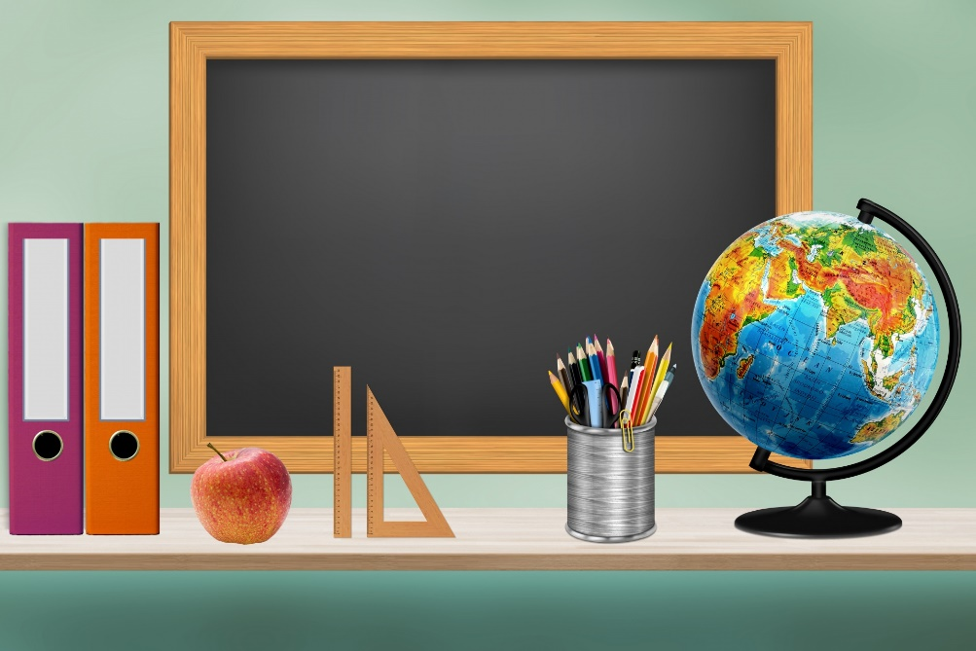
Thank You!
Looking forward to working with you and your child this year
Please note when your child is
On a Virtual Learning Day, they can
Send me a message through their RR
Google Classroom if they have a question

