Slide 1
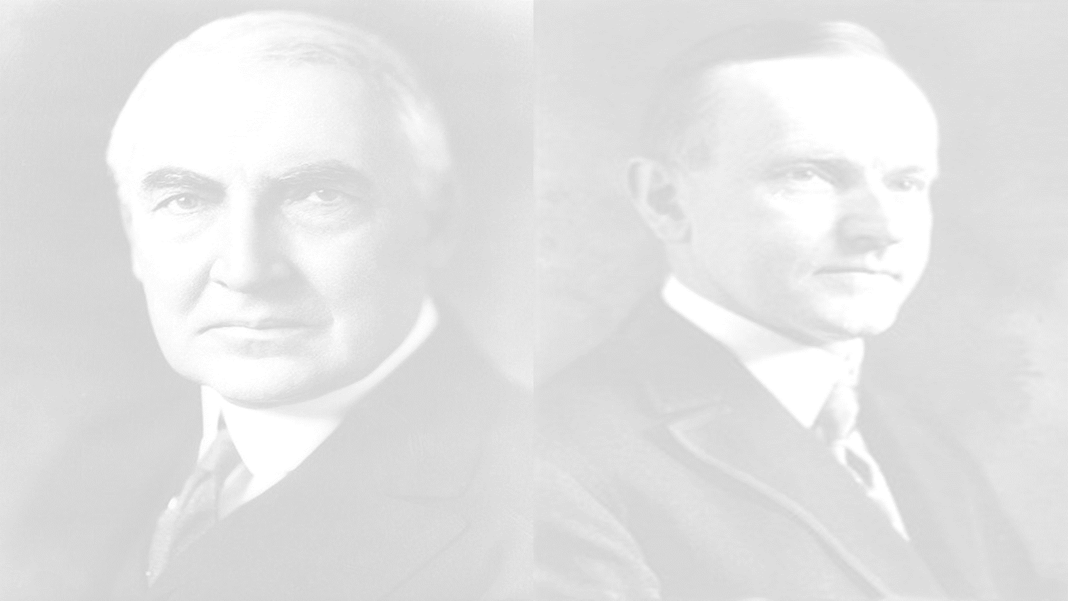
The US Presidents Series - Harding and Coolidge
Warren G. Harding | Calvin Coolidge

Slide 2
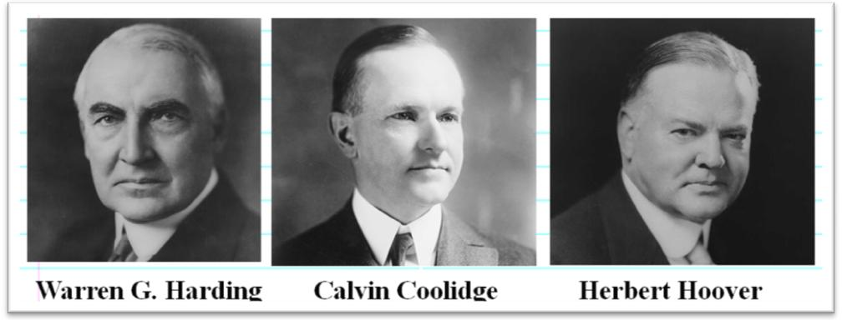
Politics of the 1920s
The 1920s were dominated by Republicans in the White House and in both houses of Congress:
Limited Progressive reforms
Developed a close relationship between the government and business that promoted private enterprise
Advocated a foreign policy based on economic investment of U.S. business in the world

Slide 3
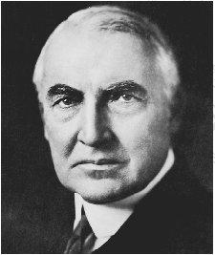
Warren G. Harding - Republican – 1921-1923
Warren Harding won the 1920 election promising “a return to normalcy”
Washington Naval Conference - Nine nations were invited to Washington, D.C. – (Not the Soviet Union) and was the first international conference held in the United States and the first disarmament conference in history.
Kellogg-Briand Pact - Sponsored by France and the U.S., the Pact renounced the use of war and called for the peaceful settlement of disputes.
Dawes Plan - Attempt to stabilize the German Economy and allow for the repayment of war reparations.

Slide 4
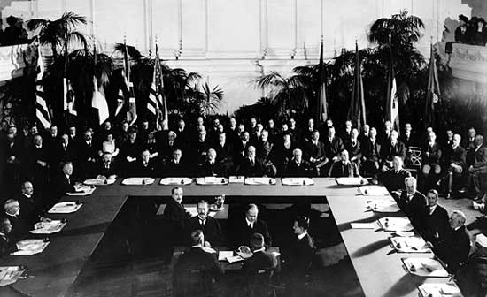
Washington Naval Conference
Nine Powers Treaty - The United States, Britain, Japan, France, Italy, Belgium, the Netherlands, Portugal and China – Internationalization of Open Door Policy
Five Powers Treaty - the United States, Great Britain, Japan, France and Italy – Limitations on Naval Warship Tonnage
Four Powers Treaty - the United States, France, Britain, and Japan - agreed to consult with each other in the event of a future crisis in East Asia before taking action

Slide 5
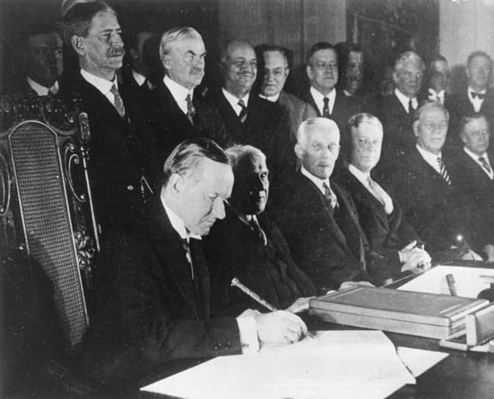
The Kellogg-Briand Pact was an agreement to outlaw war signed on August 27, 1928. The pact was one of many international efforts to prevent another World War, but it had little effect in stopping the rising militarism of the 1930s or preventing World War II.

Slide 6
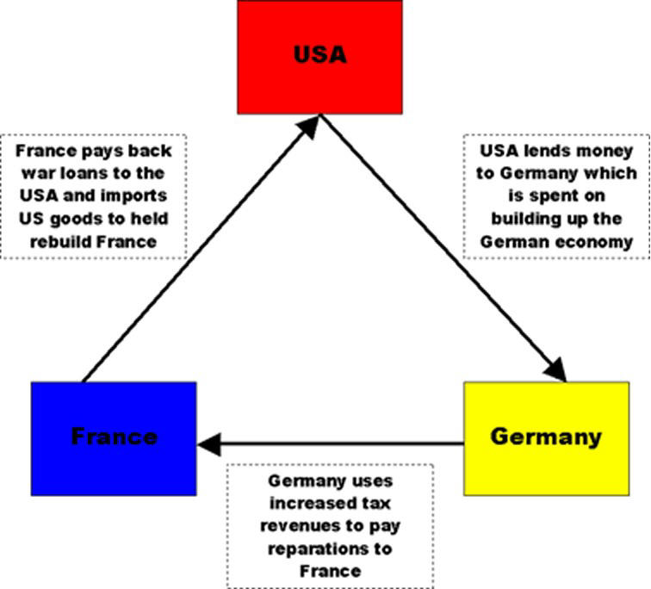
Under the Dawes Plan, Germany’s annual reparation payments would be reduced, increasing over time as its economy improved; the full amount to be paid, however, was left undetermined.
U.S. banks continued to lend Germany enough money to enable it to meet its reparation payments to countries such as France and the United Kingdom. These countries, in turn, used their reparation payments from Germany to service their war debts to the United States.

Slide 7
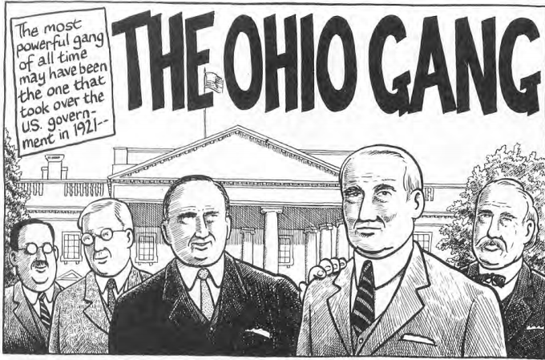
Warren G. Harding - Republican – 1921-1923
Harding Presidency is remembered for two things:
Corruption: prohibition bribery, graft in the Veterans Administration, and the Teapot Dome scandal
T. Roosevelt set aside oil fields in Wyoming and California for the navy;
Harding’s Secretary of the Interior Albert Fall accepted $400,000 to “lease” oil reserves to businesses
Treasury Secretary Andrew Mellon’s cutback on government spending, increase in protective tariffs, and reduction of income taxes

Slide 8
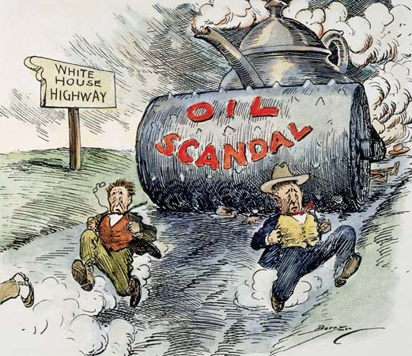

Slide 9
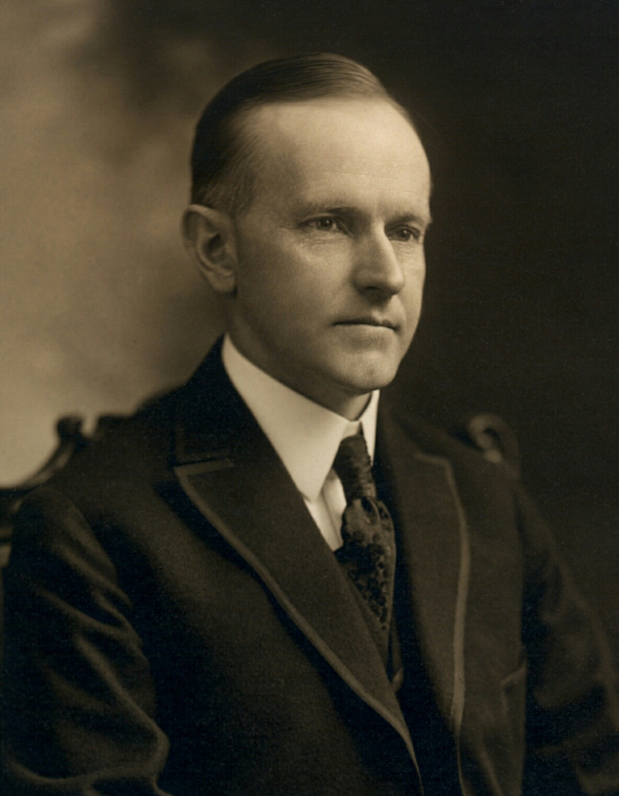
Calvin Coolidge - Republican – 1923-1929
Harding died in 1923 and VP Calvin Coolidge became president and won his own term in 1924:
Coolidge’s honesty and integrity was reassuring, but “Silent Cal” was not much of a leader
Coolidge continued Harding’s policies of less gov’t spending, lowering income taxes, and limiting Congressional legislation

Slide 10
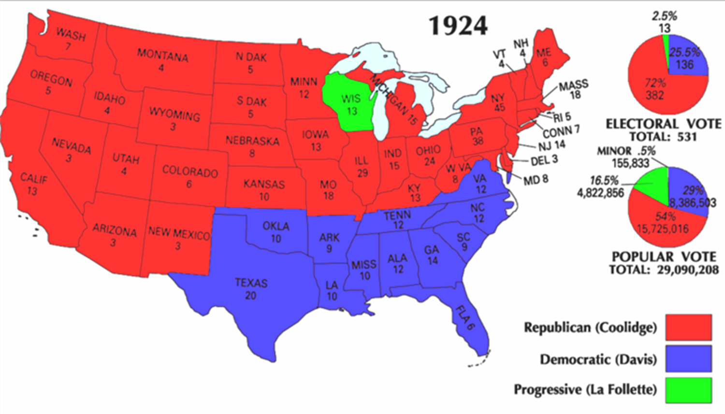

Slide 11
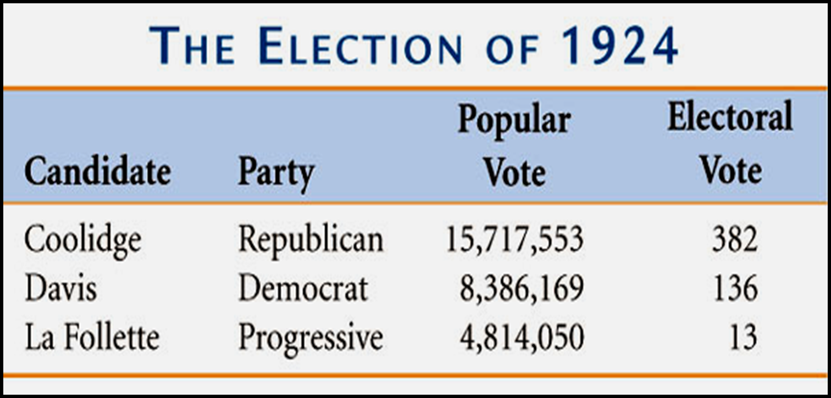
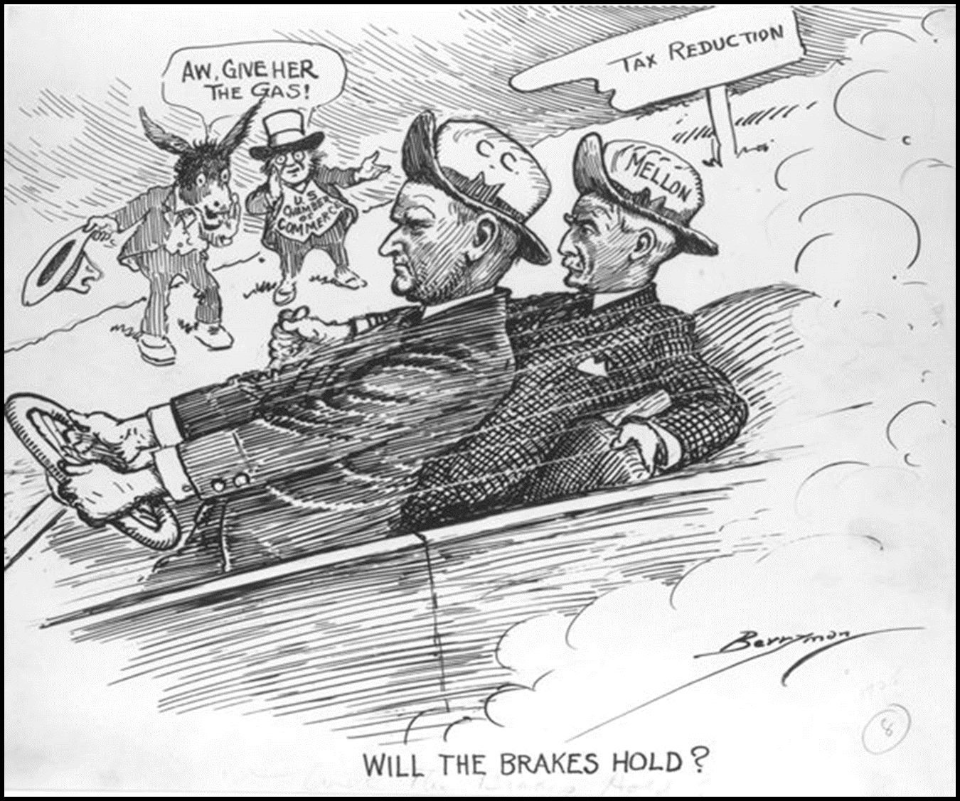
Calvin Coolidge - Republican – 1923-1929
While the Republicans dominated the government, Democrats were split:
Rural Democrats in the south and west favored prohibition, traditional Protestant values, and the Klan
Urban Democrats were mostly immigrants
The Democratic Nat’l Convention in NYC for the 1924 presidential nomination exposed this polarity
Urban voters had clearly had turned to the Democratic Party, they just needed a charismatic leader to unite the party

Slide 12
Election of 1928
The 1928 election reflected a divided USA:
Smith appealed to new voters in cities but alienated old-line Democrats; Catholicism hurt Smith more than anything else
A new urban voting bloc was revealed in 1928: For the 1st time, Democrats won the majority of votes in the 12 largest U.S. cities
Herbert Hoover Republican Protestant For prohibition Native-born Self-made millionaire committed to business and volunteerism | Alfred Smith Democrat Catholic “Wet” Of immigrant parents Rose through Tammany Hall to be a progressive NY governor

Slide 13
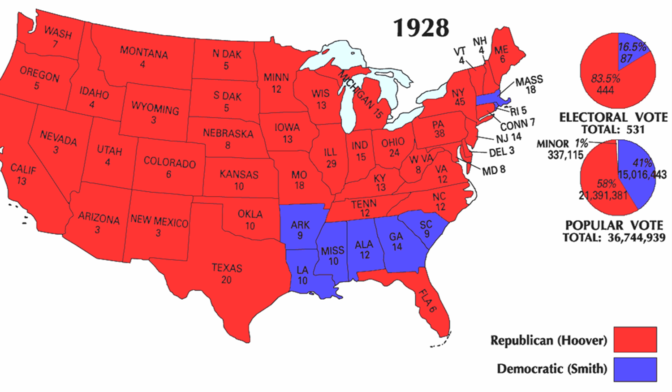

Slide 14
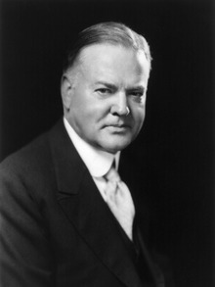
Herbert Hoover- Republican – 1929-1933
Herbert Hoover proved to be the most effective of the Republican presidents of the 1920s:
He was experienced having served as head of Wilson’s Food Administration and as Commerce Secretary for Harding and Coolidge
He believed in free enterprise and tried to strengthen U.S. trade by allying business with the government
Instead of the laissez-faire of Gilded Age, the Republican presidents of the 1920s pioneered a close relationship with business
He doubled the size of the U.S. bureaucracy by creating bureaus to oversee housing, transportation, and mining

Slide 15
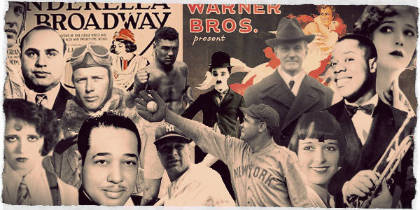
The Old and The New
Urban culture and industrial production dominated the 1920s:
Mass-produced consumer goods, mass media, advertising spread a new American culture
Much to the dismay of a rural America trying to cling to traditional values
Progressive reforms were no match for technology and prosperity

Slide 16
Sum It Up
To what extent did Republican dominance in the 1920s represent a change from Gilded Age and Progressive politics?

