Slide 1
STATISTICAL ANALYSIS

Slide 2
Reasons for using statistics
Since we can’t measure the whole population, we need to take a sample to have data representing the population.
*

Slide 3
Types of DatA
Quantitative data: IS anything that can be expressed as a number, or quantified.
Examples of quantitative data are:
scores on achievement tests
number of hours of study
weight of a subject
This data can be statistically manipulated.

Slide 4
qualitative data: Information that relates to characteristics or description (observable qualities)
Information is often grouped by descriptive category
Examples of Qualitative data are:
Species of plant
Type of insect
Shades of color
Rank of flavor in taste testing
*Remember: qualitative data can be “scored” and evaluated numerically

Slide 5
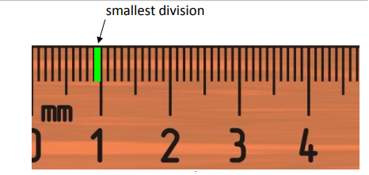
UNCERTAINTY (measurement reading error)
■
When you do a simple measurement using:
micrometer
voltmeter
thermometer
graduated cylinder
stopwatch
UNCERTAINTY is +/- half of the smallest division
When you do a measurement using a RULER or digital display:
UNCERTAINTY is +/- the smallest division
(or otherwise stated on the instrument)

Slide 6
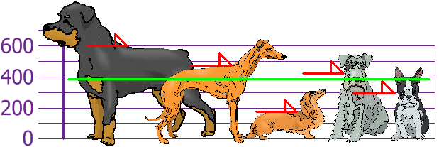
MEAN
The "mean" is the "average" you're used to, where you add up all the numbers and then divide by the number of numbers.
Mean = 600 + 470 + 170 + 430 + 3005 = 19705 = 394 mm
5 5

Slide 7
STANDARD DEVIATION is used to summarize the spread of values around the mean
Means do not tell us everything about a sample.
Samples can be very uniform with the data all bunched around the mean (Figure 1.)
or they can be spread out a long way from the mean (Figure 2).
The statistic that measures this spread is called the standard deviation.
The wider the spread of scores, the larger the standard deviation.

Slide 8
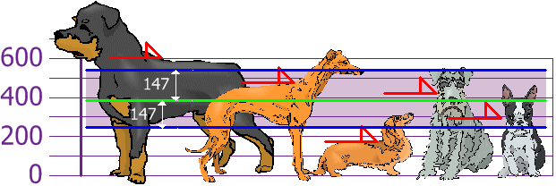
For data that has a normal distribution, 68% of the data lies within (+/-)one standard deviation of the mean.
And the good thing about the Standard Deviation is that it is useful. Now we can show which heights are within one Standard Deviation (147mm) of the Mean:
Now we can show which dog heights are within +/- 1 Standard Deviation (147mm) of the Mean
Using the Standard Deviation we have a "standard" way of knowing what is normal, and what is extra large or extra small.
Rottweilers are tall dogs. And Dachshunds are a bit short ... but don't tell them!

Slide 9
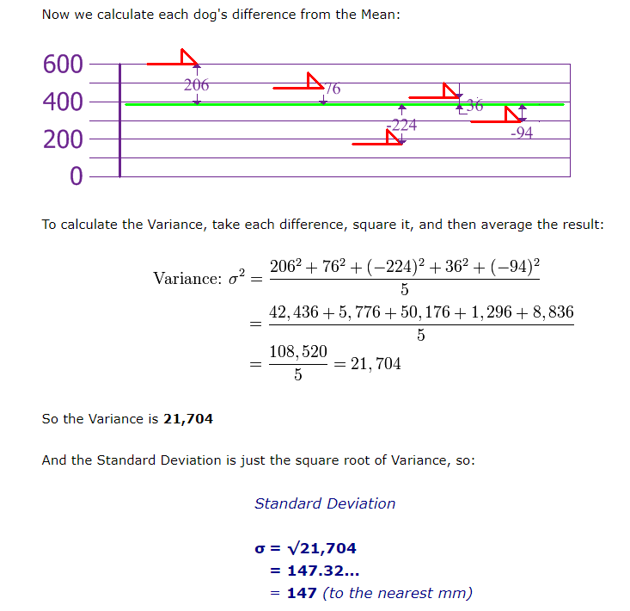
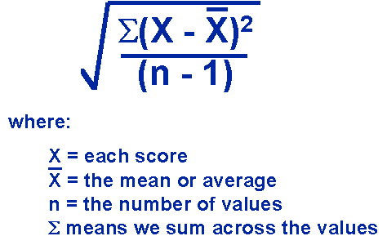
HOW Standard deviation is calculated

Slide 10
ERROR BARS
An error bar is a line through a point on a graph, parallel to one of the axes, which represents the uncertainty or variation of the corresponding coordinate of the point.
In IB Biology, the error bars most often represent the standard deviation of a data set.

Slide 11
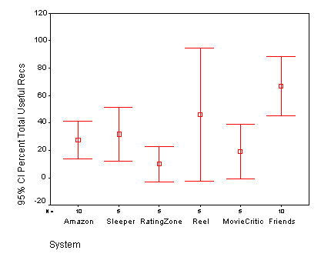
What do error bars suggest?
If the bars show extensive overlap, it is likely that there is not a significant difference between those values

Slide 13
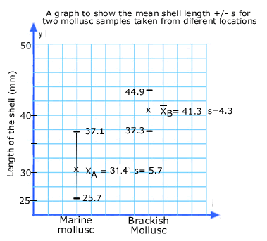
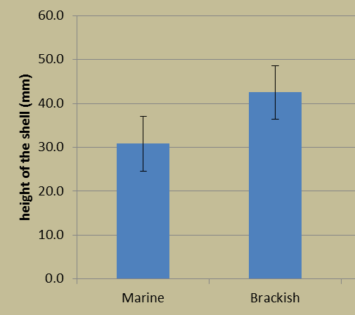
Graphing Mean with Standard dEViation as Error Bars
Figure 1: Mean length of mollusc shell in the different types of water. (Error bars represent one standard deviation.)
This standard deviation graph compares 68% of the population and begins to show that the two sets of data are likely different due to the very little overlap of error bars.

Slide 14
How do we determine if the two samples are different and not just due to chance or sampling error?

Slide 15
INDEPENDENT T-TEST
t-test is a statistical test that compares the mean and standard deviation of two samples to see if there is a significant difference between them.

Slide 16
In an experiment, a t-test might be used to calculate whether or not differences seen between the control and the experimental group are a factor of the manipulated (INDEP) variable or simply the result of chance or sampling.
The unpaired T-test would be used to determine if there is a significant difference between the control and treated enzyme activities.
The paired T-test would be used to determine if there is a significant difference between the pre- and post-treatment blood pressures.

Slide 17
In any significance test, there are two possible hypothesis
Null Hypothesis (n₀): "There is not a significant difference between the two groups; any observed differences may be due to chance and sampling error."
Alternative Hypothesis (N₁): "There is a significant difference between the two groups; the observed differences are most likely not due to chance or sampling error."

Slide 18
Null Hypothesis (n₀):
Alternative Hypothesis (N₁):
There is no significant difference between the control and treatment group enzyme activity; the difference we see in the means of the two groups may be due to chance and sampling error.
There is a significant difference between the control and treatment group enzyme activity; the difference we see in the means of the two groups is mostly likely not due to chance or sampling error.

Slide 19
In biology the critical probability left to chance or sampling Error is usually taken as 0.05 (or 5%).
This may seem very low, but it reflects the facts that biology experiments are expected to produce quite similar results.

Slide 20
T-test Conclusion
If your calculated P (probability) value from your T-Test is GREATER than .05
-Accept the NULL HYPOTHESIS
- there is no significant difference and the results are due to chance
If your calculated P (probability) value from your T-Test is LESS than .05
- Reject the NULL and Accept the ALTERNATIVE HYPOTHESIS
- There is a significant difference and your independent variable is affecting this difference.

Slide 21
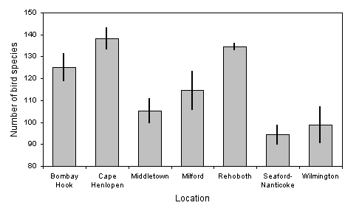
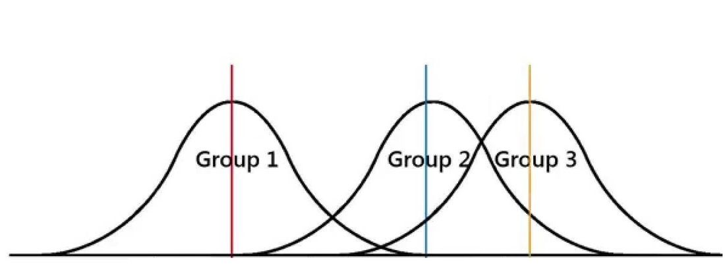
Analysis of Variance (ANOVA)
The ANOVA test is a statistical test that can be done in place of multiple T-tests when comparing the means of more than two groups at a time.
Same rules to the t-test apply (null, alternative, p-value)
The ANOVA test would be used to determine if there is a significant difference in the mean number of bird species in the seven locations.
The ANOVA is a single test to determine the significance of the difference between the means of three or more groups.

Slide 22
Correlation
When analyzing an experiment you are very often looking for an association between variables.
This can be a correlation to see if two variables vary together or a relationship to see how one variable affects another.
One test is the Pearson correlation coefficient ( r )
+1 (perfect positive correlation) through 0 (no correlation) to -1 (perfect negative correlation

Slide 23
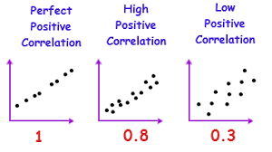
If your correlation coefficient is a positive number, then you know that you have a direct, positive relationship. This means that as one variable increases (or decreases) the values of the other variable tend to go in the same direction. If one increases, so does the other. If one decreases, so does the other in a predictable manner.

Slide 24
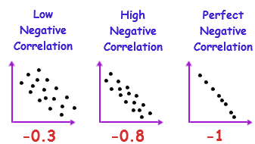
If your correlation coefficient is a negative number you can tell, just by looking at it, that there is an indirect, negative relationship between the two variables. As you may recall, a negative relationship means that as values on one variable increase (go up) the values on the other variable tend to decrease (go down) in a predictable manner.

Slide 25
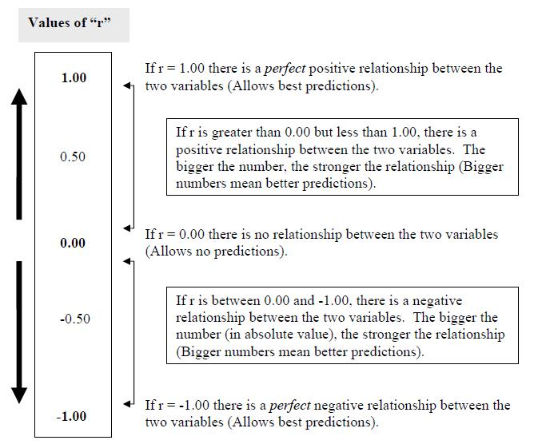

Slide 26
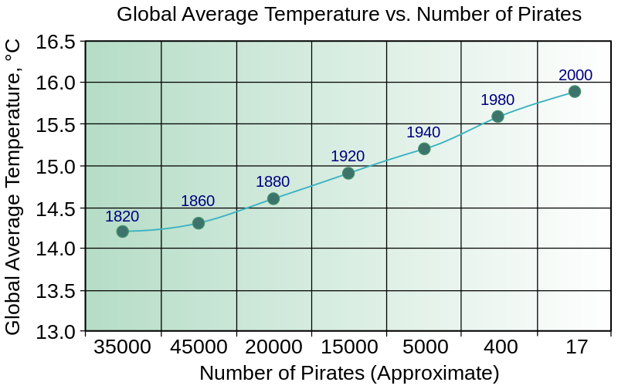
CORRELATION does not imply causation, FURTHER testing does

Slide 27
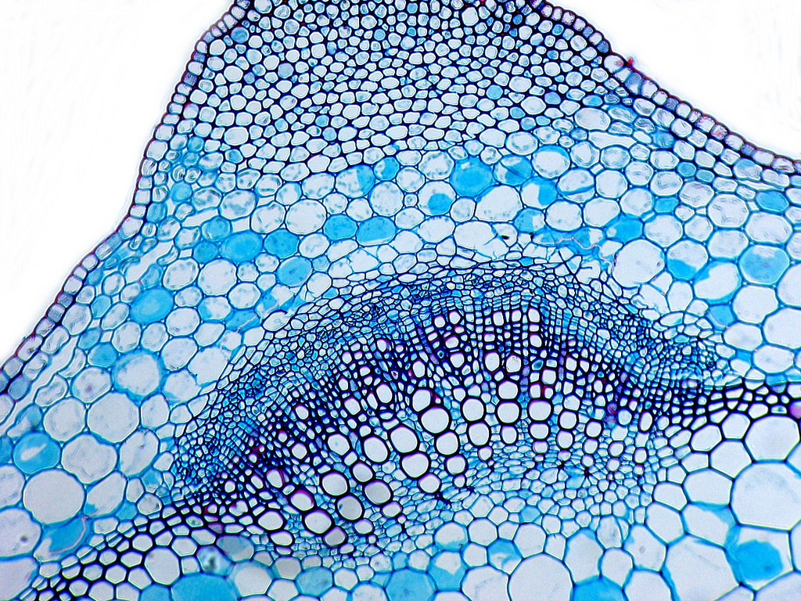
“Why is this Biology?”
Variation in populations.
Variability in results.
affects
Confidence
in conclusions.
The key methodology in Biology is hypothesis testing through experimentation.
Carefully-designed and controlled experiments and surveys give us quantitative (numeric) data that can be compared.
We can use the data collected to test our hypothesis and form explanations of the processes involved… but only if we can be confident in our results.
We therefore need to be able to evaluate the reliability of a set of data and the significance of any differences we have found in the data.
Image: 'Transverse section of part of a stem of a Dead-nettle (Lamium sp.) showing+a+vascular+bundle+and+part+of+the+cortex'
http://www.flickr.com/photos/71183136@N08/6959590092 Found on flickrcc.net

Slide 28
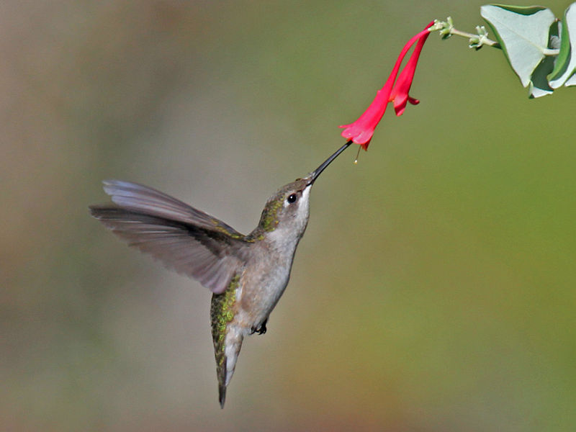
Hummingbirds are nectarivores (herbivores that feed on the nectar of some species of flower).
In return for food, they pollinate the flower. This is an example of mutualism –
benefit for all.
As a result of natural selection,
hummingbird bills have evolved.
Birds with a bill best suited to
their preferred food source have
the greater chance of survival.
Photo: Archilochus colubris, from wikimedia commons, by Dick Daniels.

Slide 29
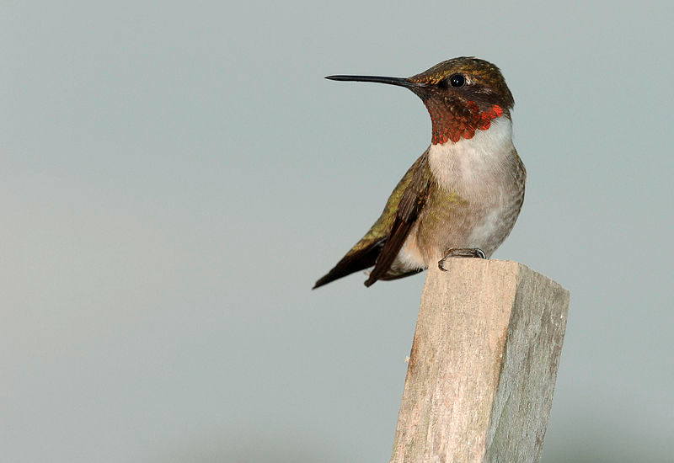
Researchers studying comparative anatomy collect data on bill-length in two species of hummingbirds: Archilochus colubris
(red-throated hummingbird) and
Cynanthus latirostris (broadbilled hummingbird).
To do this, they need to collect sufficient
relevant, reliable data so they can test
the Null hypothesis (H₀) that:
“there is no significant difference
in bill length between the two species.”
Photo: Archilochus colubris (male), wikimedia commons, by Joe Schneid

Slide 30
The sample size must
be large enough to provide sufficient reliable data and for us to carry out relevant statistical tests for significance.
We must also be mindful of uncertainty in our measuring tools and error in our results.
Photo: Broadbilled hummingbird (wikimedia commons).

Slide 32
The mean is a measure of the central tendency
of a set of data.
Calculate the mean using:
Your calculator
(sum of values / n)
Excel
 | Table 1: Raw measurements of bill length in A. colubris and C. latirostris.
 |  | Bill length (±0.1mm)
 | n | A. colubris | C. latirostris
 | 1 | 13.0 | 17.0
 | 2 | 14.0 | 18.0
 | 3 | 15.0 | 18.0
 | 4 | 15.0 | 18.0
 | 5 | 15.0 | 19.0
 | 6 | 16.0 | 19.0
 | 7 | 16.0 | 19.0
 | 8 | 18.0 | 20.0
 | 9 | 18.0 | 20.0
 | 10 | 19.0 | 20.0
 | Mean
 | s
n = sample size. The bigger the better.
In this case n=10 for each group.
All values should be centred in the cell, with decimal places consistent with the measuring tool uncertainty.
=AVERAGE(highlight raw data)

Slide 33
The mean is a measure of the central tendency
of a set of data.
 | Table 1: Raw measurements of bill length in A. colubris and C. latirostris.
 |  | Bill length (±0.1mm)
 | n | A. colubris | C. latirostris
 | 1 | 13.0 | 17.0
 | 2 | 14.0 | 18.0
 | 3 | 15.0 | 18.0
 | 4 | 15.0 | 18.0
 | 5 | 15.0 | 19.0
 | 6 | 16.0 | 19.0
 | 7 | 16.0 | 19.0
 | 8 | 18.0 | 20.0
 | 9 | 18.0 | 20.0
 | 10 | 19.0 | 20.0
 | Mean | 15.9 | 18.8
 | s
Descriptive table title and number.
Uncertainties must be included.
Raw data and the mean need to have consistent decimal places (in line with uncertainty of the measuring tool)

