Slide 1
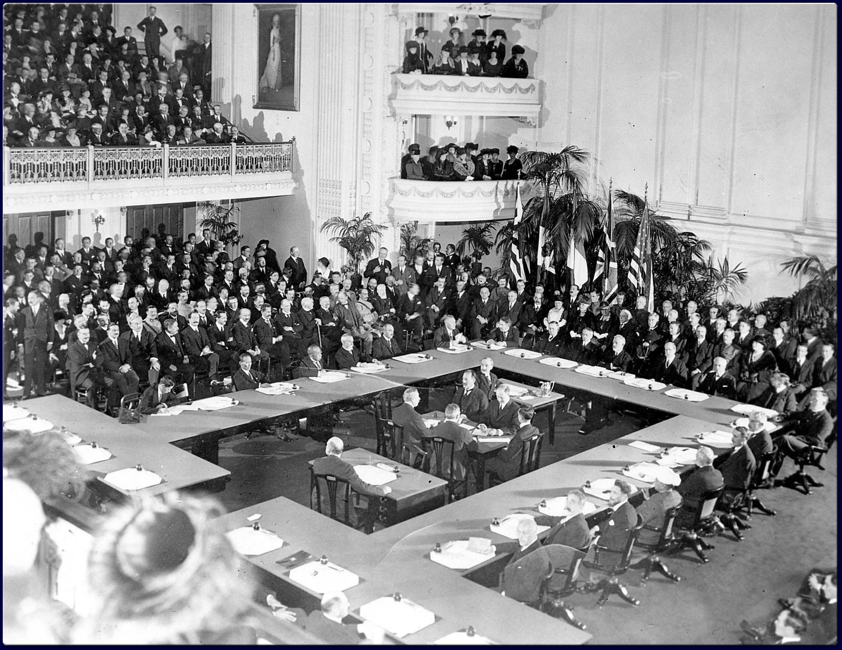
The End of the Great War & the Versailles Peace Conference
“The First World War killed fewer victims than the Second World War, destroyed fewer buildings, and uprooted millions instead of tens of millions – but in many ways it left even deeper scars both on the mind and on the map of Europe. The old world never recovered from the shock.” Edmund Taylor, historian

Slide 2
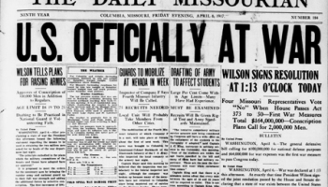
The Turning Point
In April 1917, led by President Woodrow Wilson, the United States entered World War I on the side of France, Great Britain, Italy and Russia. Known as the Triple Entente and/or the Allied forces, these countries have been fighting the Central Powers (Germany, Austria-Hungary, the Ottoman Empire, and Bulgaria) for the past three years and war fatigue was setting in. The French nation was in desperate need for help. Nearly 75% of their men refused to attack when ordered to and approximately 50% of all Frenchmen in their 20s were killed in the war

Slide 3
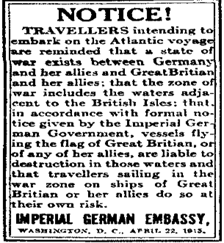
The German Naval Tactic
When the US entered the war, the first priority was to weaken the German “U-boat” blockade of the British Isles. The Germans, who had over 200 submarines, were using unrestricted submarine warfare tactics to sink British vessels. One of every four freighters headed for British ports were sunk by German torpedoes. US naval commanders decided to set up a system of “convoys” based around a large number of merchant ships, protected by warships. It cut shipping losses in half.

Slide 4
The Conclusion of the Great War
One year after the US entry into the Great War (1918), the European continent was being swarmed by US military personnel. Hundreds of thousands of infantrymen began arriving in Europe every month. One million troops were on the continent by the Fall.
August 1918: With the assistance of the US, the Allies were able to open up holes in the German lines. Eventually, German General Paul von Hindenburg had to admit that his nation lost the war. A short time later, German Kaiser Wilhelm was overthrown.
October 1918: The German government asked for an armistice.
November 11, 1918: An armistice went into effect.
January 1919 -- January1920: The Paris Peace Conference (Versailles Conference) was held.

Slide 5
The Winners and Losers of the War
When the world leaders met in Paris to draw up a peace settlement to officially end the Great War, it was not difficult to identify which countries were on the winning side. The members of the Allied Powers—Great Britain, France, Italy, and Japan—along with their allies such as Belgium, Serbia, Portugal, Greece and the United States clearly won the war. However, identifying the losing nations was not as easy. Some nations didn’t exist in 1914 or had completely disappeared by the time the war ended.

Slide 6
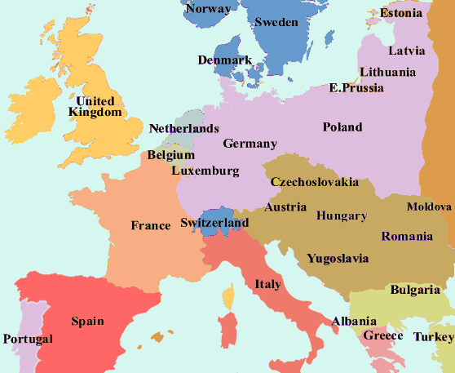
The Participants
Austria- Went into the war as one-half of the dual monarchy of Austria-Hungary under Emperor Franz Josef. When the war was over, Austria was a small German-speaking state with no empire and a new republican government.
Czechs and Slovaks- Went into the war as a constituent part of the dual monarchy of Austria-Hungary. After the war, they came out as a new, independent state, Czechoslovakia that insisted it had nothing to do with the Austrians or the Hungarians and that it shouldn’t be treated as a defeated country.
Germany- Went into the war as an imperial monarchy under the Kaiser Wilhelm. The nation came out of the war as a democratic republic being led by a socialist president, Friedrich Ebert. The Allies had to consider whether or not it was right to punish the republic for the faults of the old regime.

Slide 7
The Participants (cont.)
Hungary- Went into the war as a constituent part of the dual monarchy of Austria-Hungary. Hungary came out of the war as a small central European state with a communist government and no means to defend itself.
Poland- Went into the war as mainly part of Russia, but also part of Austria-Hungary and Germany, so Poles fought on both sides of the war. After the war, Poland was created as a new, independent state that didn’t want to be politically tied to the Germans, Austrians, or Russians and shouldn’t be considered as one of the defeated countries.
Turkey- Went into the war as the Ottoman Empire, covering Turkey, Armenia, and much of the Middle East. When the war was over, Turkey was still being run by an Ottoman sultan but the Ottoman Empire had collapsed.

Slide 8
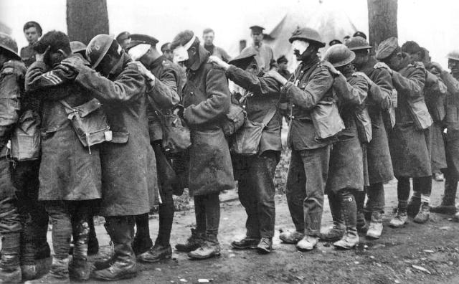
In the end, the Allies decided that there were five defeated countries: Germany, Austria, Hungary, Bulgaria, and Turkey.

Slide 9
The Problems with the Conference
In retrospect, there were some major flaws with the way in which the peace conference was held. For example:
The conference was held in Paris. With emotions still high after the war, it would have served the world best to have the conference at a neutral country and hosted by a neutral chairperson. However, the France was the host nation and they had every intention of using the conference to get revenge for what the Germans had done to their country.
It is said in world politics, when both countries leave the bargaining table and neither country is pleased with the outcome, then it is a fair treaty. However, at the Versailles Conference, the Germans were not even invited to take part in the conference and were not allowed to present their ideas. The Germans were only invited at the last moment to sign the treaty.
Defeated countries should not be humiliated at the negotiation table because it will leave deep, emotional scars. However, at the Versailles Conference, the Allied nations—in particular France and Great Britain—used the signing ceremony as a way to humiliate the German delegates. They were force to sign the agreement, with no chance to testify on behalf of their nation, and had to agree to take full blame for causing the war.

Slide 10
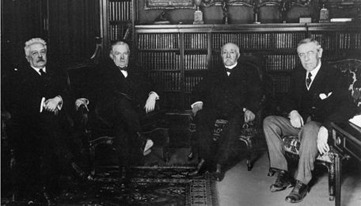
The Big Four
While virtually all participants in the Great War had representatives at the Versailles Conference, the leaders of France, Great Britain and the United States clearly had the most say. They were known as the “Big Four.”

Slide 11
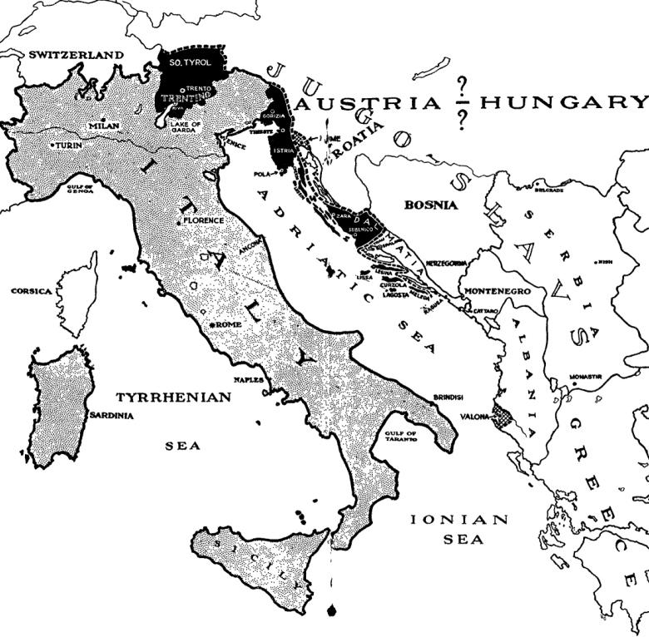
The Italian Demands
Italy was represented by Prime Minister Vittorio Orlando. Orlando demanded that the countries acknowledge the promises made to Italy in the Treaty of London of 1915. This treaty convinced the Italians to join forces with Great Britain and France during World War One.
The Treaty of London promised the Italians: (1) Trieste; (2) Tyrol; (3) the coast of Dalmatia (Croatia); and (4) parts of the Ottoman empire and German colonies. Orlando left the peace conference disappointed.

Slide 12
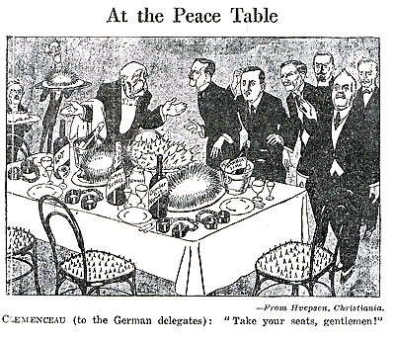
Punish the Germans
France was represented by Prime Minister Georges Clemenceau. He was an old radical who had no respect for rules and/or tradition if they got in the way of what he felt needed to be accomplished. In the back of his mind was the German invasion of France in 1871 and how the Germans humiliated the French. He was determined to crush Germany to the point where they could never pose a threat to France again.

Slide 13
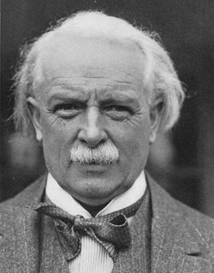
The British Representative
Great Britain was represented by Prime Minister David Lloyd George. Lloyd George was being pushed by the British public sentiment that wanted to punish Germany for the hardships they brought to the British people. Only a very tough peace treaty would stop Germany from ever threatening the peace of Europe and would also satisfy the British public opinion.

Slide 14
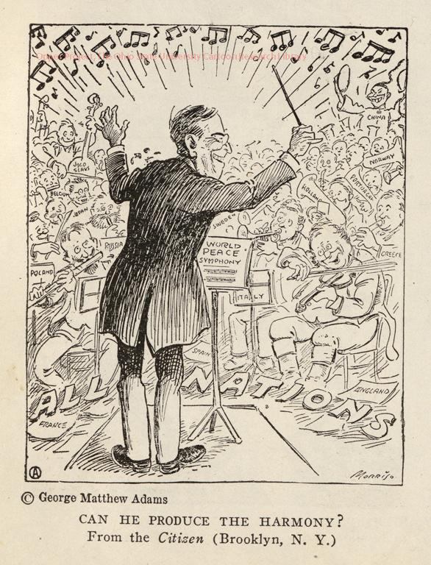
The President of the United States
The United States was represented by President Woodrow Wilson. Wilson believed that he had a good understanding of European politics and history and could create a peace plan that would prevent all future wars. His self-confidence was on display when he refused to invite a single member of the Republican Party to accompany him to Europe. As a result, almost any settlement that he negotiated appeared as one-sided and made it difficult for Congress to approve.
Wilson proposed his “Fourteen Points” at the conference. He believed that if the European nations followed these fourteen proposals, the Great War would really be the “war to end all wars.”

Slide 15
The Fourteen Points
Wilson’s Fourteen Points called for the following:
There can be no more secret agreements to resolve problems.
There must be freedom of the seas.
Removal of all economic barriers.
Militaries were to be reduced to the lowest possible number.
Colonial borders must be resolved.
The Russians should decide their own form of government.

Slide 16
The Fourteen Points (cont.)
The restoration of Belgium.
The evacuation of Alsace-Lorraine.
The adjustment of Italy’s frontier.
The freedom of the people of Austria-Hungary.
The restoration of Romania and Montenegro.
The freedom of the non-Turkish people of the Ottoman Empire.
The creation of an independent Poland which has access to the sea.
A league that offers security through guarantees (League of Nations).

Slide 17
Self-Determination Must be Maintained
The two major ideas behind his Fourteen Points were:
National self-determination—Wilson believed that people of a particular national group should have their own independent nation state. When they had this, all disputes over territory would end.
National self-determination was a good idea when it established countries for the Poles (Poland) and Estonians (Estonia). These people had a large population in Europe but no nation state. However, some other national groups were too small to form a country for. Thus, some groups had to merge with their neighbors to create a nation state, such as the Czechs and the Slovaks (Czechoslovakia). Another problem with self-determination is that France and Great Britain said this would not apply to their colonies in Asia or Africa or Ireland. Also, the Germans and Austrians were not allowed to join together as one state even though they were ethnically German.

Slide 18
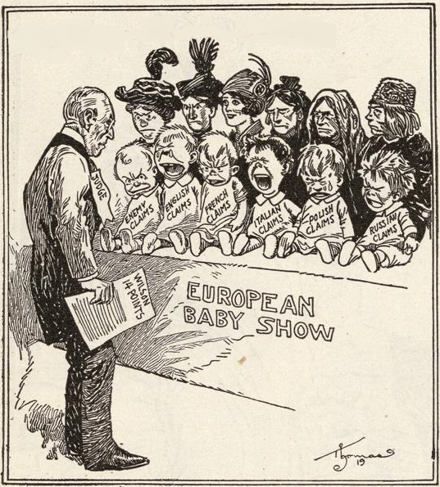

Slide 19
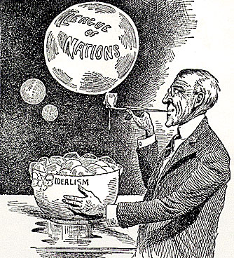
The Creation of a League of Nations
The establishment of a League of Nations—Wilson proposed the creation of an international government that would have the power and authority to stop the nations of the world from going to war with each other.
The League of Nations was intended to include every nation on an equal basis. However, Great Britain and France wouldn’t allow their colonial possessions to sit in the League. Also, the Allies agreed that Germany wouldn’t be allowed to sit in and neither would the Soviet Union.

Slide 20
The War Impacted All
At the Versailles Conference, the Big Three had to handle more issues than simply deciding what to do with Germany. Some of the other issues that they had to settle were:
Africa- Germany had owned large parts of Africa (Cameroon, Togo, South-West Africa). The Big Three had to decide what should happen to these areas now that Germany was defeated.
Central Europe- During the war, Austria-Hungary was led by Franz Josef. At the age of eighteen, he ascended to the head of the Hapsburg throne. For years, he successfully maintained domestic peace within his empire. This was not easy considering that Austria-Hungry was heterogeneous. Majority of the people living within the empire identified themselves as Magyars. The second major ethnic group was the Germans. The third largest group of people was Slavs.

Slide 21
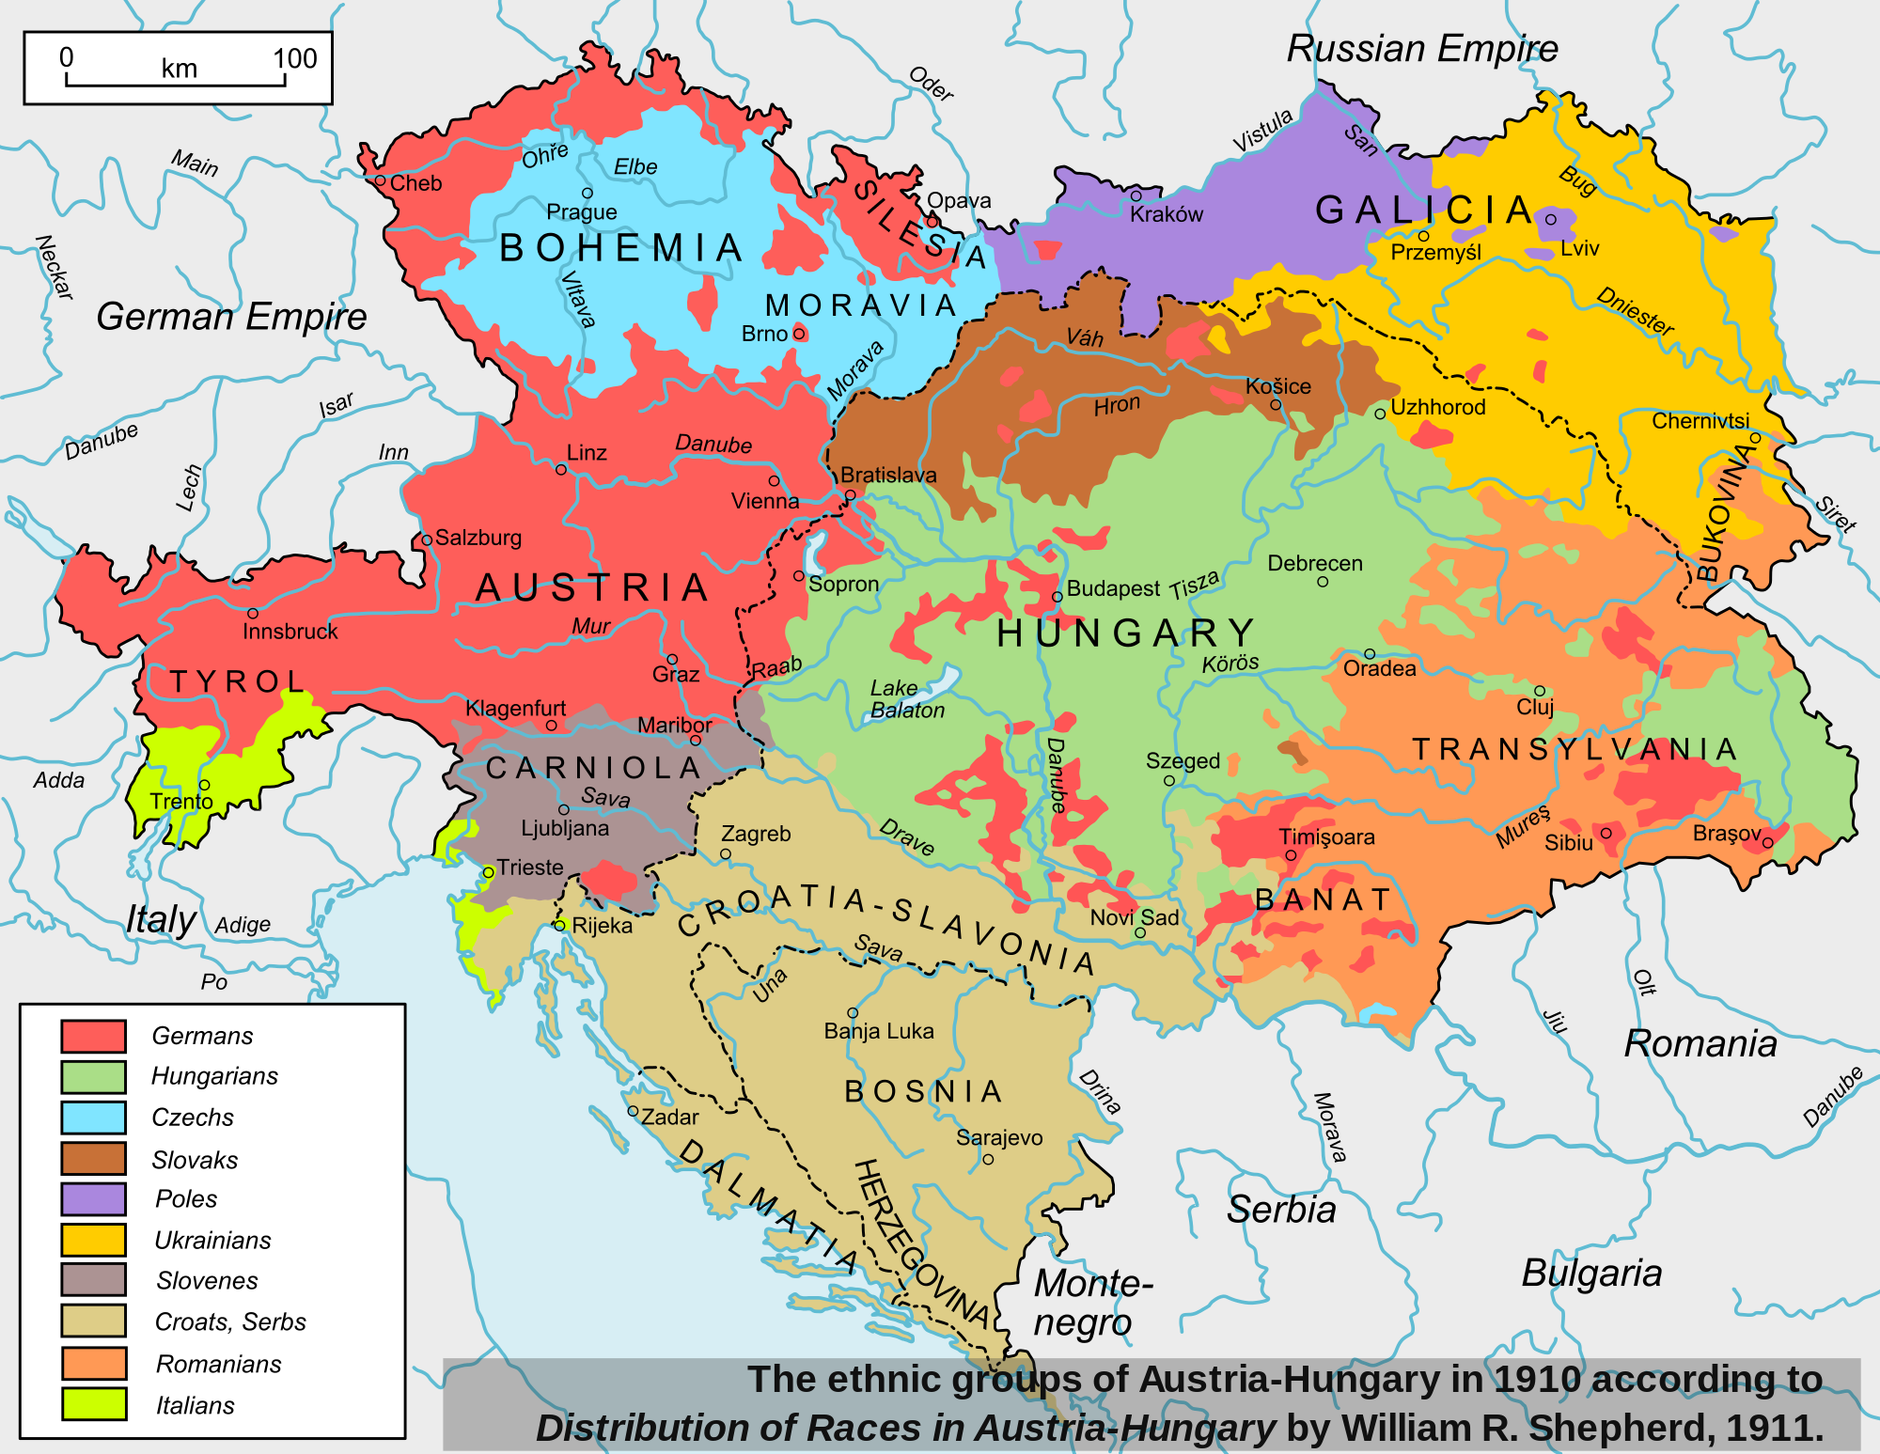

Slide 22
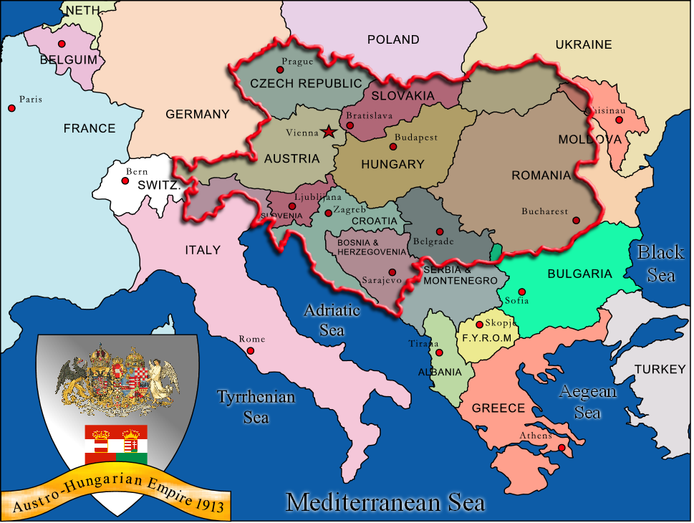
The Collapse of the Österreich
By the end of the war, the Austria-Hungary empire had collapsed. All of the different national groups that were once part of the empire declared their independence. Many of these groups broke into territorial disputes with each other. Deciding where the borders should be drawn had to take into consideration culture and history.

Slide 23
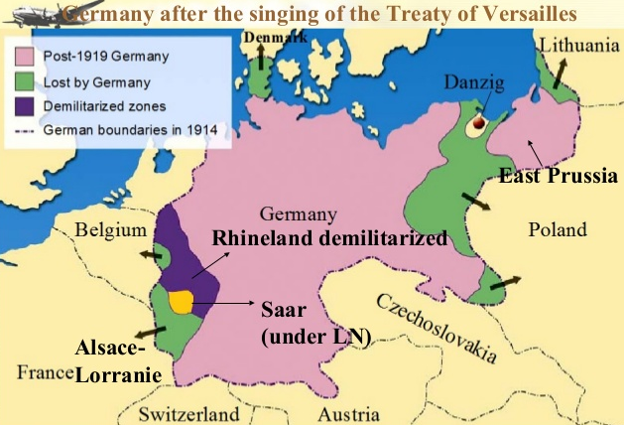
The War Impacted All
China and Japan- Both countries fought on the side of the Allies. However, Japan was much stronger than China and made some important contributions to the war. They wanted land in the Pacific and in China.
France and Belgium- Both countries suffered enormously from the war and wanted compensation. They also claimed lands in Germany that they once controlled. France wanted Alsace and Lorraine back and Belgium wanted the return of Eupen and Malmedy.

Slide 24
The War Impacted All
Hungary- At the end of the Great War, a communist coup took place in Budapest and a provisional government was set up Bela Kun. The Allied leaders sent representatives to meet with Bela Kun to see if he really was in control of the country. They reported back that he wasn’t so the Allies wouldn’t accept a Hungarian delegation at the conference. The result was that Hungary’s neighbors took some of Hungary’s land.
Italy- The Italians were guaranteed lands but Wilson felt that by giving them their promised lands, more problems would be created. Thus, a clash between the US (who entered the war in 1917) and the Europeans who have been fighting since 1914 developed. Tensions escalated to the point where Orlando left the conference (but eventually returned).
Middle East- Sharif Hussein of Mecca was told by the British that he would rule over a huge, independent Arab state. However, the British and French had privately agreed to divide it up between themselves.

Slide 25
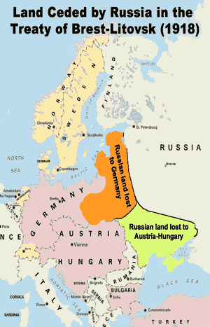
The War Impacted All
Russia- Russia made its own peace with Germany at Brest-Litovsk in March 1918 but the Allies declared the treaty null and void. Russia was now a communist state and was promoting the idea of a world-wide communist revolution. The Allied nations decided not to invite Russia to the peace conference.
Turkey and the Balkans- The war began in the Balkans with the assassination of Archduke Franz Ferdinand. Bulgaria had fought on the German side and its neighboring countries were trying to take lands from Bulgaria. The Allies also had to decide what to do with the collapsed Ottoman Empire and the newly formed country of Turkey.

Slide 26
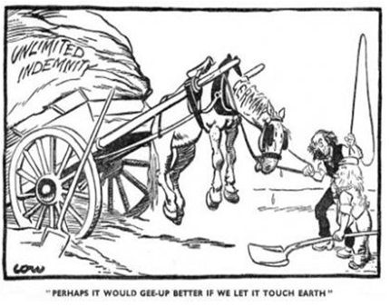
The Steep Payment Plan
Peace treaties often include a heavy fine, known as an indemnity, that a defeated country has to pay. Paying the indemnity means that the defeated nation will use their national savings until the debt is paid off. The country will usually then increase their national tax to make back that money. However, after the Great War, France and Britain insisted on Germany paying reparations because they caused the war.
Paying reparations would mean paying for physically rebuilding French and Belgian factories and railways, as well as paying widow’s pensions and the medical bills of injured soldiers.

Slide 27
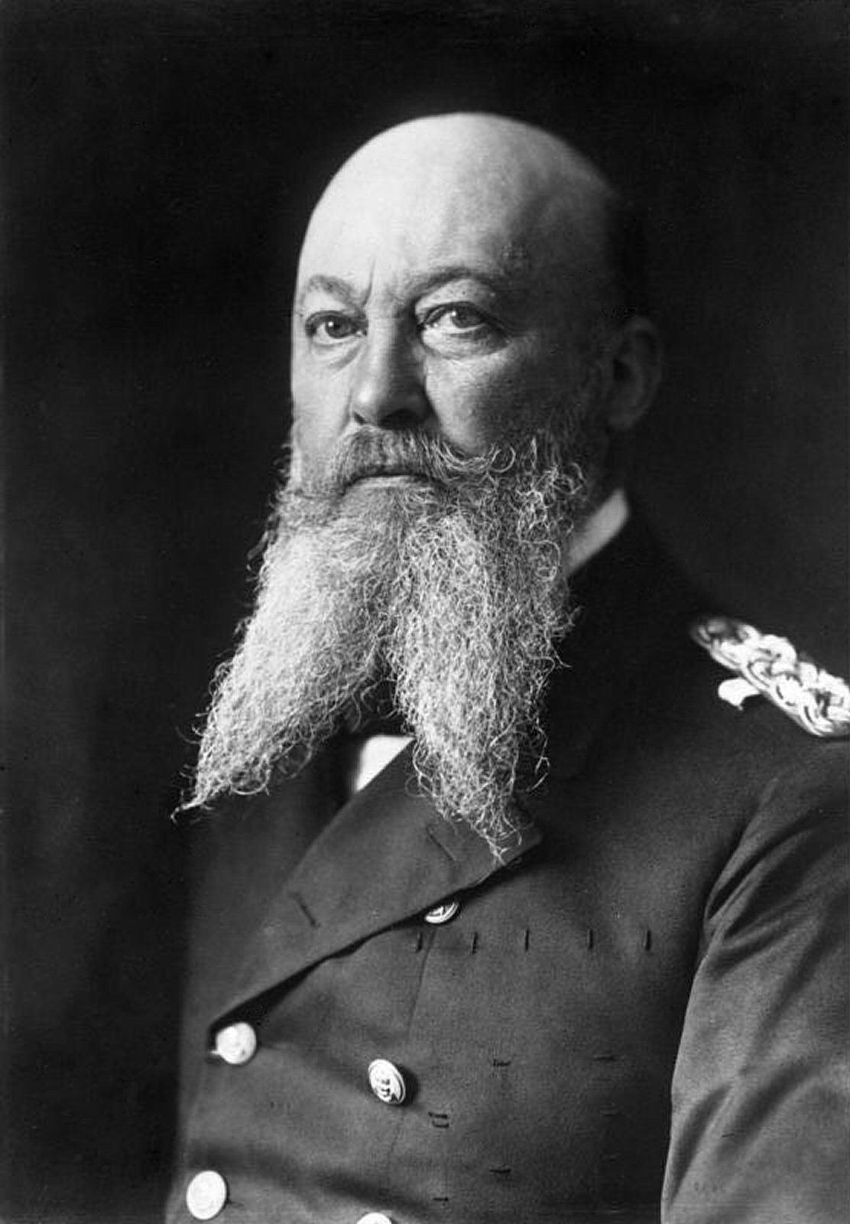
Militarism During the War
One of the main reasons why the Allies blamed Germany for causing the war was that they thought Germany had become an aggressively militaristic state. Prior to and during the war, Germany was being run by Kaiser Wilhelm II. The Kaiser, along with his political advisors, felt it best to concentrate their efforts in building up the strongest army in Europe. This was purely based on their central locality in Europe. Germany had a two-front land threat, that being Russia to the east and France to the west (these two nations were in an alliance). However, the German military growth went beyond the army.
In 1897, Alfred von Tirpitz, the Secretary of State for Germany's Admiralty, forced through Germany's First Navy Law. The law stated that nineteen battleships should be built in the next seven years. The plans for the fleet were increased to even larger proportions in 1900, which included twenty-four battleships by 1920. British experts predicted that by 1906, Germany would have the second-largest navy in the world, and in October of 1902, they went further to say that the German fleet was being built with a view of going to war with Britain.

Slide 28
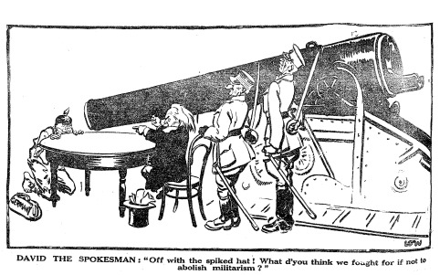
Intentionally Weakening Germany
Thus, the Allied nations needed to not only redraw the map of Europe to keep Germany weak but to also change Germany itself and make the people less militaristic. The way to do this, they thought, was to destroy Germany’s means of waging war. Thus, Germany would be denied having a large army and navy.

Slide 29
Many World War One historians still debate who should be blamed for causing the Great War. There are two general theories behind this debate:
Sidney Fay
Fritz Fischer
One theory places principal responsibility on the conditions that exacerbated international conflicts in those years. It focuses on the aggressive colonial conquests worsening relations among the nations, to the nationalist hostilities dividing the people of Europe, to the arms race, to the failure of alliances. Thus, this theory argues that no one state is to be blamed for causing the war.
The second theory concentrates specifically on the expansionist plans of Germany and the dangerous German-Austrian decision in 1914 to destroy Serbia. Supporters of this argument also focus on the “blank check theory” as a justification for war.

Slide 30
The Demands Put on Germany
With no chance to defend their actions at the Versailles Conference, the German delegates were forced to agree to the following:
They had to accept responsibility for starting the war. Known as “Article 231: War Guilt Clause,” Germany was now responsible for paying reparations.
Germany agreed to pay reparations in cash with no total sum agreed upon and no set end-date.
Germany agreed to give up lands including: Alsace-Lorraine (France), Eupen and Malmedy (Belgium), Northern Schleswig (Denmark), and West Prussia and the port of Danzig (Poland). Also called the Polish Corridor, the port of Danzig was 60% German speaking.
Germany agreed not to unite with Austria to create a large German state.

Slide 31
More Demands on Germany
Germany agreed to hand over all its overseas colonies to the Allies.
Germany was only allowed to have an army of 100,000 men.
Germany wasn’t allowed to have any tanks, submarines, large battleships or any military air force. In addition, all factories intended to make armaments had to be shutdown.
Germany wasn’t allowed to station any troops in the Rhineland, the area along the French border. It is said that the area was “demilitarized.”
The Saarland, an industrial region along the French border, was to be governed by France for 15 years. After 15 years the people would vote on their political future.
Germany wasn’t allowed to join the League of Nations.

Slide 32
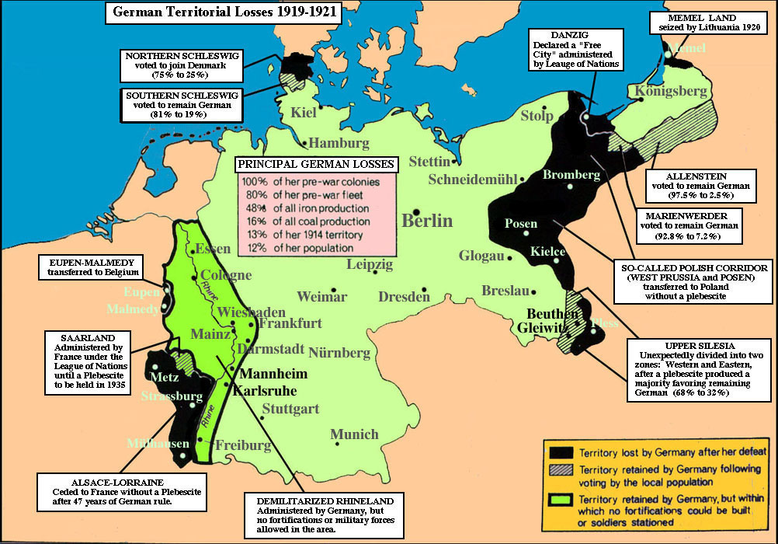
Due to the harshness of the treaty, the Germans called the Treaty of Versailles a diktat (a dictated peace).

Slide 33
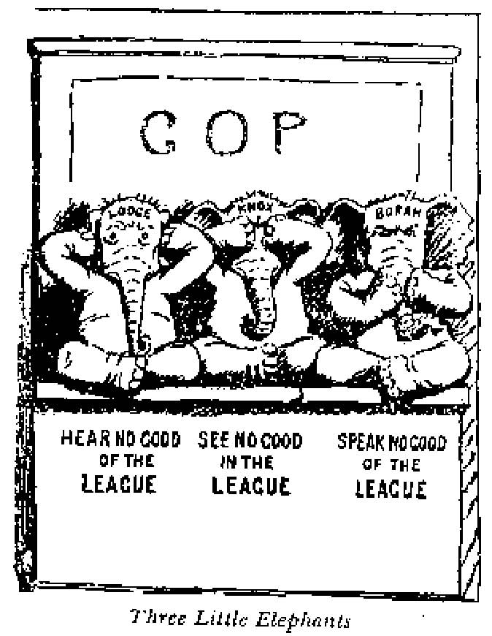
The Senate’s Reaction
Before the United States could accept the Treaty of Versailles and join the League of Nations, the US Senate had to agree to it. Unfortunately for President Wilson, the Republicans had a majority of the seats in the Senate and many were insulted by Wilson’s lack of incorporating the Republicans in the peace conference. Many Americans were also leery about the League of Nations, feeling that it would pull the United States into more foreign conflicts. The general sentiment was a desire to return to an isolationist period. In the end, the Senate rejected the treaty, which meant the US would not join the League of Nations.

Slide 34
How the League Was Organized
When a country signed the Treaty of Versailles, they agreed to join the League of Nations. The League of Nations, based on collective security, had two main components. They were an:
Assembly- every member state was represented equally
Council- only the Great Powers (England, France, Italy, and Japan) were in this committee
The League could impose economic sanctions on any troublesome country and could take military action if needed. But, members had to agree unanimously on these decisions and no country was required to provide troops to the League.

Slide 35
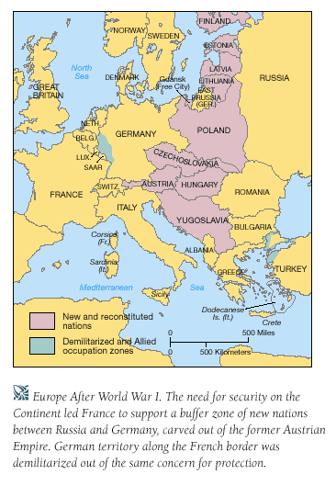
The New Map of Europe
Due to the falling apart of major empires and the desire to fulfill Wilson’s idea of self-determination, seven new countries were formed in Europe called the “successor states.” They were all in Eastern Europe:
Finland
Estonia
Latvia
Lithuania
Poland
Czechoslovakia
Yugoslavia

Slide 36
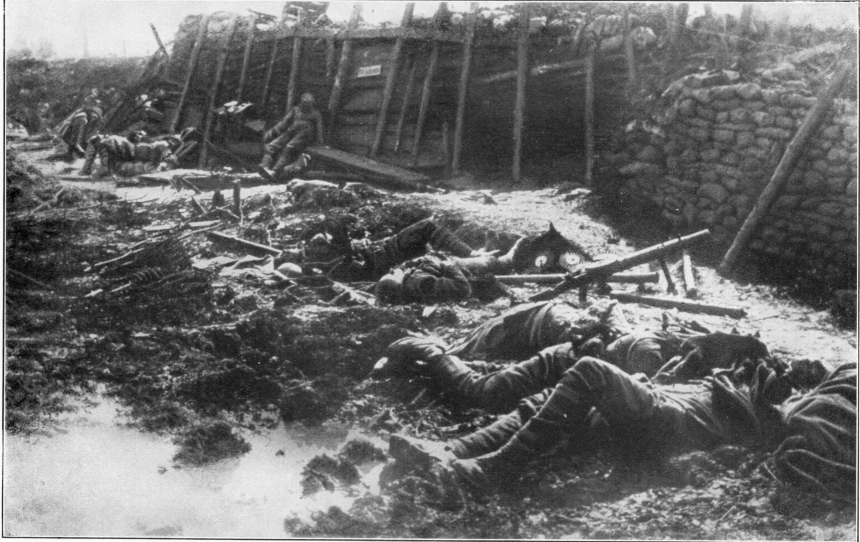
Major Results of the Great War
The results of World War I shaped European and world history for the next generation and beyond. Some of the more drastic results were:
The Number of Casualties: It was the deadliest war ever fought up to that point. Over 10 million people were killed. Almost all were soldiers.
Russia lost over 4.5 million people.
France lost over 1.5 million men. This would end up being disastrous for France. The government drafted men at the age of 20 which meant that most of them weren’t married or had no children. The years following the war would be known as the “Hollow Years” in France.
England lost over 1 million men. The problem for England was that she lost too many officers.

Slide 37
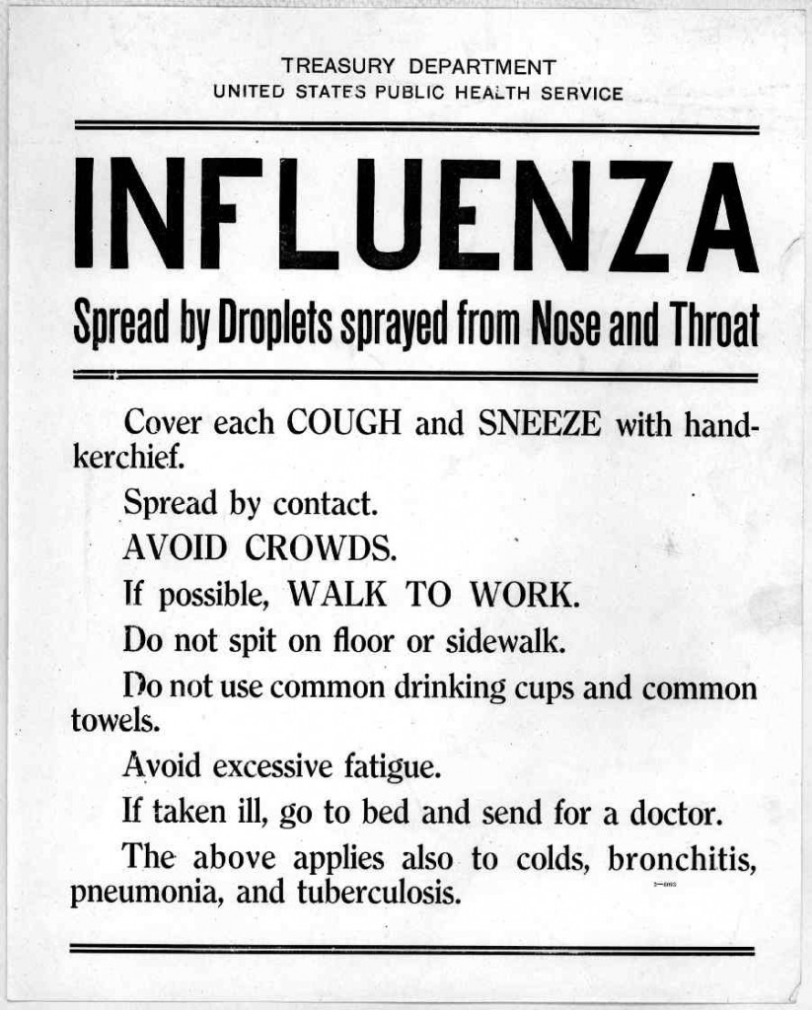
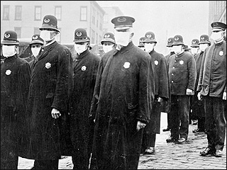
A Worldwide Epidemic
While not directly associated with combat fatalities, a large number of people died by the Spanish Influenza which broke out in 1918. Because of the constant movement of troops and low immune systems, this pandemic spread rapidly throughout Europe and much of the world. Some estimates claim that over 100 million people died within a one-year span (1918-1919) because of the Spanish Influenza. This would amount to approximately 5% of the world’s total population.

Slide 38
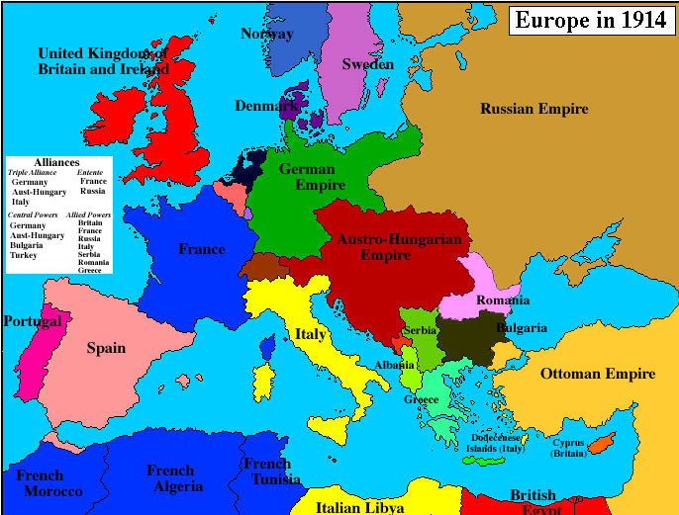
The European Map Changes
Four Empires Were Destroyed: The German Empire, Russian Empire, Austrian-Hungarian Empire, and the Ottoman Empire were dismembered.

Slide 39
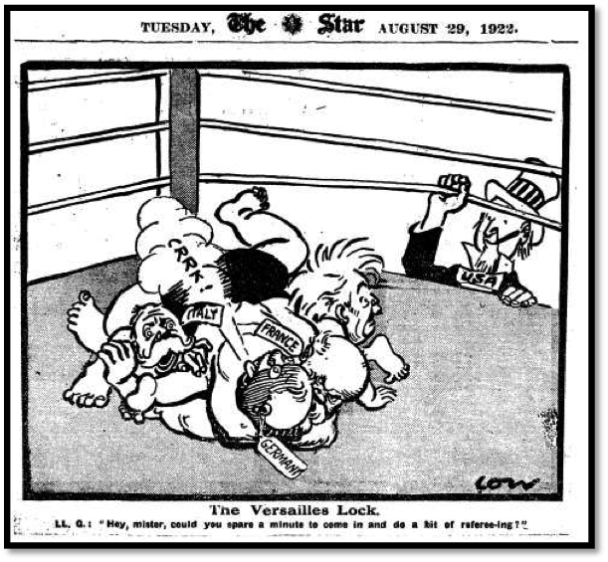
Down But Not Out
The Seeds Are Laid for Another War: By leaving the Germans bitter after World War I led directly to World War II.

Slide 40
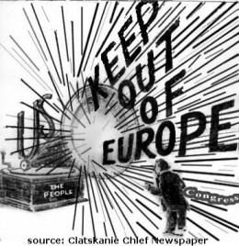
The Big Winner
A New Superpower: World War I created a new superpower, that being the United States. However, from 1919 to 1941, the United States fell into a period of isolation.

Slide 41
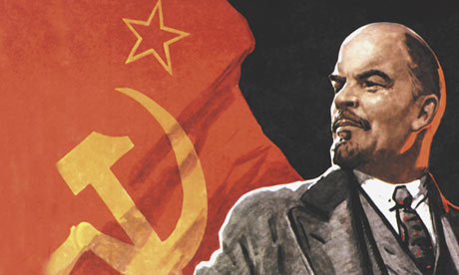
The Birth of Communism
A Red Nation: The single most important result of WWI was the establishment of communism in Russia. Within two decades, fascism arises. After WWII, when fascism is defeated, the Cold War occurs.

