Slide 1
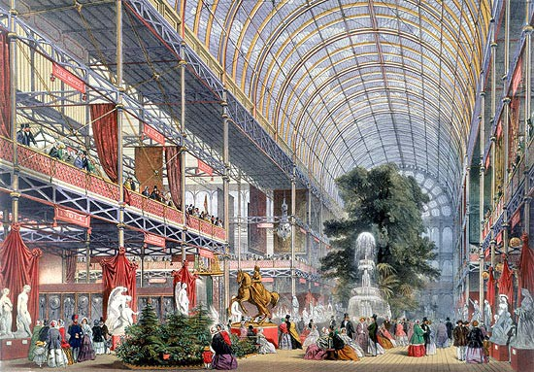
Victorian England 1832-1901
Great Exhibition Hall 1851 represents 19th century progress!

Slide 2
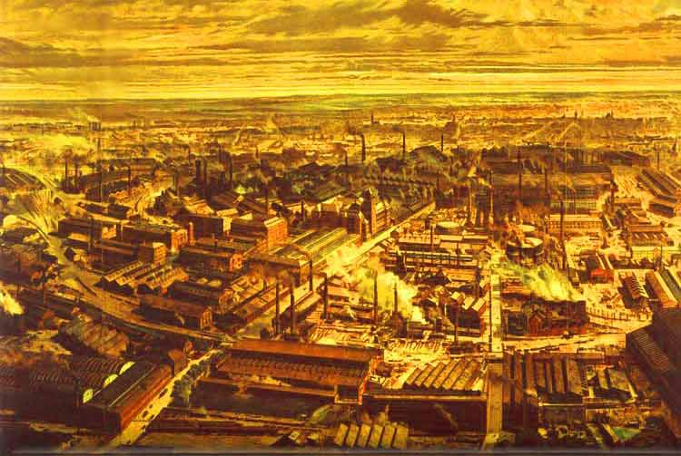
This view of 19th century London shows the darker side of progress, the Industrial Revolution at its height.

Slide 3
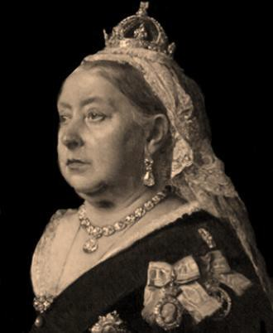
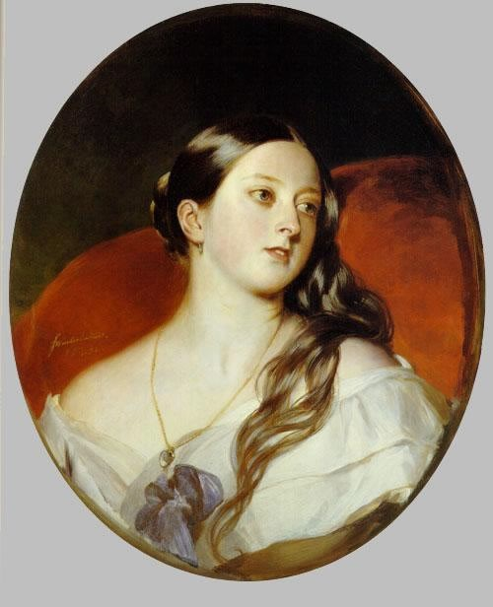
Queen Victoria as a young girl and as queen. Her reign lasted over 63 years, the longest of any British monarch. Like Elizabeth I, she gave her name to this period of British history and literature.
Queen Victoria took the crown at 18.

Slide 4
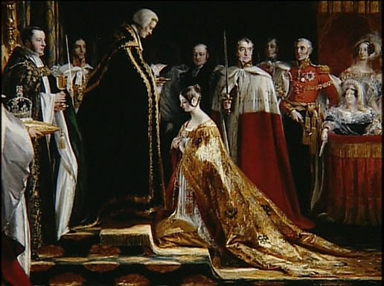
Queen Victoria
She was a popular queen, the first to take residence in Buckingham Palace. She spoke English, French, German, Italian, and Hindustani.
She became queen when the monarchy was unpopular with the people, but she won them over with her modesty, practicality, personality, and style.

Slide 5
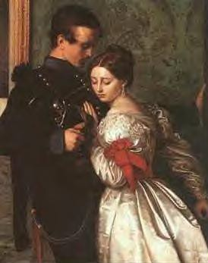
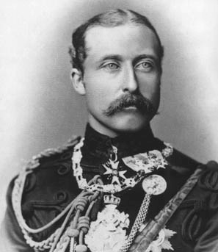
Victoria met Prince Albert, a cousin who was a minor German Prince, when she was 16. Four years later at age 20 and already queen, she fell in love with him and married. Some believe he married her only to gain social status; however, their marriage was a happy one. They parented 9 children. He died in 1861 and from that time on she dressed only in black. For the next 40 years until her death, she ordered that a fresh suite of clothing be laid out for him daily.
She started the tradition of a bride wearing white at her wedding.
Marriage

Slide 6
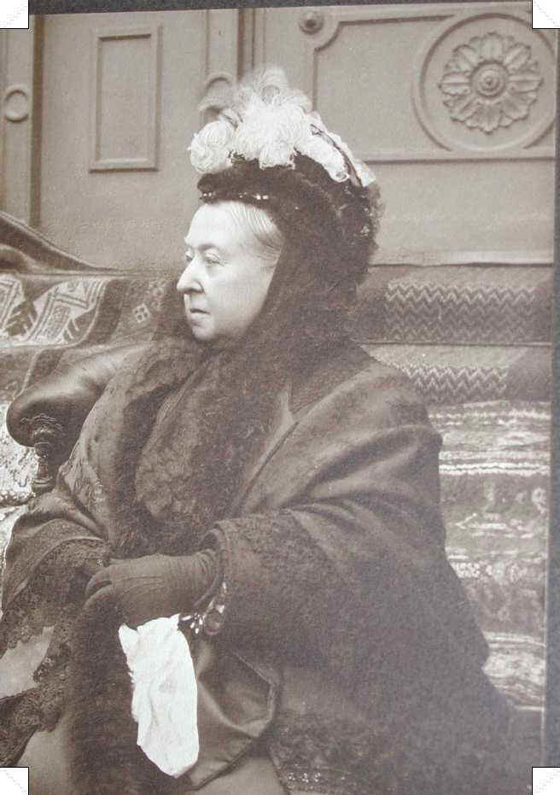
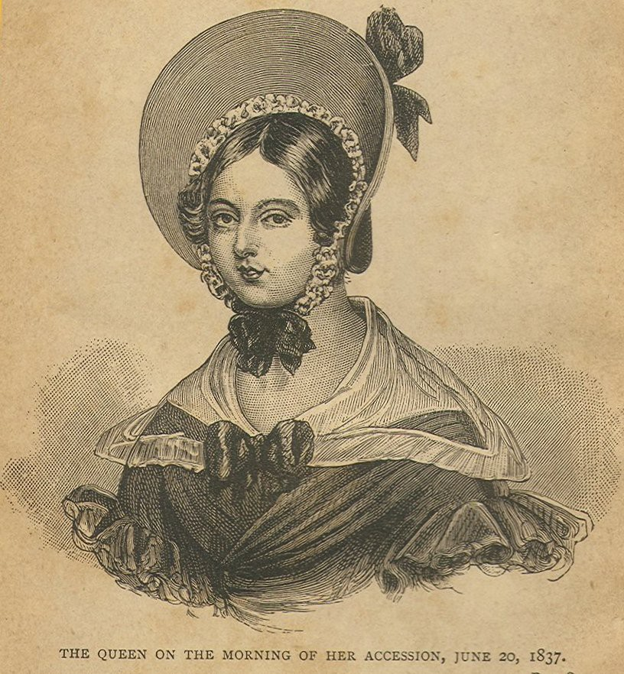
Queen Victoria at 20 and as a widow.
The Queen on the morning or her coronation. After Albert’s death she wore widow’s black and a widow’s bonnet in public, never a crown.

Slide 7
The Victorian era (1830-1900)
Positives
Negatives
Queen Victoria turned England into world’s leading military/economic power
Period of intense change:
Railroads
Postal system
Improvements in medicine, sanitation
Gov’t-supported schools
Political reforms (more could vote)
Increase in industry
Decrease in dependence on agriculture
Increase in city populations
Changes to traditional British society were disturbing and frightening:
*Increased urban poverty
*Challenge to British
Empire’s power through
foreign wars
*Workers fighting for power
*Women entering work force

Slide 8
The World of J&H
Britain in 1880s: social, economic, spiritual changes
Jekyll and Hyde represents
1. “Natural man”: free of civilizing influences of society and religion
2. Darwinism
3. Freud’s studies in psychoanalysis
4. Symbolic representation of the threats of innovations in economics, science, workings of the mind

Slide 9
Historical/Cultural Context
Calvanism - strict form of Protestant religion founded by Swiss reformer John Calvin 16th century-associated with moral restraint and demanded austerity and a grim respectability we have come to associate with Victorian times
Predestination-the Elect were certain people-known only to God-who would be granted entry to Heaven

Slide 10
Historical/Cultural Context
Appearance is an important feature of the story-the façade which conceals the reality is often important in this work of prose – note how the appearance of buildings often reflects the nature of the inhabitants
The story is a psychological exploration of evil and forces the reader to examine the nature of morality through its conflicting characters Jekyll and Hyde who are, as we know, representations of different moral extremes within the same man.

Slide 11
Victorian Social Classes
Victorian society was highly stratified. Social classes did not mix, and behavior, especially among members of the upper class, was expected to be exemplary at all times.
The unrealistically rigid morality of upper class Londoners led many to live double lives.

Slide 12
Breakdown of Victorian Society
At the end of the 1800s, Britain was experiencing a period of intense social, economic, and spiritual change, after many decades of confident growth and national self-fulfillment.
Population doubled creating a demand for housing, food and clothing. Irish potato famine created a flood of new immigrants.
Dr Jekyll and Mr Hyde perfectly captured some readers’ fears that their carefully built society was hypocritical.

Slide 13
Breakdown of Victorian Society
“The sun never sets on the British Empire.” England was a imperial nation gaining control of countries around the world. During Victoria’s reign, 25% of the world’s population, was part of the British Empire.
Imperialism: policy of extending a nation’s authority be acquiring territory or by dominating their politics and economy.
Hegemony: dominating over groups with or without the threat of force.

Slide 14

British Empire during Victoria’s reign, controlled one quarter of the world’s population, about 458 million people. It covered 14.2 million square miles, about a quarter of Earth’s total land area.
This is the reason why the English language was at one time the language of business, law, and government.

Slide 15
Victorian Society
Social conventions for WOMEN remain similar to those of the Bennet sisters. Women were to marry and provide homes. A working class woman, if married, could be a servant and if unmarried, a teacher or governess. Many women did not marry simply because there were not enough men. This led to the creation of the phrase “redundant women.”
Legal changes were to their advantage. Although they still could not vote, WOMEN had the right to retain their own property after marriage, to sue for divorce, and to fight for the custody of their children in a separation.

Slide 16
Victorian literature expresses a world of ideas in a culture comfortable enough with itself to ponder and debate these.
Comfortable:
    100 years of peace 1815 (Napoleon, Waterloo) to 1914 (WWI)
    Industrial Revolution expanded the middle class
    By 1860’s all men except agricultural workers had the right to vote
    1860-1900 literacy rate went from 40% to 90% (marriage certificates)
    Obsessed with being gentile, decorous amounted to prudery

Slide 17
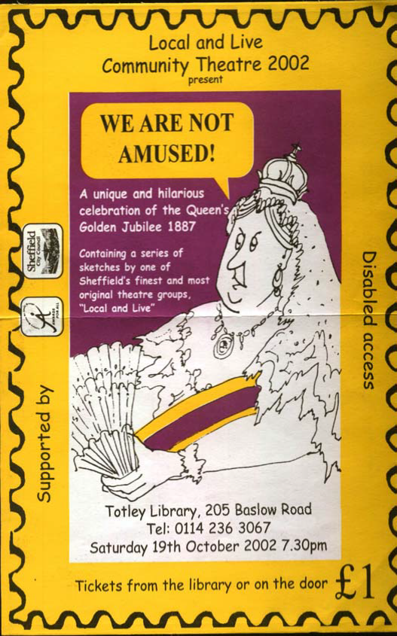
A young women of personality and charm, Queen Victoria was influenced by the prudery of the time. Some say the queen often used the expression “We are not amused” whenever a conversation “took a ribald turn”.
Language in particular reflected the uptight prudishness of the era. Since it would be improper to refer to body parts, a family at the dinner table would be embarrassed to ask for a thigh or a breast from a plate of chicken, so they used the euphemistic dark and white meat.

Slide 18
Victorian Poets
Wordsworth said the “A poet is a man speaking to other men.” Poetry was an individual experience and spoke of that experience.
Robert Shelley, a Victorian, expanded the role of the poet when he said “Poets are the acknowledged legislators of the world.” Poetry confirmed what the Victorians valued or pointed out problems in their society. Their poetry often related to society’s problems or misdirection.

Slide 19
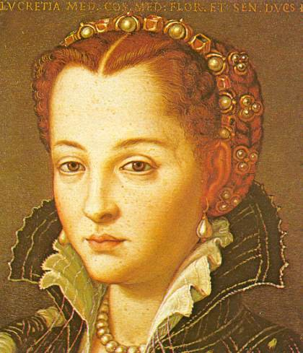
Victorian Social Consciousness
These poets questioned the cost of exploiting the earth and human beings to achieve comfort for the few. They protested or made fun of the codes of decorum or manners as well as authority.

Slide 20
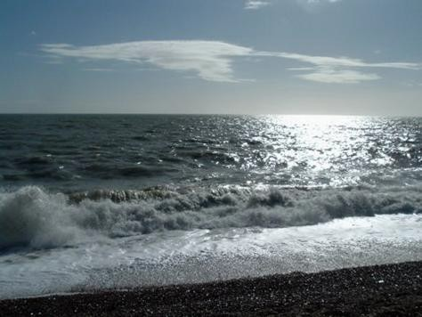
The attitudes of the poets toward their world will change as we read.
The beginning of the era is similar to the Romantics. The world was orderly and nature’s beauty was a reflection of God’s plan and goodness.
Alfred Lord Tennyson represents this beginning. His poetry “assures readers. . .that everything was part of a benevolent plan in which eventually all losses will be made right.” He saw God in his world. He also looks to the past to the lives of several mythical characters to find ideals of human behavior.

Slide 21
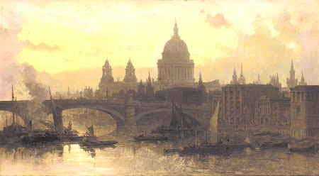
The Victorian created the concept of smog, called “the storm cloud of the 19th century.” John Ruskin describes “. . .the sky is covered with greasy cloud; now raincloud, but a dry black veil, which not ring or sunshine can pierce; partly diffused in feeble mist, enough to make distant objects unintelligible, yet without any substance, or wreathing, or color of its own. . . . It looks partly as if it were made of poisonous smoke. . . . But mere smoke would not blow to and fro in that wild way. It looks more to me as if it were made of dead man’s souls.”

Slide 22

By the middle of the 19th century, other writers seemed less certain about a spiritual or divine presence in the world. Matthew Arnold writes that “the sea of faith had ebbed. There was no certainty or if there was, what was certain was that existence was not governed by a benevolent intelligence that cared for its creatures.”
Thomas Hardy’s “The Darkling Thrush” is the grimmest of these questioning poems. It was written on January 31st 1899 and marked the close or death of the 19th century.

Slide 23
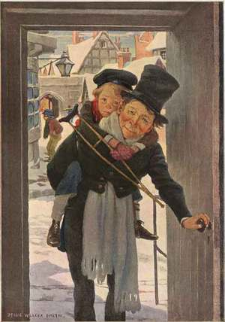
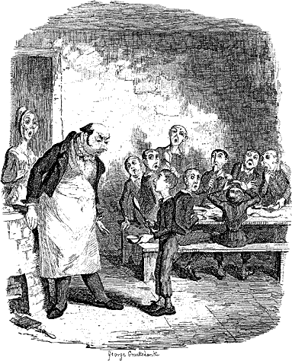
Victorian Social Consciousness
Victorian authors continued to reflect their social concerns in their writing. In his novels, Charles Dickens attacked the hollowness, glitter, superficiality as well as the poverty and cruel conditions of those like Tiny Tim and the orphan Oliver Twist.
“Many of Dickens's most memorable scenes showed decent people neglected, abused, and exploited.”

Slide 24
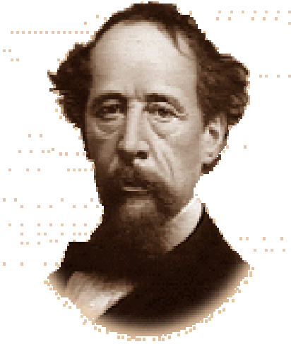
Dickens’s last novel, Our Mutual Friend, features a family called the Veneerings. “ They are ‘bran-new people in a bran- new house in a bran-new quarter of London.”
Veneer is a thin surface layer, as of finely grained wood, glued to a base of inferior material. Cherry, ebony walnut veneers are used in making furniture often instead of solid wood; therefore the craftsman conceals, something common or inferior, with a deceptively attractive outward show. So what sort of people do you suppose the Veneerings were?

Slide 25
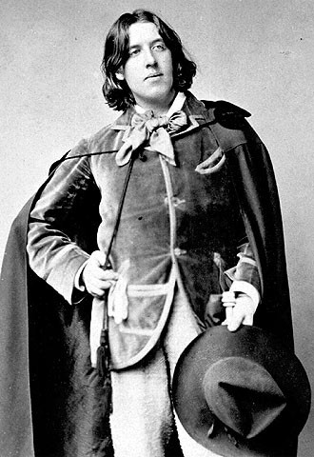
Victorian Drama
Oscar Wilde was the Victorian playwright who, like Dickens, poked fun at those who were socially pushy or insincere. He makes delicious fun of the idle, often phony upper class in his play, The Importance of Being Earnest. This play is called a comedy of manners.
If you enjoy watching Boston Legal, you are watching a contemporary comedy of manners.

Slide 26
All in all, Victorian literature is about change and a culture’s reaction to change.
The telegraph, telephone, photography (Victoria was the first royal to have her portrait “taken” rather than “painted”) the advent of the automobile and electric lighting changed not only the way people lived, but their view of the world in which they lived.
Darwin unsettled the world by offering another view of creation while Nightingale, who founded the first modern nursing school, gave women a role model.

Slide 27
Information from…
Text quotes taken from:
Elements of Literature: Literature of Great Britain. Holt, Rinehart and Winston, Inc.: Austin, Texas, 1993.
Images from: www.boostyourenglish.net/…/queen_victoria.htm www.google.com/images
mysite.cherokee.k12.ga.us
5b1.wikispaces.com/file/view/Jekyll+and+Hyde+powerpoint.ppt
www.docstoc.com/docs/82461938/Dr-Jekyll-and-Hyde-Intro-PPT

