Slide 1
Chapter 12 - SERVICES
IS WALMART GOOD FOR AMERICA?
http://www.pbs.org/wgbh/pages/frontline/shows/walmart/view/

Slide 2
HOW BIG IS WALMART?
1. Americans spend $36,000,000 at Wal-Mart every hour of every day.
2. This works out to $20,928 profit every minute!
3. Wal-Mart will sell more from January 1 to St. Patrick’s Day (March 17th) than Target sells all year.
4. Wal-Mart is bigger than Home Depot + Kroger + Target + Sears + Costco + K-Mart combined.
5. Wal-Mart employs 1.6 million people and is the largest private employer.
6. Wal-Mart is the largest company in the history of the World.
8. During this same period, 31 Supermarket chains sought bankruptcy.
9. Wal-Mart now sells more food than any other store in the world.
10. Wal-Mart has approximately 3,900 stores in the USA of which 1,906 are Super Centers; this is 1,000 more than it had 5 years ago.
11. Each year, approximately 7.2 billion different purchasing experiences will occur at Wal- Mart store. (Earth's population is approximately 6.5 billion.)
12. 90% of all Americans live within 15 miles of a Wal-Mart

Slide 3
As you walk in, please answer the following questions.
Ice Cream Stand Principle
If you were at the beach and there were a number of ice cream stands, which one would you buy your ice cream from and why?
Hotelling’s model (locational interdependence) the location of industries can't be understood without reference to the location of other industries of like kind.
ex: two similar vendors would locate next to each other in the middle of a market area to maximize profit

Slide 4
Services
Provide a human need/desire and get money for it
Tertiary
Quaternary
Quinary
Types of services
  Consumer services – provide services to individual consumers who desire them and can afford to pay for them
  Business services – facilitate activities of other businesses
  Public services - provide security and protection for citizens and businesses

Slide 5
Services Defined
A service is any activity that fulfills a human want or need and returns money to those who provide it.
A settlement is a permanent collection of buildings, where people reside, work, and obtain services.
They occupy a very small percentage of Earth’s surface, substantially less than 1 percent, but settlements are home to nearly all humans, because few people live in isolation.
In sorting out where services are distributed in space, geographers see a close link between services and settlements, because services are located in settlements.

Slide 6
Services and Location
The optimal location of industry, described in Chapter 11, requires balancing a number of site and situation factors; but the optimal location for a service is simply near its customers.
On the other hand, locating a service calls for far more precise geographic skills than locating a factory.
The optimal location for a service may be a very specific place, such as a street corner.
Within more developed countries, larger cities offer a larger scale of services than do small towns, because more customers reside there.
As they do for other economic and cultural features, geographers observe trends toward both globalization and local diversity in the distribution of services.

Slide 7
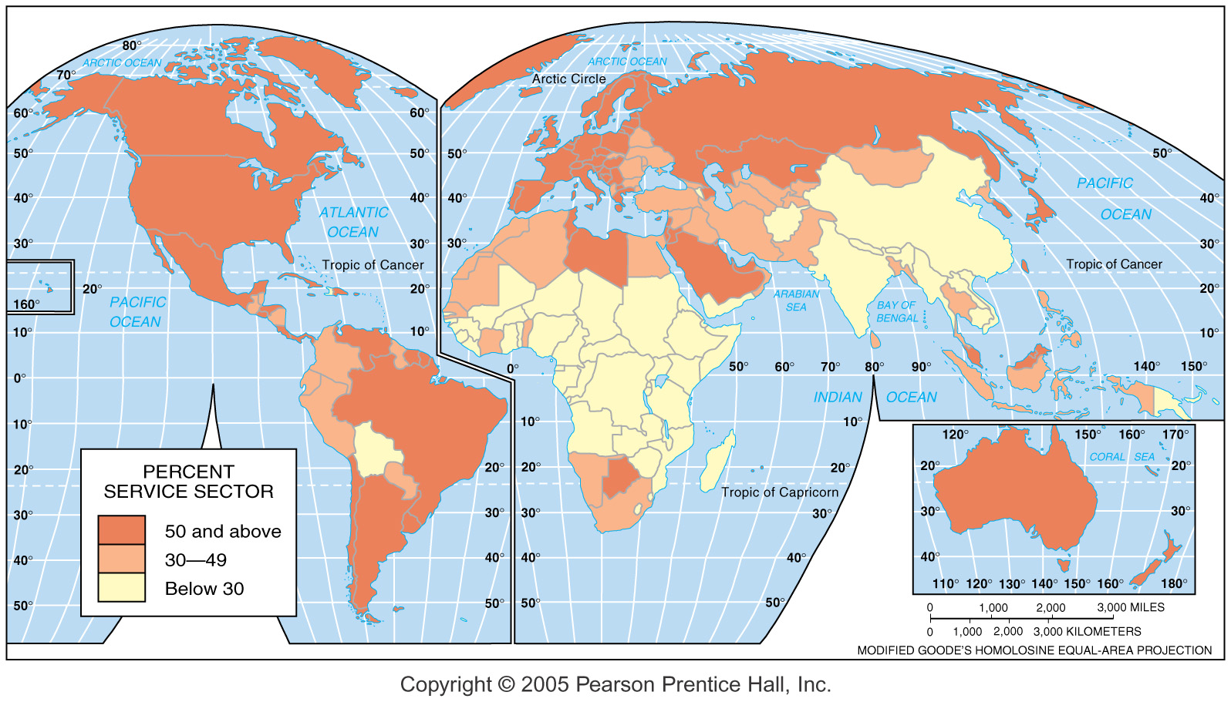
Service Sector Employment
Fig. 12-1: Over half of workers are employed in the service sector in most MDCs, while a much smaller percentage are in the service sector in most LDCs.

Slide 8
Consumer Services
Retail and wholesale 14% of all US jobs – department stores, grocers, motor vehicle sales, and wholesalers that provide to retailers
Health and social – 14% of all US jobs – hospitals, health care services such as doctors offices and nursing homes
Leisure and hospitality services – 9% of US jobs – restaurants, bars, lodging
Education services – 15% of all US jobs
About one-half of all jobs in the United States are in consumer services.

Slide 9
Business Services
Another one-fourth of all jobs in the United States are in business services.
  Professional services – law, management, architecture, engineering, design, consulting, clerical, secretarial, and custodial work
  Financial services – FIRE – finance, investment, real estate
  Transportation and information services – trucking, warehousing, publishing, broadcasting, water and electric utilities

Slide 10
Public Services
In the United States about 10 percent of all workers are in public services.

Slide 11
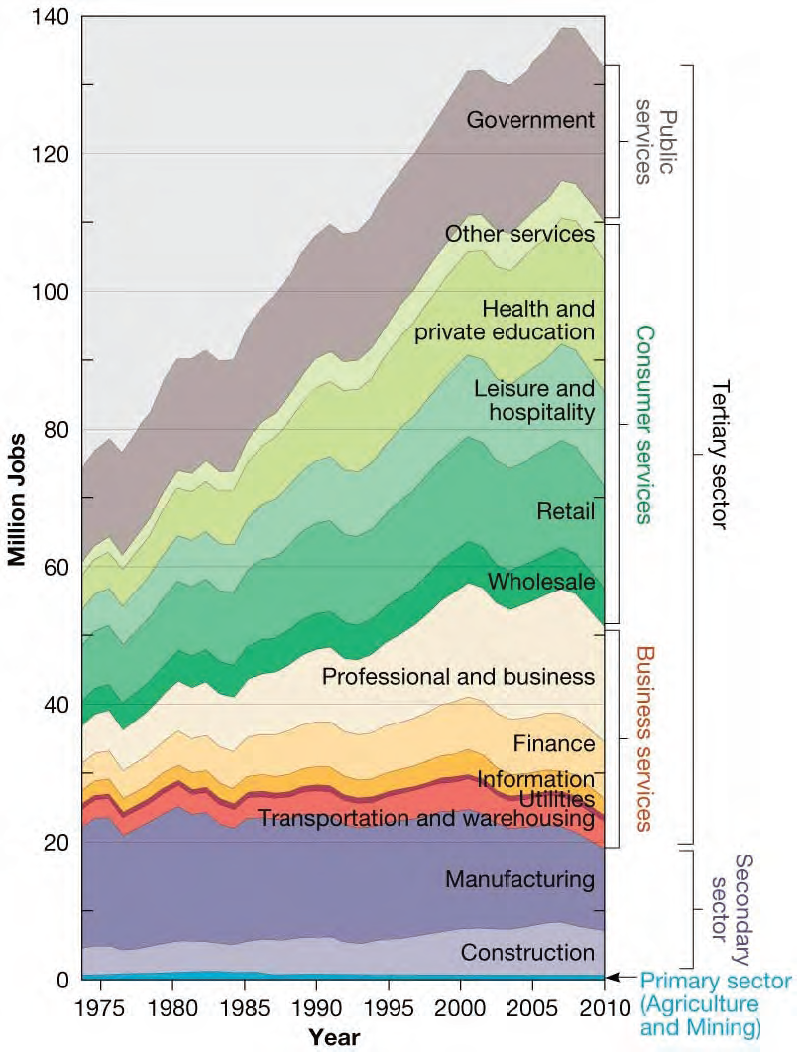
Employment Change in U.S.
Between 1972 and 2010 all of the growth in employment in the United States has been in services.
Fig 12-6: Growth in employment in the U.S. since 1972 has been entirely in the tertiary sector, with the greatest increase in professional services.

Slide 12
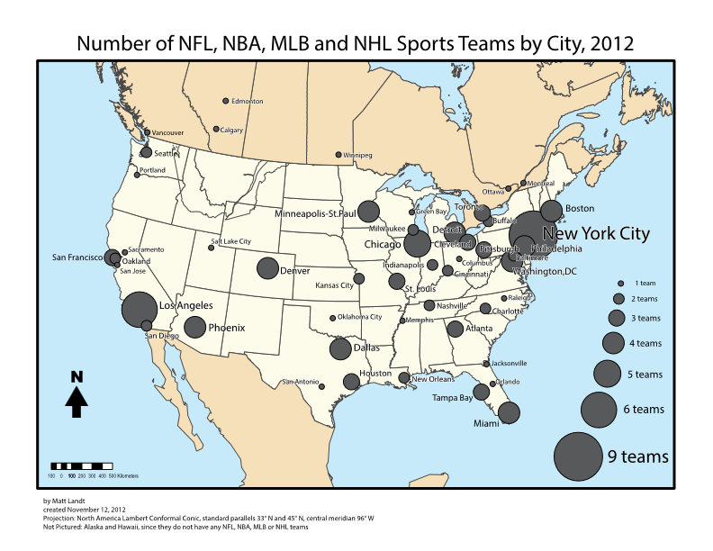
Basic Questions on Central Place Theory
Why are almost all medical specialists found in large cities?
Why are almost all professional sports teams located in large cities?
Why can there be three Dunkin Donuts within a 3 mile radius or 3 TD Banks within three miles of Commack High School?

Slide 13
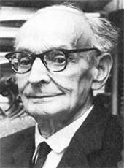
Walter Christaller
Die Zentralen Orte in Suddeutschland
Central Places in Southern Germany
Originally published in 1933, translated into English in 1966
Notes:
Born 1893, died 1969. This was Christaller’s doctoral dissertation in geography. The book that had the greatest impact on American geography with respect to central place theory: Brian J. L. Berry, Geography of Market Centers and Retail Distribution, Englewood Cliffs, N.J.: Prentice Hall, 1967.

Slide 14
FIVE ASSUMPTIONS OF THE CENTRAL PLACE THEORY
The surface of the ideal region would be flat and have no physical barriers
Soil fertility would be universal
Population, purchasing power evenly distributed
Uniform transport network that permitted direct travel from each settlement to the other
Constant maximum distance or range for the sale of any good or service produced in a town prevailed in all directions from the town center

Slide 15
Central Place Theory: Christaller
Terminology
  Central Place – market center where goods/services are exchanged w/ surrounding customers
    Cities/towns usually serve this function
    Area serviced = market area/hinterland (nodal region)
  Range = distance people willing to travel for something
    (Groceries v. medical care)
    (TIME! Not distance)
  Threshold = minimum # of people (customers) needed to sustain a business (viable)
    Kroger needs 30,000
  Breaking Point = line where customers will choose to go to another business for a service/good
  Low vs High Order Goods

Slide 16
Central Place Theory
Central Place Theory attempts to explain the pattern of settlements & Urban Hierarchy =
  Hamlet
  Village
  Town
  City
  Mega city
  World city
Cities are economic hubs because diverse services & goods are not available in smaller settlements

Slide 17
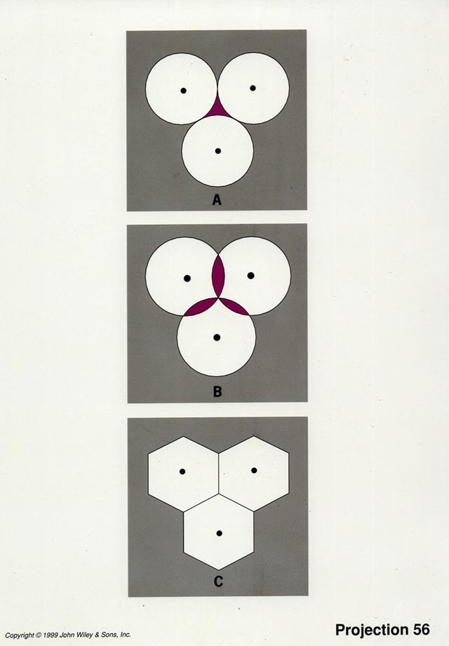
What shape should hamlet’s, village’s, town’s, etc. economic reach or hinterland be?
Why?

Slide 18
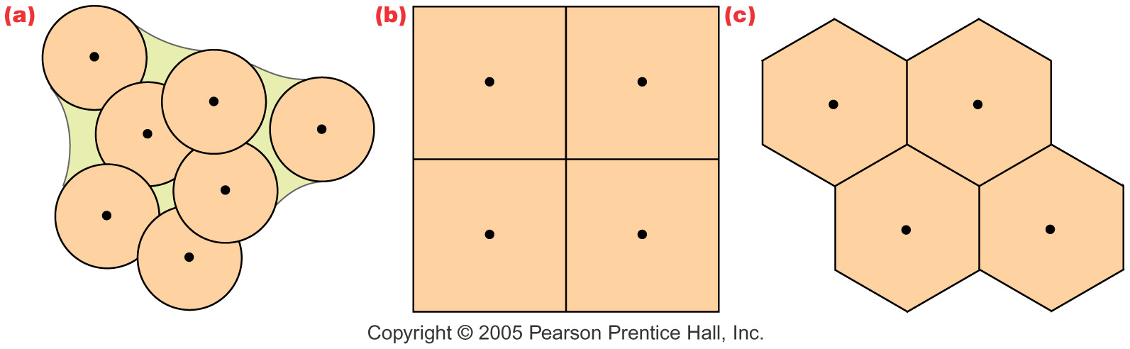
Market Areas as Hexagons
Fig. 12-5: Hexagons are often used to delineate market areas because they are a compromise between circles, which have edges equidistant from the center but leave gaps, and squares, which don’t leave gaps but whose edges are not equidistant from the center.

Slide 19
What does this line represent?
What does this space represent?

Slide 20
Central Place Theory
Central Places compete with each other for services & goods http://www.datapointed.net/visualizations/maps/distance-to-nearest-mcdonalds-sept-2010/
http://flowingdata.com/2010/03/10/what-burger-chain-reigns-supreme/
Thus, larger the city, greater the distance between it & its rivals

Slide 21
Would you travel farther to buy a new car or the week’s groceries?
To buy a new car
Would you travel farther to see your family physician or a heart specialist?
To see a heart specialist
Would you travel farther to go to elementary school or to go to high school?
To go to high school
Notes:
Become aware of how far you are willing to travel to make a purchase. Private sector and public sector goods and services are both accounted for in CPT.

Slide 22
A Hierarchy of Educational Services
City:
College
Town:
High School
Village:
Elementary
School
Hamlet:
No Schools
Notes:
You have more elementary schools than high schools, more high schools than colleges. Elementary schools are closer to each other; colleges are farther apart from each other.

Slide 23

How could central place theory help you to choose a location for:
A new hospital?
A new high school?
A new mall?
A new café?
A new grocery store?
A new Starbucks?
A new McDonalds?
A new baseball team?
Notes:
Each of these needs a big enough customer base in order to operate profitably. Are there unserved areas of the metropolitan region?

Slide 24
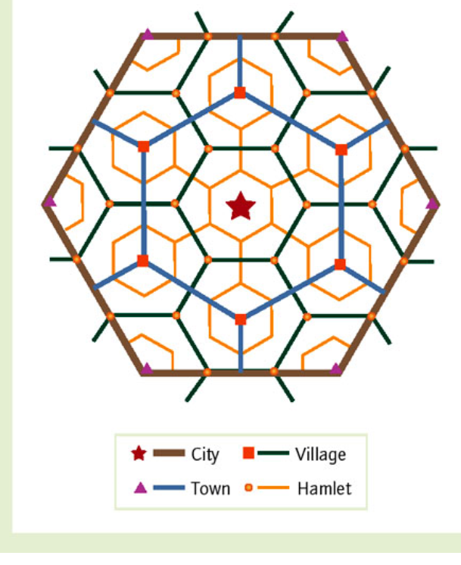

Slide 25
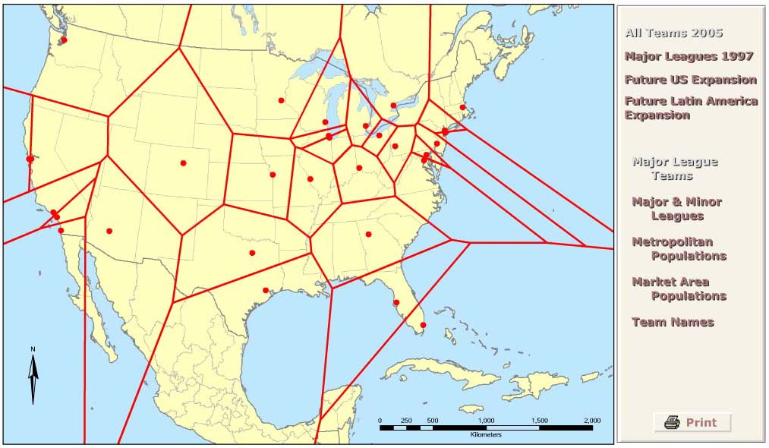
A new Major League team?
Online Activity

Slide 26
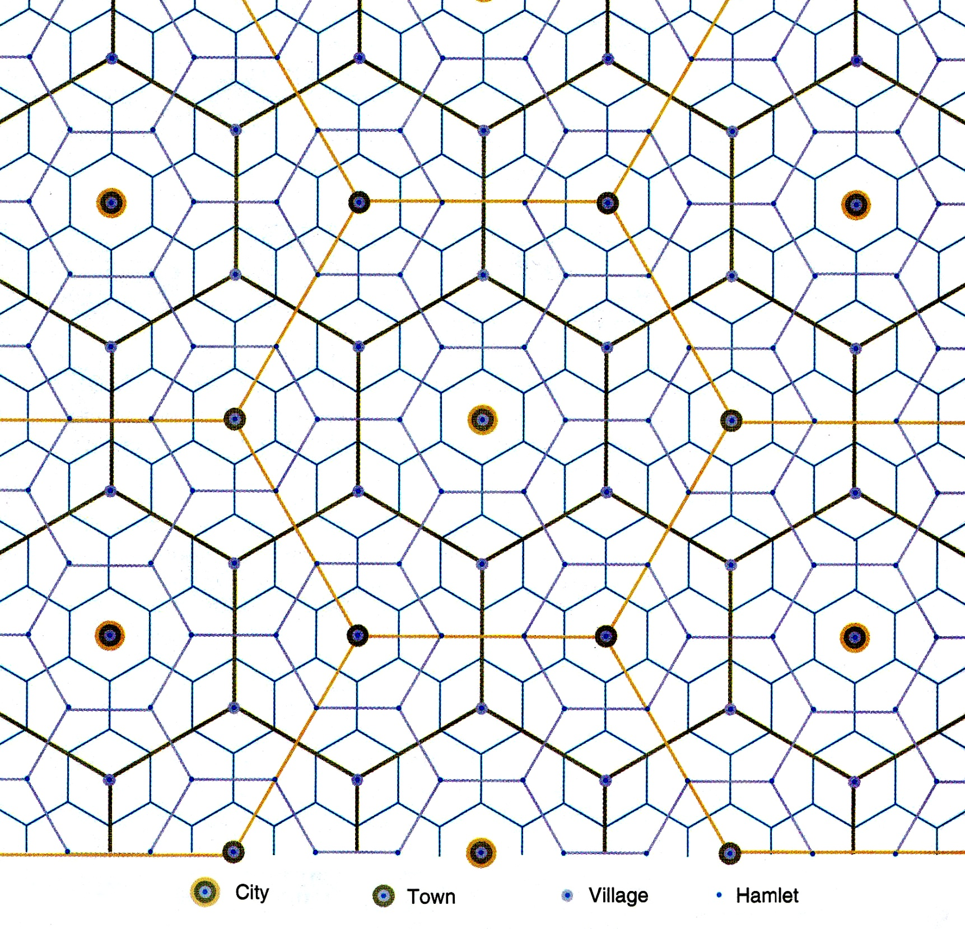
Notes:
A central place network. Whatever you do, don’t start teaching CPT with this diagram! But,by the end of your coverage of CPT, students should be able to look at this diagram, explain it, and critique it. Source: Rubenstein, 9th ed, p410

Slide 27
Why do we not ever see a perfect central place hierarchy?
Physical geography is important! Topography and hydrography interfere.
Consumer behavior is determined by more than economic considerations.
The automobile has made long-distance travel popular (cheap and easy).
People make multiple-purpose shopping trips, often bypassing the smallest places.
The Internet has made it unnecessary to have customers nearby.

Slide 28
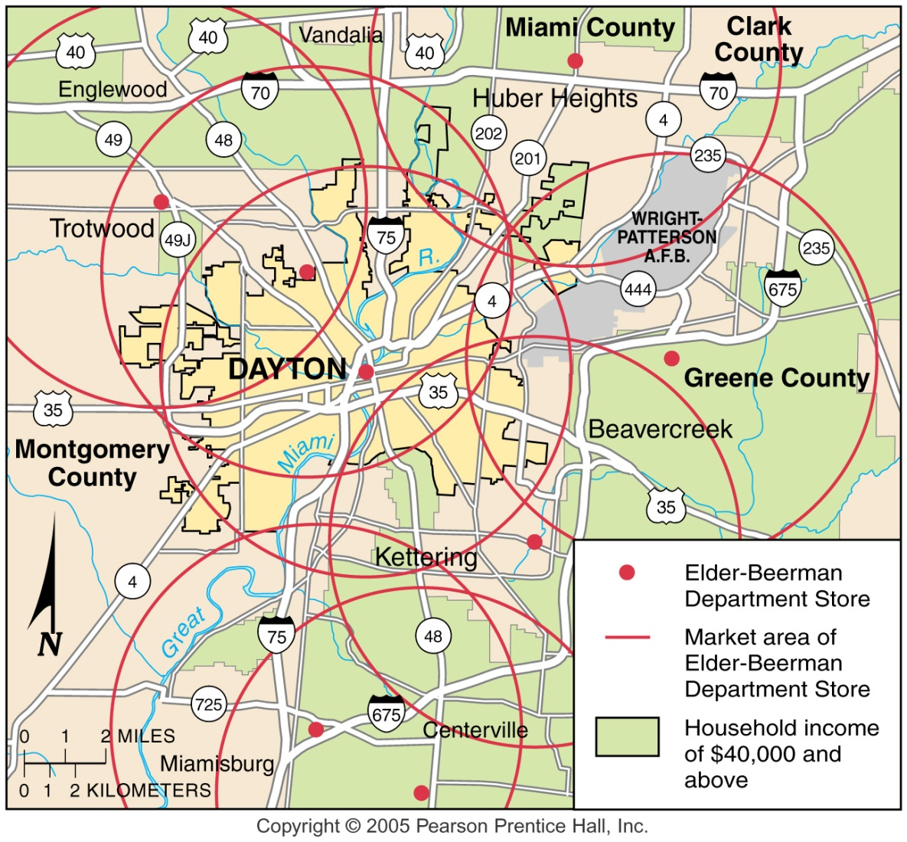
Market Areas for Stores
Market areas, ranges, and thresholds for department stores in the Dayton, Ohio, metropolitan area.

Slide 29
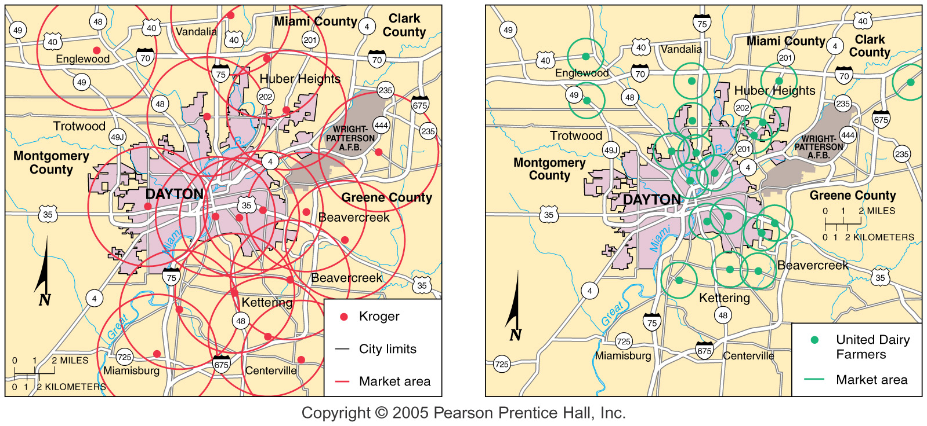
Supermarket and Convenience Store Market Areas
Fig. 12-8: Market area, range, and threshold for Kroger supermarkets (left) and UDF convenience stores in Dayton, Ohio. Supermarkets have much larger areas and ranges than convenience stores.

Slide 30
Review Questions
1. What geometric pattern is associated with Christaller’s Central Place Theory?
A) Square.
B) Circle.
C) Hexagon.
D) Octagon.
E) Pentagon.
2. What assumption(s) are in Christaller’s Central Place Theory?
A) A flat isototropic plane with no physical barriers.
B) Uniform soil fertility.
C) Population and purchasing power would be evenly distributed.
D) Uniform transportation system in all directions.
E) All of the above.

Slide 31
3. The minimum number of people needed to support a business is called the
A) range.
B) peak land value intersection.
C) economic base of settlements.
D) threshold.
E) minimum population requirement.
4. The maximum distance a person is willing to travel to frequent a service is called the
A) range.
B) economic distance.
C) threshold.
D) spatial shopping behavior.
E) geographic marketing area.
5. Rank the following services from low to high order.
A) Soft drink, bakery, shoe store, auto dealership.
B) Bakery, shoe store, soft drink, auto dealership.
C) Shoe store, soft drink, bakery, auto dealership.
D) Auto dealership, shoe store, bakery, soft drink.
E) Auto dealership, soft drink, shoe store, bakery.

Slide 32
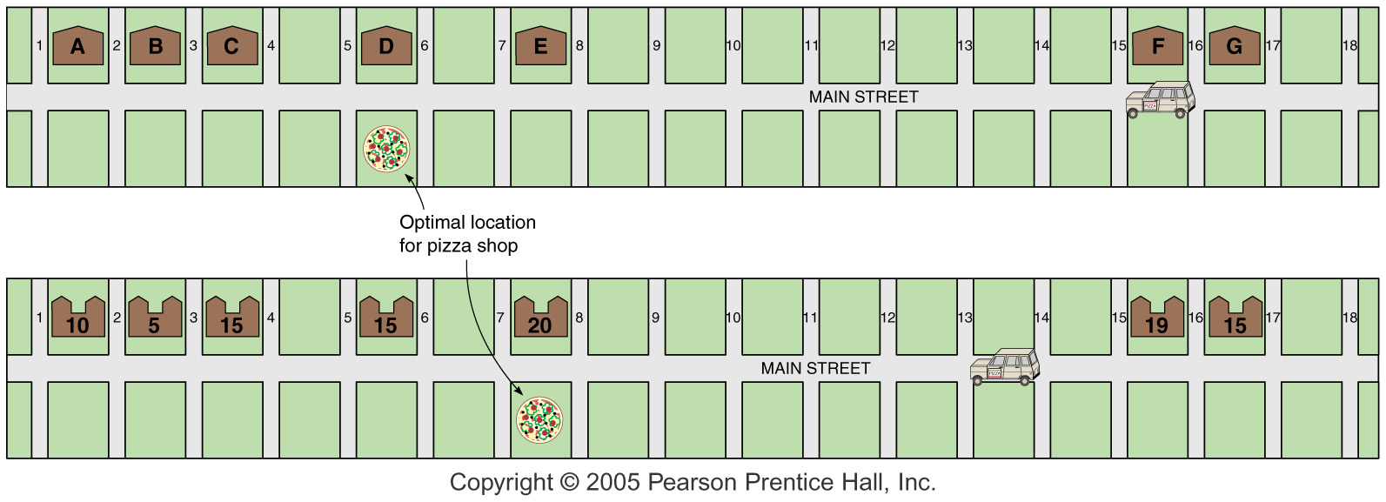
Optimal Location
(for Pizza Shop)
The optimal location for a pizza delivery shop with seven potential customers in a linear settlement (top) and with 99 families in apartment buildings (bottom).

Slide 33
Profitability of Location
The gravity model predicts that the optimal location of a service is directly related to the number of people in the area and inversely related to the distance people must travel to access it.

Slide 34
Rank-Size Rule
(May not apply in LDC) Applies pretty well to U.S. and to Germany.
(rank = “n”
Population = (1/n)pop. of largest city
1/1 = biggest city without peer
4th in size = ¼ of size of #1
Ex: city X is 5th largest and the largest has 100,000 people… population of city X is?

Slide 35
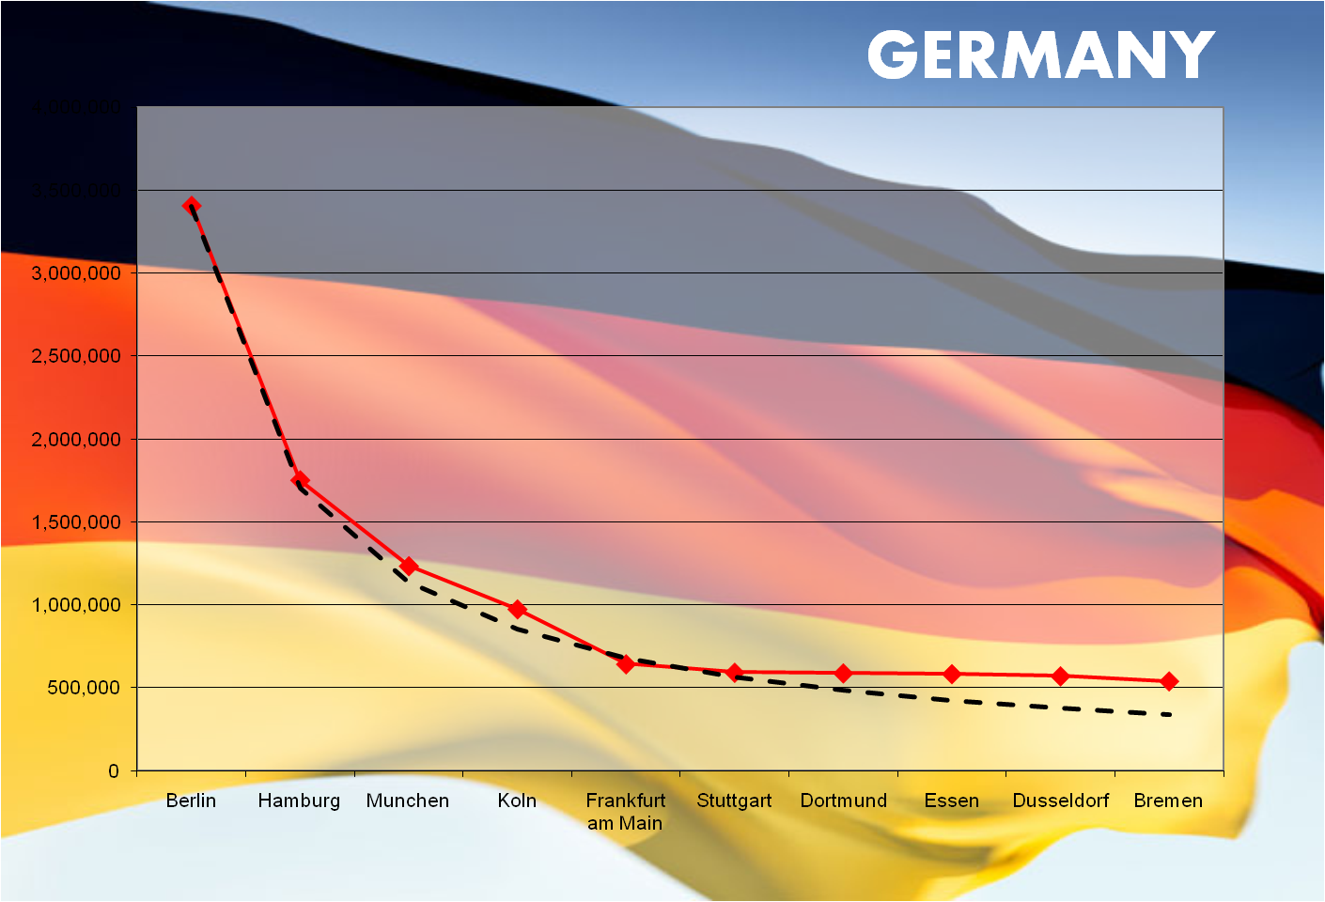

Slide 36
Primate City Rule
#1 city is MORE THAN 2x pop. of #2 city
  Core: UK and France
  Periphery: Nigeria, Argentina, Mexico
Problems with countries with primate city
  No uniform development
  People don’t have access to goods/services throughout the country
Solution → Forward capital – moving the capital to achieve a certain goal
  Abuja, Nigeria
  Brasilia, Brazil
Achieve more even development of the country

Slide 37
Review of Chapter 12
What are the three types of services?
  - consumer, business, public
What are the four major types of consumer services?
- retail and wholesale, education, health and social services, leisure and hospitality
3. What are the major types of business services?
- professional (law, management, engineering, secretarial, etc)
- financial (FIRE- finance, insurance, and real estate)
- transportation and information (trucking and warehousing)
4. What is the purpose of public service?
- security and protection
5. What is the fastest growing consumer service in recent years? Why?
- health care
6. What is the fastest-growing business service in recent years?
- professional services

Slide 38
7. What is a central place?
- market center for the exchange of goods and services
8. What is the market area or hinterland?
The area surrounding a service from which customers are attracted (nodal region – functional region)
9. Who first proposed the Central Place Theory?
- Walter Christaller
10. Why do geographers use hexagons to represent market areas?
- no gaps – compromise between a circle and a square
11. What is the range of a service?
Maximum distance people are willing to travel to use a particular service
12. What is the threshold of a service?
The minimum number of people to support a particular service
13. What are the various sizes of settlements for a market area?
hamlets, villages, towns, cities

Slide 39
14. What is the rank-size rule?
- the country’s nth largest settlement is 1/n the population of the largest settlement
15. What is the primate city rule?
- Largest settlement has more than twice as many people as the second-ranking settlement
16. What is a primate city?
- country’s largest city
17. What is an example of a country that uses the rank-size rule?
Germany
18. What is an example of a country that uses the primate city rule?
Mexico, Brazil, Nigeria
19. What is the gravity model?
- Predicts the optimal location of a service is directly related to the number of people in the area and inversely related to the distance people must travel to access it.

Slide 40
20. What are examples of world cities?
- New York, Tokyo, London
21. Why are these cities considered to be world cities?
- They are based on the centrality/accessibility of the following services
  Business (offices, stock exchanges, transportation hubs)
  Consumer (retail, entertainment, cultural)
  Public (government headquarters, seats of political power)
22. What type of business services are located in world cities and why?
- offices, stock exchanges, transportation hubs
23. Explain the benefits of using offshore financial services?
-low taxes, bank secrecy laws
24. What are the benefits of business-process outsourcing or back-office functions?
- Low wages, ability to speak English

Slide 41
Megacities
Megacities have populations of more than 10 million people in their metropolitan/urbanized areas.
The term was created by the United Nations in the 1970s.
No cities were that large in 1900.

Slide 42
Megacities
Ten largest megacities in the world:
Tokyo
Mexico City*
Seoul, South Korea
New York City
Sao Paulo, Brazil*
Mumbai, India*
Delhi, India*
Shanghai, China*
Los Angeles, CA
Osaka, Japan
*Located in the semi-periphery

Slide 43
Megacities
Many megacities in less developed countries house new arrivals in:
  overpopulated apartment buildings
  tenements
  Slums
Many megacities are unable to control expansion and haphazard development that seriously affect the quality of life within the urban area.

Slide 44
. What are the major differences between basic and non-basic services in relation to the economic base?
Basic – export primarily to costumers outside the settlement
Non-basic – enterprises whose consumers live in the same community
Exporting done by basic industries brings money into local economy stimulating growth in the nonbasic services
26. What is the multiplier effect?
one basic job produces two non-basic jobs
27. Why is tourism on the rise? How does it impact the indigenous population?

Slide 45
Why Do You Want to Entice Businesses to Move to Your Area?
Basic v. non-basic jobs
  Non-Basic: service sector jobs that serve the city
  Basic: serves as exports outside hinterland
  Ask “Where is the money coming from?”
  Calculated by comparing employment in a city to employment in the country as a whole
  Some jobs are both basic and non-basic!
  Most factories/industrial plants fall into which category?

Slide 46
Basic vs. Non-Basic
Employment structure = statistics on number of people employed in basic vs. non-basic jobs
Economic base of a city or settlement
  Which basic industries are located there?
  Brings in money
  Creates more jobs
  Predict future of a settlement
    Are basic industries growing?
    Are basic industries being outsourced?

Slide 47
Why do you want a lot of new basic jobs in your community?
Multiplier Effect = one basic job produces two non-basic jobs
Bob, the world’s best psychologist, has clients from all over the world. He gets paid about $1,000 per hour. His office is in Atlanta and he spends about 90% of his salary inside the city limits. He therefore helps employ many waiters, grocery store clerks, cooks…

Slide 48
Basic or non-basic?
Nurse
2. Family dentist
3. Mega-structure engineer
4. DJ
5. Teacher
6. University Professor
7. US Senator
8. Warner Brothers Studio
9. Suffolk County Policeman
10. Dominos delivery guy
11. ESPN Sportscast personality
12. Call Center
13. Doctor - general practitioner
14. Which job sectors are Basic Jobs?

Slide 49
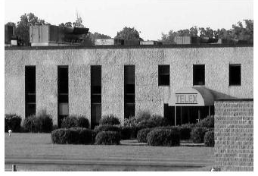

Example of FRQ
https://secure-media.collegeboard.org/apc/_ap06_humangeo_sg.pdf

Slide 50
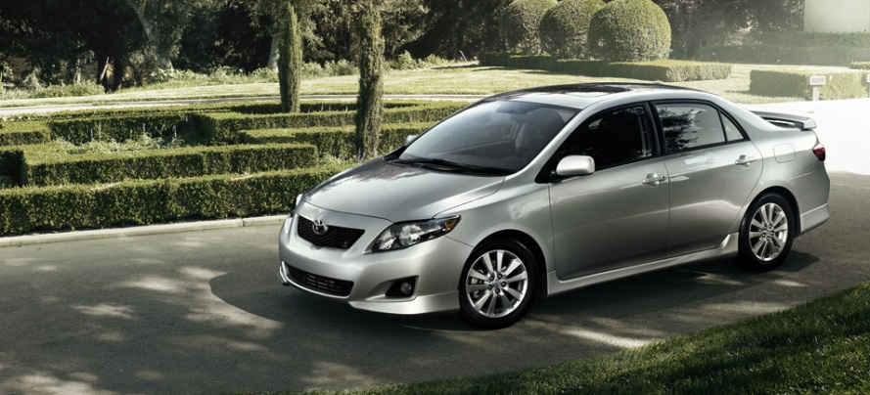
Recent Developments with Industry/Services
1. Homogenization of global tastes
  World cars: Toyota Carolla best selling car ever (Ford Fiesta, Honda Civic, etc. (Emissions, mpg, meets environ. standards for many countries)
  Clothes, foods
  Bland and moderate foods vs. extreme flavors
  What concept does this represent???
    Globalization – every urban place looks the same/provides the same goods/services

Slide 51
Recent Development with Services
2. Tourism’s Rise (11% of all jobs worldwide)
  World’s largest industry/service
  Outside of agriculture, the largest employer
  Medical tourism
  https://www.youtube.com/watch?v=UFOUYlLpslo
  http://abcnews.go.com/Nightline/video/us-companies-medical-tourism-cut-costs-20427966
  http://www.cnn.com/2010/HEALTH/04/26/cheaper.surgery/index.html?hpt=C1
  Ecotourism - low environmental impact, locals make money, culturally sensitive
  Are indigenous people’s culture sustained or eroded?
Problems
  Capital Flight
  Environmental Issues
Globalization vs. Local Diversity as it applies to tourism

Slide 52
Recent Development with Services
3. Advances in Telecommunication changes how business is done
  NASDAQ → no trading floor; all digital
  “Back offices” outside the CBD headquarters in India, Ireland, Kenya
  Telecommuting reduces transportation costs/traffic issues
  Call centers
  “Footloose” industries relocate
  Claim-processing relocates to places with:
    Low labor costs
    English speakers

Slide 53
Examples of FRQs
A. Identify and explain ONE way that tourism has diminished regional landscape distinctiveness.
B. Identify and explain ONE way that tourism has enhanced regional landscape distinctiveness.

Slide 54
Review Questions
What are examples of world cities?
Why are these cities considered to be world cities?
What type of business services are located in world cities and why?
4. Explain the benefits of using offshore financial services.
5. Explain the major difference between basic and non-basic services in relation to the economic base.

Slide 55
World Cities
and
Megacities

Slide 56
Modern Cities
In the place of great manufacturing cities are modern world cities that have become centers of:
    business
    consumer services
    public services

Slide 57
World Cities
The three world cities that serve as the largest regional centers are:
  London
  New York
  Tokyo

Slide 58
WORLD CITIES

Slide 59
World Cities
World Cities—based on the centrality/accessibility of the following services
  Business (offices, stock exchanges, transportation hubs)
  Consumer (retail, entertainment, cultural)
  Public (government headquarters, seats of political power)

Slide 60
World Cities
  Economics (NY, London, Tokyo)
  Political: (D.C., Brussels = EU, NYC = UN)
  Fashion (Milan)

Slide 61
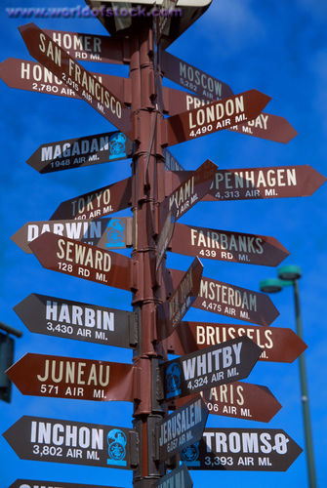
Business Services in World Cities
The clustering of business services in the modern world city is a product of the Industrial Revolution.
Factories are operated by large corporations formed to minimize the liability to any individual owner.
A board of directors located far from the factory building makes key decisions.
Support staff also far from the factory account for the flow of money and materials.
This work is done in offices in world cities.
World cities offer many financial services to these businesses.. . (and) stock exchanges . . . are located in world cities.
Lawyers, accountants, and other professionals cluster in world cities.
Advertising agencies, marketing firms, and other services concerned with style and fashion locate in world cities.

Slide 62
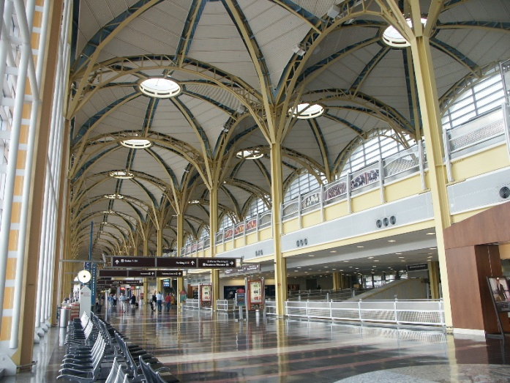
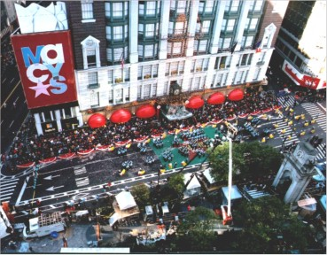
Consumer Services in World Cities
Transportation services converge on world cities.
They tend to have busy harbors and airports and lie at the junction of rail and highway networks.
Because of their large size, world cities have retail services with extensive market areas, but they may even have more retailers than large size alone would predict.
Luxury and highly specialized products are especially likely to be sold there.
Personal services of national significance are especially likely to cluster in world cities, in part because they require large thresholds and large ranges, and in part because of the presence of wealthy patrons.

Slide 63
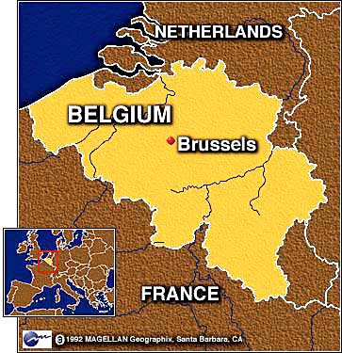
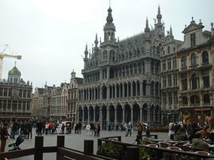
Public Services in World Cities
World cities may be centers of national or international political power.
Most are national capitals.
Also clustered in the world cities are offices for groups having business with the government.
Unlike other world cities, New York is not a national capital.
But as the home of the world’s major international organization, the United Nations, it attracts thousands of U.N. diplomats and bureaucrats, as well as employees of organizations with business at the United Nations.
Brussels is a world city because it is the most important center for European Union activities.

Slide 64
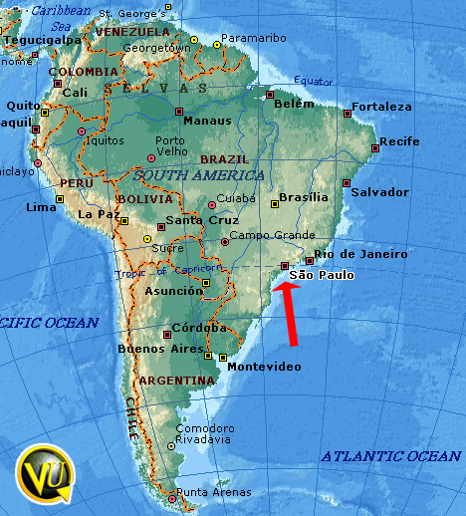
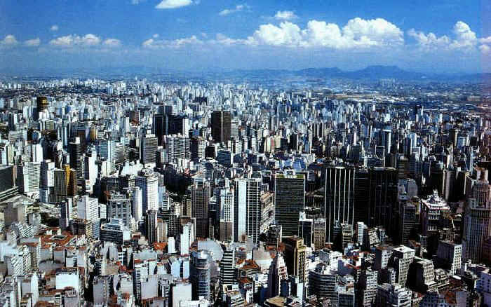
Hierarchy of Business Services
Geographers distinguish four levels of cities that play a major role in the provision of producer and other business services in the global economy. . . a handful of world cities, which can be subdivided into three groups,. . . regional command and control centers, specialized producer-service centers, and dependent centers.

Slide 65
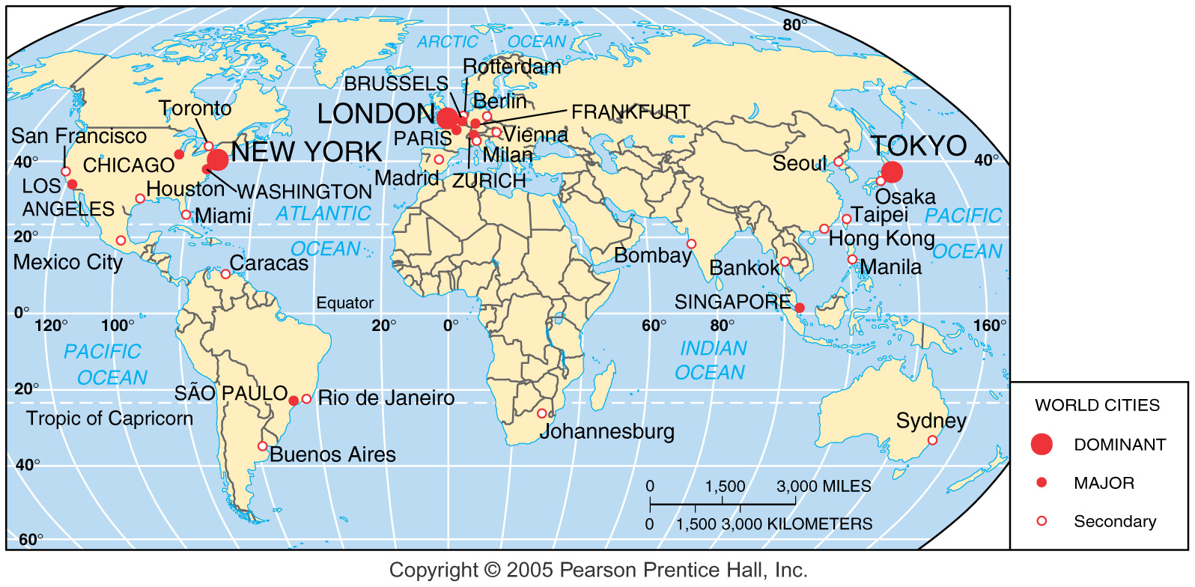
Hierarchy of World Cities
Fig. 12-14: London, New York, and Tokyo are the dominant world cities in the global economy. Other major and secondary world cities play lesser roles.

Slide 66
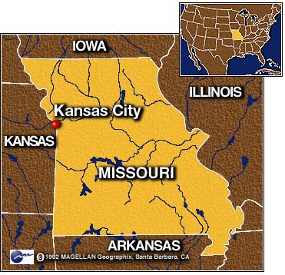
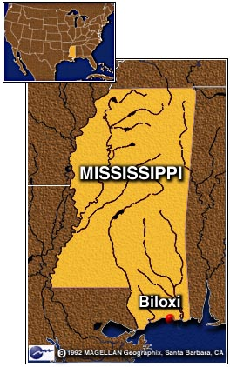
Command and Control Centers
The second level of cities—command and control centers—contains the headquarters of many large corporations,. . . concentrations of. . . business services,. . . educational, medical, and public institutions.
Two levels of command and control centers can be identified: regional centers and sub-regional centers.
In the United States, examples of regional command centers are Atlanta and Kansas City.
Examples of sub-regional centers are Biloxi and Oklahoma City.

Slide 67
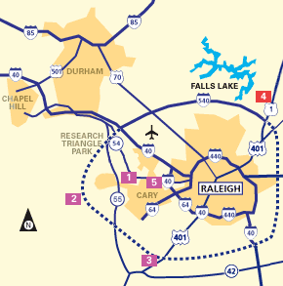
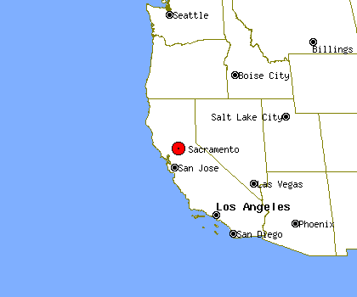
Specialized Producer-Service Centers
The third level of cities, specialized producer-service centers, offers a more narrow and highly specialized variety of services.
One group of these cities specializes in the management and R&D activities related to specific industries.
A second group . . . specializes as centers of government and education, notably state capitals that also have a major university.

Slide 68
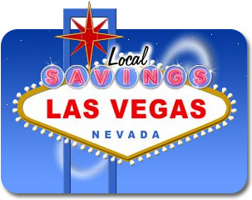
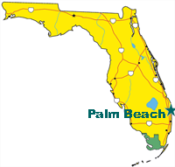
Dependent Centers
The fourth-level cities, dependent centers, provide relatively unskilled jobs and depend for their economic health on decisions made in the world cities, regional command and control centers, and specialized producer-service centers.
Four subtypes of dependent centers can be identified in the United States: resort, retirement, and residential centers. . . manufacturing centers. . . industrial and military centers. . . (and) mining and industrial centers.

Slide 69
Economic Base of Settlements
A settlement’s distinctive economic structure derives from its basic industries, which export primarily to consumers outside the settlement.
Non-basic industries are enterprises whose customers live in the same community, essentially consumer services.
A community’s unique collection of basic industries defines its economic base.
A settlement’s economic base is important, because exporting by the basic industries brings money into the local economy, thus stimulating the provision of more nonbasic consumer services for the settlement.
A community’s basic industries can be identified by computing the percentage of the community’s workers employed in different types of businesses.
If the percentage is much higher in the local community, (compared to the country), then that type of business is a basic economic activity.
Each type of basic activity has a different spatial distribution.
Some settlements have a very high percentage of workers employed in the primary sector, notably mining.
The economic base of some settlements is in the secondary sector.
Most communities that have an economic base of manufacturing durable goods are clustered between northern Ohio and southeastern Wisconsin, near the southern Great Lakes.
Nondurable manufacturing industries, such as textiles, are clustered in the Southeast, especially in the Carolinas.

Slide 70
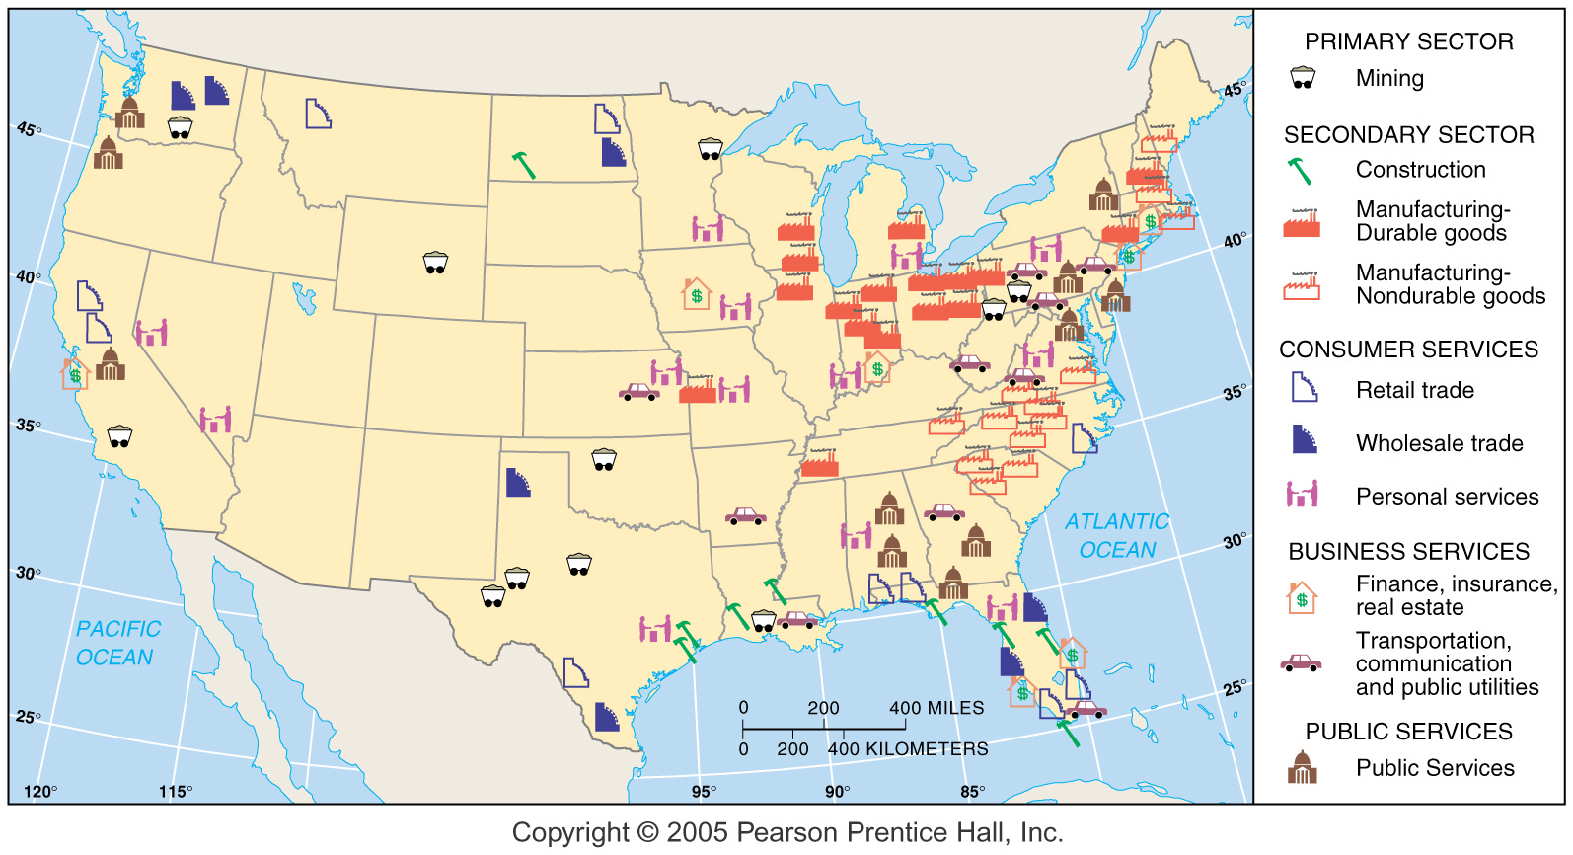
Economic Base of U.S. Cities
Fig. 12-16: Cities that have a high proportion of their labor force engaged in the specified economic activity shown.

Slide 71
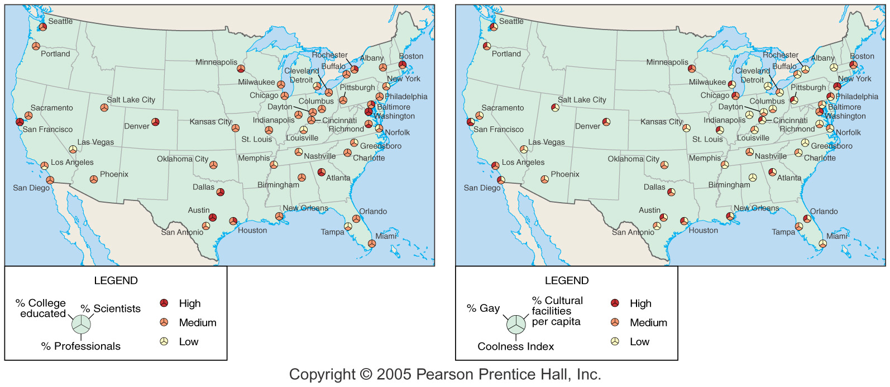
Geography of Talent
Fig. 12-17: Cities with high levels of talent (scientists, professionals, etc.) are also often cities with high levels of diversity.

Slide 72
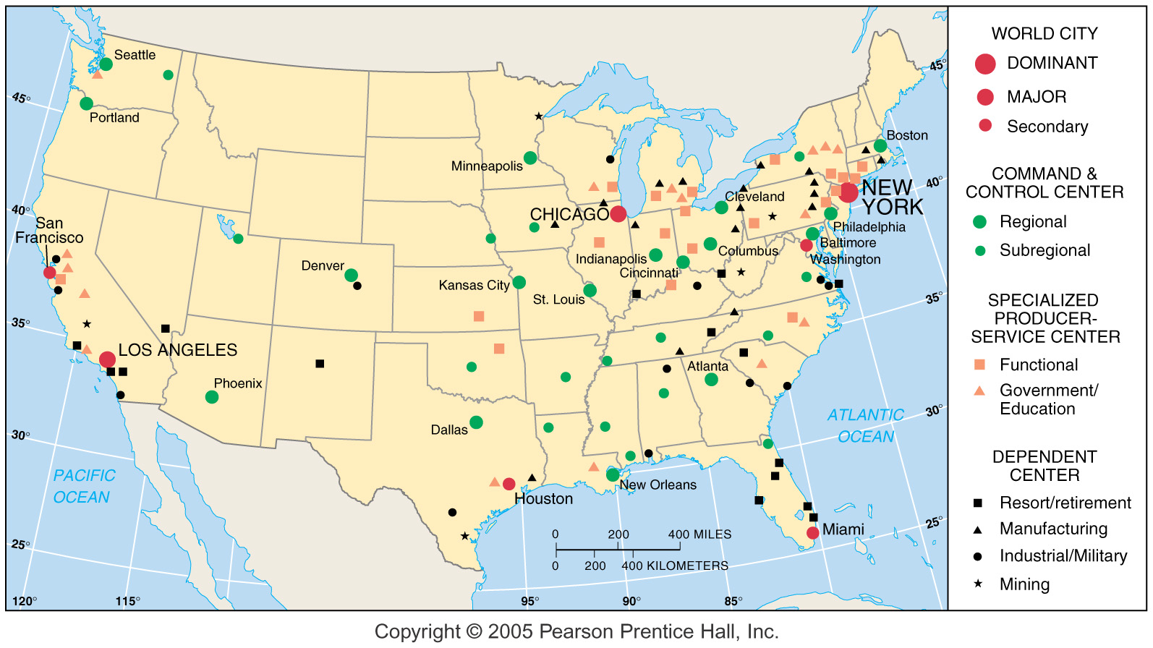
Business-Service Cities in the U.S.
Fig. 12-15: Below the world cities in the hierarchy of U.S. cities are command and control centers, specialized producer-service centers, and dependent centers.

Slide 73
Nike Sweatshops, Behind the Swoosh: https://www.youtube.com/watch?v=M5uYCWVfuPQ (20:30)

Slide 74
Specialized cities
One/two industries/services dominate = “Functional Specialization”
  ex: Old-time Chicago (beef, wheat, timber…) today Laurent, South Dakota
  ex: Dalton Ga. = carpet manufacturing
  ex: Lost Wages… Las Vegas, NV.
Why do modern cities want a diversified economic base?
As cities grow Functional Specialization decreases.

Slide 75
Example of FRQ

Slide 76
Recent Developments with Industry/Services
1. Homogenization of global tastes
  World cars: Toyota Carolla best selling car ever (Ford Fiesta, Honda Civic, etc. (Emissions, mpg, meets environ. standards for many countries)
  Clothes, foods
  Bland and moderate foods vs. extreme flavors
  What concept does this represent???
    Globalization – every urban place looks the same/provides the same goods/services

Slide 77
Recent Development with Services
2. Tourism’s Rise (11% of all jobs worldwide)
  World’s largest industry/service
  Outside of agriculture, the largest employer
  Medical tourism
  https://www.youtube.com/watch?v=UFOUYlLpslo
  https://www.cnn.com/2019/02/13/health/india-medical-tourism-industry-intl/index.html
  https://www.10news.com/franchise/indian-river-lagoon/health/is-medical-tourism-right-for-you-could-save-you-big-bucks-but-there-are-risks
  Ecotourism - low environmental impact, locals make money, culturally sensitive
  Are indigenous people’s culture sustained or eroded?
Problems
  Capital Flight
  Environmental Issues
Globalization vs. Local Diversity as it applies to tourism

Slide 78
Examples of FRQs
A. Identify and explain ONE way that tourism has diminished regional landscape distinctiveness.
B. Identify and explain ONE way that tourism has enhanced regional landscape distinctiveness.

Slide 79
Recent Development with Services
3. Advances in Telecommunication changes how business is done
  NASDAQ → no trading floor; all digital
  “Back offices” outside the CBD headquarters in India, Ireland, Kenya
  Telecommuting reduces transportation costs/traffic issues
  Call centers
  “Footloose” industries relocate
  Claim-processing relocates to places with:
    Low labor costs
    English speakers

Slide 80
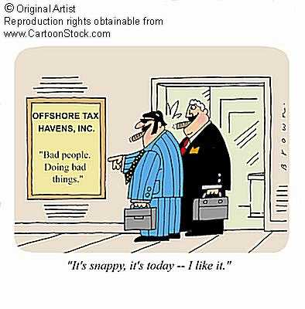
Recent Development With Services
4. Offshore financial centers & tax havens =
ex: Luxembourg, Cayman Islands
(600 banks
and only 75
have an office
there)

Slide 81
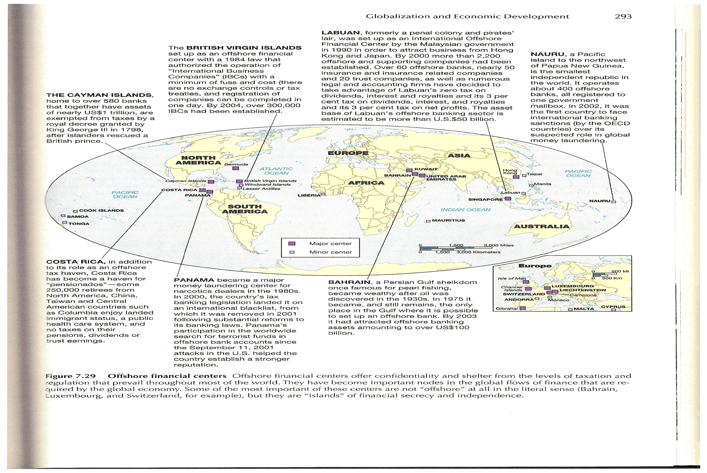
Off-shore financial centers

Slide 82
Recent Development with Industry/Service
5. Suburbanization of Services
  Services historically locate near CBD (Central Business District)
    Provides more customers for higher threshold services
    Attracts people from further distances (higher range services)
  As land values increase in CBD…
    People/Services move to suburbs/overseas (N.America)
    Land used more intensively (vertical geography)
      Rise of skyscrapers
      Underground activities
    Manufacturing relocating to suburbs/rural areas

Slide 83
Geography of Talent
Fig. 12-17: Cities with high levels of talent (scientists, professionals, etc.) are also often cities with high levels of diversity.

Slide 84
Specialized cities
One/two industries/services dominate = “Functional Specialization”
  ex: Old-time Chicago (beef, wheat, timber…) today Laurent, South Dakota
  ex: Dalton Ga. = carpet manufacturing
  ex: Lost Wages… Las Vegas, NV.
Why do modern cities want a diversified economic base?
As cities grow Functional Specialization decreases.

Slide 85
What is the main difference between clustered rural settlements and dispersed rural settlements?
What were the clustered settlements in colonial America like?
What were the dispersed settlements in the United States and the United Kingdom like?
What were the early types of services that originated in early settlements?
What is the difference between urban and rural settlements?

Slide 86
Clustered Rural Settlements
A clustered rural settlement typically includes homes, barns, tool sheds, and other farm structures, plus personal services, such as religious structures and schools.
In common language such a settlement is called a hamlet or village.
The fields must be accessible to the farmers and are thus generally limited to a radius of 1 or 2 kilometers (one-half to 1 mile) from the buildings.
In some places, individual farmers own or rent the land; in other places, the land is owned collectively by the settlement or by a lord.
Parcels of land. . . may be allocated to specific agricultural activities.
Consequently, farmers typically. . . have responsibility for. . . scattered parcels in several fields.
This pattern. . . encouraged living in a clustered rural settlement to minimize travel time to the various fields.
Traditionally, when the population of a settlement grew too large for the capacity of the surrounding fields, new settlements were established nearby.
The establishment of satellite settlements often is reflected in place names.
Clustered rural settlements are often arranged in one of two types of patterns: circular and linear.

Slide 87
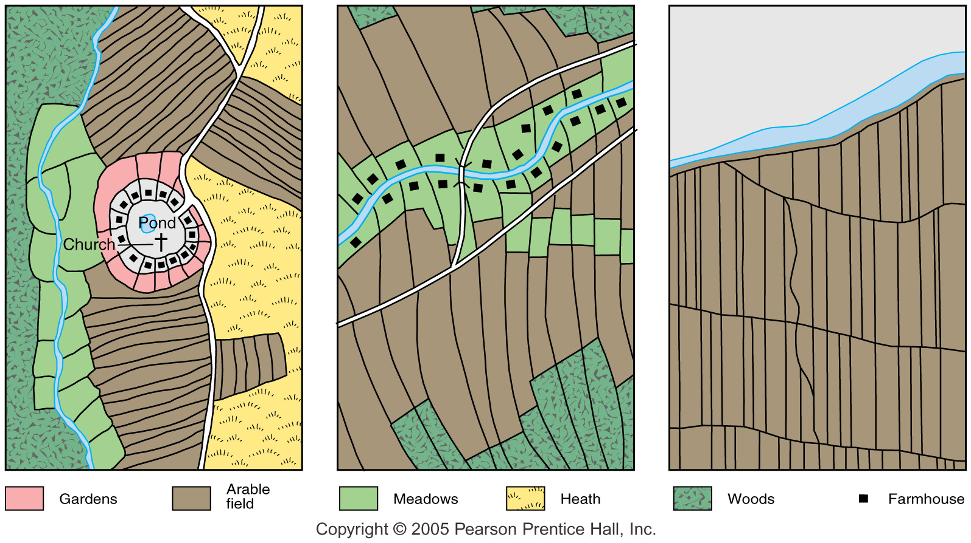
Rural Settlement Patterns
Fig. 12-4: Circular settlement patterns are common in Germany. Linear “long lot” patterns are often found along rivers in France, and were transferred to Québec.

Slide 88
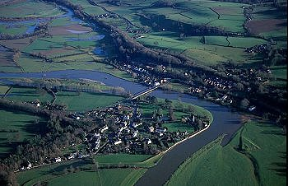
Linear Rural Settlements
Linear rural settlements feature buildings clustered along a road, river, or dike to facilitate communications.
The fields extend behind the buildings in long, narrow strips.
Today, in North America, linear rural settlements exist in areas settled by the French.
The French settlement pattern, called long-lot or seigneurial, was commonly used along the St. Lawrence River in Québec and the lower Mississippi River.

Slide 89
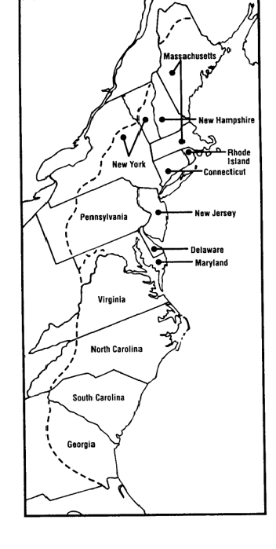
Colonial American Clustered Settlements
The first European colonists settled along the East Coast in three regions: New England, the Southeast, and the Middle Atlantic.
New England colonists built clustered settlements centered on an open area called a common.
Clustered settlements were favored by New England colonists for a number of reasons.
Typically, they traveled to the American colonies in a group.
The settlement was usually built near the center of the land grant.
New England settlements were also clustered to reinforce common cultural and religious values.
Colonists also favored clustered settlements for defense against Indian attacks.
Each villager owned several discontinuous parcels on the periphery of the settlement, to provide the variety of land types needed for different crops.
Beyond the fields the town held pastures and woodland for the common use of all residents.
The southeastern colonies were first settled in the 1600s with small, dispersed farms.

Slide 90

Dispersed Rural Settlements
Dispersed rural settlements have become more common in the past 200 years, especially in Anglo-America and the United Kingdom, because in more developed societies they are generally considered more efficient than clustered settlements.

Slide 91
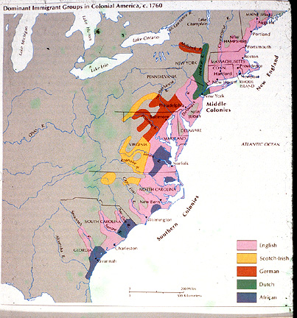
Dispersed Rural Settlements in the United States
The Middle Atlantic colonies were settled by a more heterogeneous group of people.
Further, most Middle Atlantic colonists came as individuals.
Dispersed settlement patterns dominated in the American Midwest in part because the early settlers came primarily from the Middle Atlantic colonies.
In New England a dispersed distribution began to - replace the clustered settlements in the eighteenth century.
In part, the cultural bonds that had created clustered rural settlements had weakened.
Owning several discontinuous fields had several disadvantages: Eventually people bought, sold, and exchanged land to create large, continuous holdings instead of several isolated pieces.
A shortage of land eventually forced immigrants and children to strike out alone and claim farmland on the frontier.

Slide 92
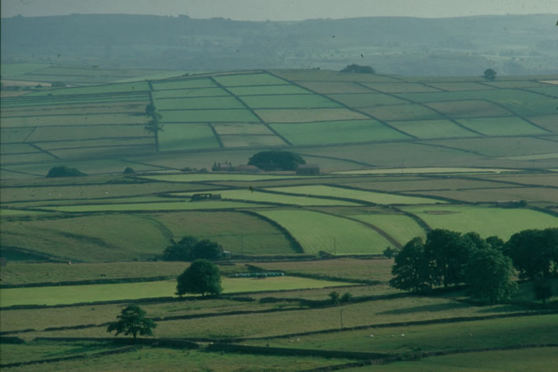
Enclosure Movement
To improve agricultural production, a number of European countries converted their rural landscapes from clustered settlements to dispersed patterns.
A prominent example was the enclosure movement in Great Britain, between 1750 and 1850.
Because the enclosure movement coincided with the Industrial Revolution, villagers who were displaced from farming moved to urban settlements and became workers in factories and services.
The enclosure movement brought greater agricultural efficiency, but it destroyed the self-contained world of village life.

Slide 93
Systems of Cities
What determines the growth of villages into towns or towns into cities? Growth is dependent on:
  political factors
  cultural factors
  economic factors

Slide 94
Systems of Cities
Example of an economic factor contributing to growth:
  A settlement located on a good harbor may grow through trade.
Example of a cultural factor contributing to growth:
  A town may establish itself as a cultural center by fostering:
    libraries
    museums
    theatres
    Universities
Example of a political factor contributing to growth:
  A decision as to where to locate the capital may cause one town to grow and provide specialized businesses and employment opportunities.
  A town not chosen as the capital could lose population, businesses, and employment.

Slide 95
Systems of Cities
Geography plays a key role in determining urban growth because location and topography influence where people settle, causing some cities to grow and other to stagnate.

Slide 96
How did cities originate?
The first agricultural revolution, also known as the Neolithic Revolution, occurred approximately 10,000 years ago.
It led to permanent settlements, but the communities remained small and simple.
Government buildings appeared on the landscape and villages became more diversified.

Slide 97
Formative Era
The period between 4000 and 2000 B.C.E. is called the Formative Era for both the development of states and urbanization.
As the more complex settlements grew, the need for central authority increased.
As a result, states (organized territories under governments) appeared.

Slide 98
Formative Era
States grew in the following areas along the:
  Nile River (Egypt)
  Tigris and Euphrates Rivers (Mesopotamia)
  Indus River (South Asia)

Slide 99
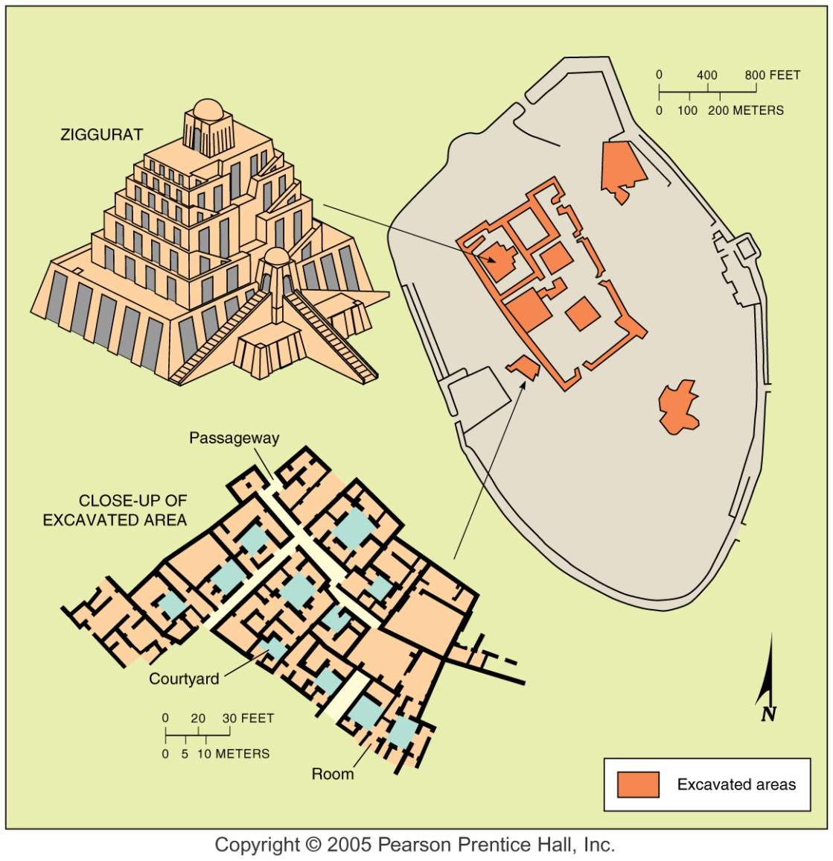
Ancient Ur
Fig. 12-10: Ur, in modern-day Iraq, was one of the earliest urban settlements. The ziggurat, or stepped temple, was surrounded by a dense network of residences.

Slide 100
Formative Era
Other early civilizations appeared:
  along rivers in East Asia (early China)
  around the Aegean Sea (forerunners of the Greeks)
All of these civilizations had major cities that increased in size and complexity as farming techniques improved and trade developed.

Slide 101
Function and Location of Ancient Cities
Agriculture had to be planned and controlled so as to guarantee a flow of food into the city, especially once irrigation developed.
Governments began to:
  collect taxes
  build fortified walls to protect the city from invaders
City sites were chosen for their:
  defensibility
  location near productive farmlands along rivers
  availability of water for farming and transportation
  Job specialization and social inequality grew along with the need to acquire, store, and distribute food.

Slide 102
Function and Location of Ancient Cities
A group of urban elite (decision makers and organizers) controlled the resources and, sometimes, the lives of others.
The urban elite:
  saw that the gods looked favorably upon the people and food production
  developed a system of writing
  helped organize resources
The urban elite:
  codified laws
  organized the construction of public buildings such as:
    temples
    government centers
    granaries for storing food

Slide 103
Function and Location of Ancient Cities
Function of ancient cities:
  Centers of power—headquarters for government officials
  Religious centers—priests, temples, and shrines
  Economic centers—markets, traders, wealthy merchants
  Educational centers—teachers and philosophers for the urban elite (the leaders of the city)

Slide 104
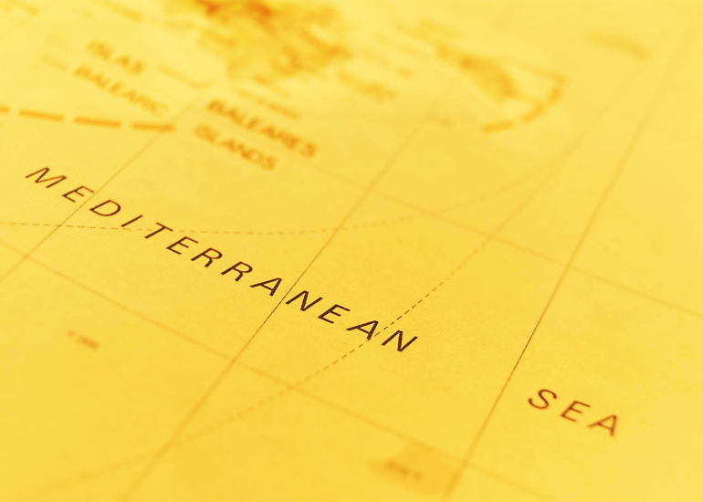
Early Urbanization
Around the Mediterranean –
The Classical Period

Slide 105
Classical Period
Settlements were originally established in the area around the eastern Mediterranean Sea about 2500 years ago by forerunners of the ancient Greek s.
City-states were organized into self-governing communities that included the nearby countryside.
The city-states provided the following for the surrounding hinterland:
  government
  military protection
  other public services

Slide 106
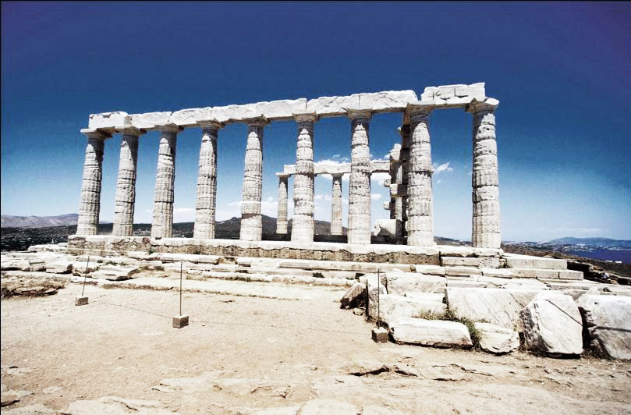
The Greeks
Athens was one of the first cities to reach a population of 100,000 during the 5th and 4th centuries B.C.E.

Slide 107
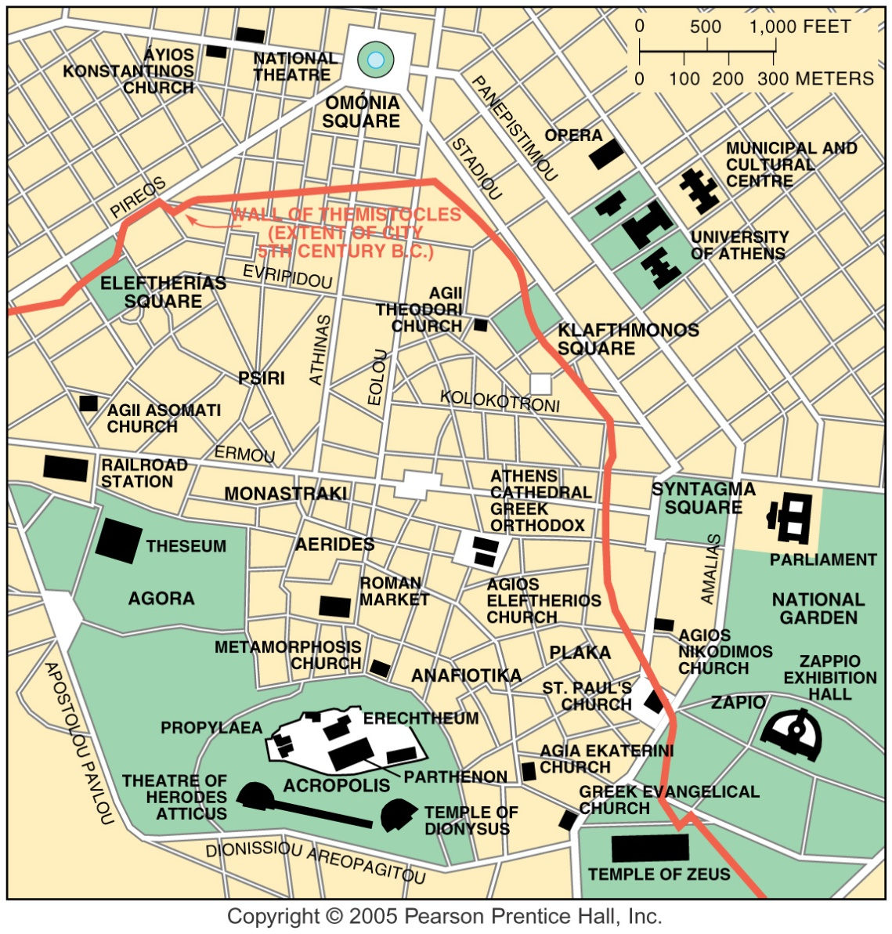
Athens, Greece
Fig. 12-11: The hilltop site of the Acropolis, dating to about 500 B.C., still dominates the skyline of modern Athens.

Slide 108
The Romans
When the Romans succeeded the Greeks as rulers of the region, their urban empire incorporated:
  a large part of Europe’s interior
  North Africa
  Settlements were established as centers of administrative, military, and other public services, as well as trading and other retail services former Mesopotamian lands
Many cities were part of the hinterlands.
Rome reached a population of 250,000 inhabitants in the second century B.C.E.
The cities of the Roman Empire were connected by land and sea routes.
Roman roads were so expertly built that many are still intact today.

Slide 109
Earliest Civilizations in China
The earliest civilizations in East Asia grew around the Huang River and its tributaries.
The great Silk Road stretched from China to the Mediterranean Sea.
This trade route brought much wealth and diversity to Chinese cities.
These cities became centers for:
  government
  culture
  education
  the economy
By the 11th century, the greatest of the trading cities of the south was Hangzhou.
  It was home to merchants, craftsmen, and government officials.
  Its primary exports included silk, copper coins, and ceramics.

Slide 110

Urban Growth in
China

Slide 111
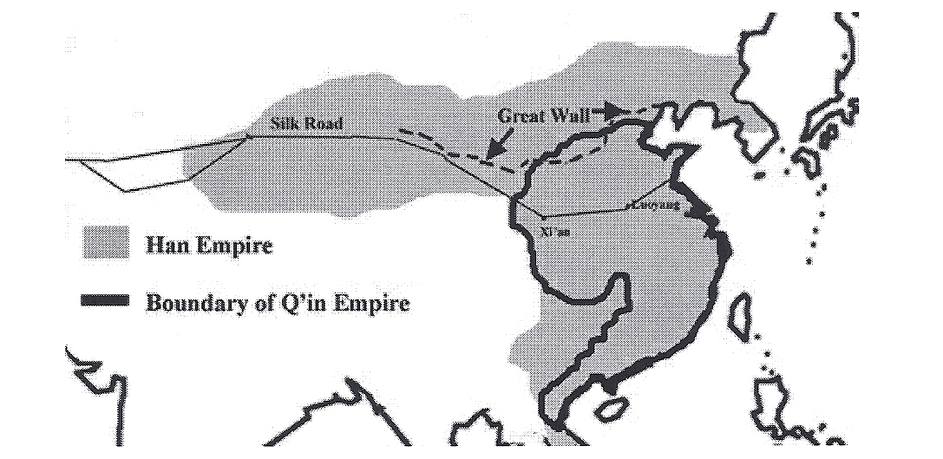
EARLY URBAN CHINA

Slide 112
Medieval Cities – Age of Feudalism
After the fall of the Roman Empire, urban life began to revive during the 11th century.
Urban life was stimulated by trade between the Italian cities of Genoa and Venice and the Middle East (a result of the Crusades).
Characteristics of medieval cities:
  narrow and winding streets
  occupational groups (e.g. bakers, carpenters) clustered in distinct sections of the city

Slide 113
Preindustrial cities –Renaissance Era
Mercantile city (developed in the pre-industrial age)
  Trade was central to the design of the city.
  The central square was lined with shops that specialized in products brought in by the trade routes.

Slide 114
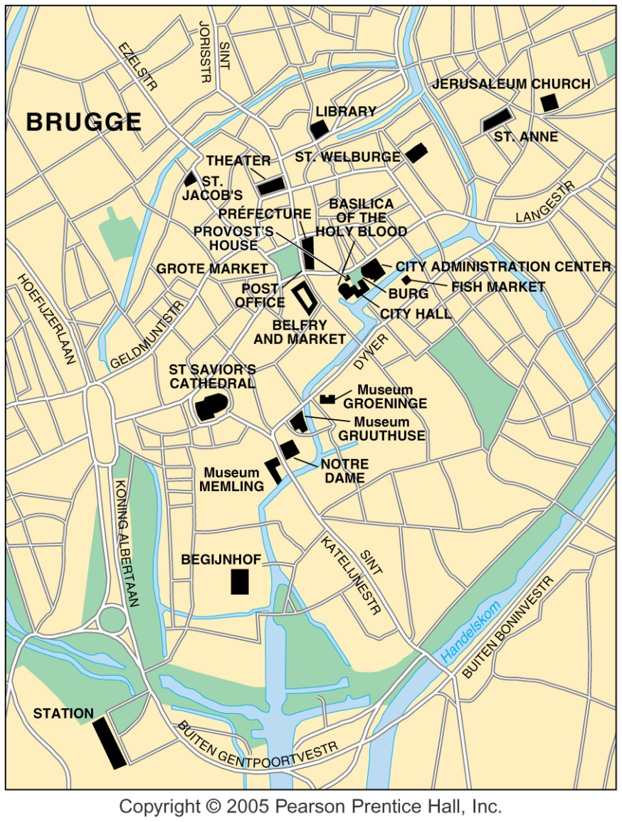
Brugge, Belgium
Fig. 12-12: Brugge (or Bruges) was a major port and wool manufacturing center from the 12th century. It is marked by squares surrounded by public buildings.

Slide 115
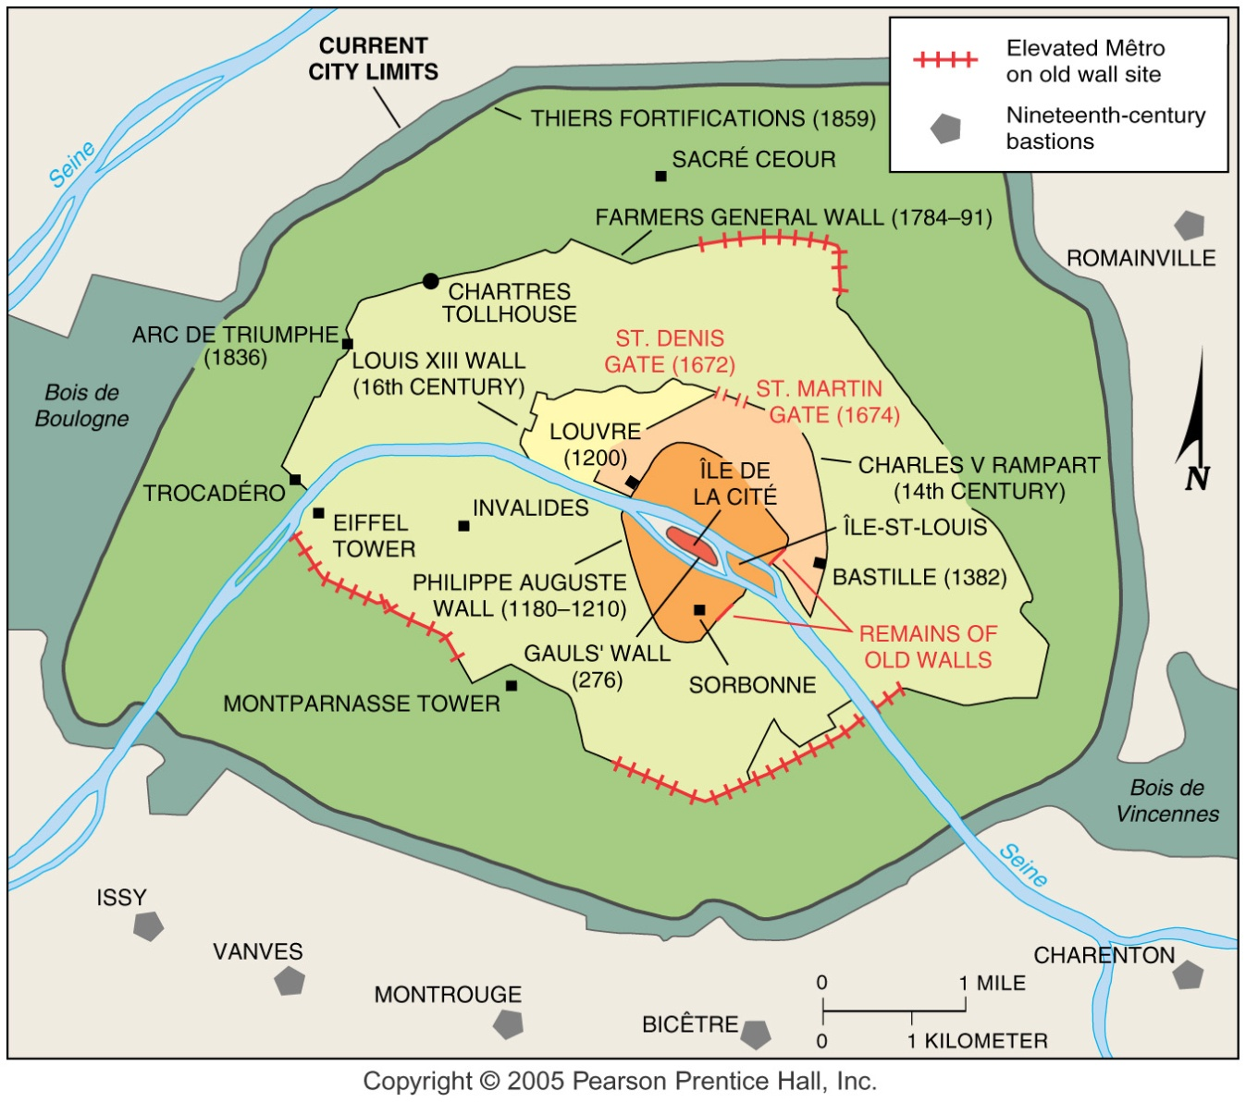
Paris
Fig. 12-13: Paris was originally surrounded by walls which were expanded to include new neighborhoods as the city grew.

Slide 116
The Industrial Revolution
Manufacturing city
  Factories attracted workers from rural areas.
  Small, narrow streets gave way to wide boulevards to accommodate the flow of commercial traffic.
  City planning and zoning was introduced (where to locate businesses, houses, etc.).
  Cities grew along railroad lines that connected the cities to markets.
  Cities suffered from problems such as:
    overcrowding
    sanitation
    pollution
    disarray
  As cities grew, problems multiplied, although conditions improved as a result of:
    government intervention
    legislation
    introduction of city planning and zoning

Slide 117
Rural-Urban Migration
and
Urban Growth

Slide 118
Connection between Industry and Urbanization
Industrial development led to urban growth during the 1800s in Europe and North America.
Today about ¾ of people in developed countries live in urban areas.
More recently, migration from rural to urban areas has rapidly increased in the less developed countries of:
  Africa
  Asia
  Latin America

Slide 119
Urban Growth
As countries begin to industrialize, opportunities shift from rural to urban areas.
The pull to the city stimulates migration.
Nearly all countries have two things in common:
  The proportion of people living in cities is rising.
  The cities themselves are large and growing.

